Slide 1
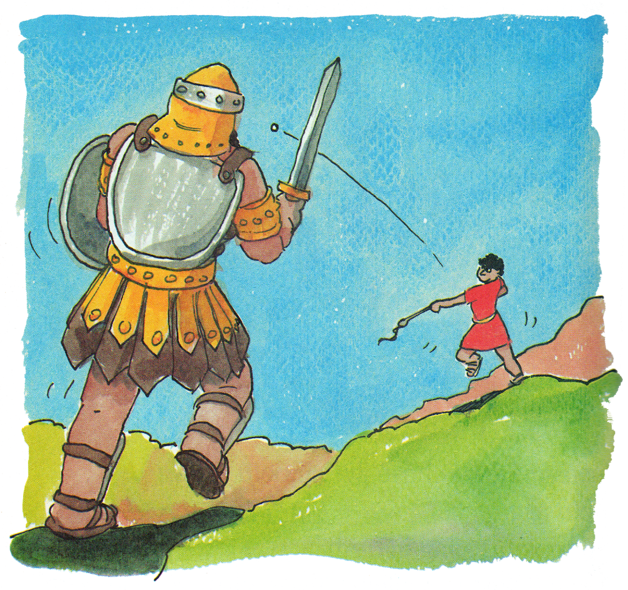
David and Goliath: Another Look
I Samuel 17
Notes:
2 Tim 2:15 “¹⁵ Be diligent to present yourself approved to God, a worker who does not need to be ashamed, rightly dividing the word of truth.
2Tim 3:16-17 Profitable to equip for every good work
Acts 17:10-12 The example of the Bereans searching the scriptures daily

Slide 2
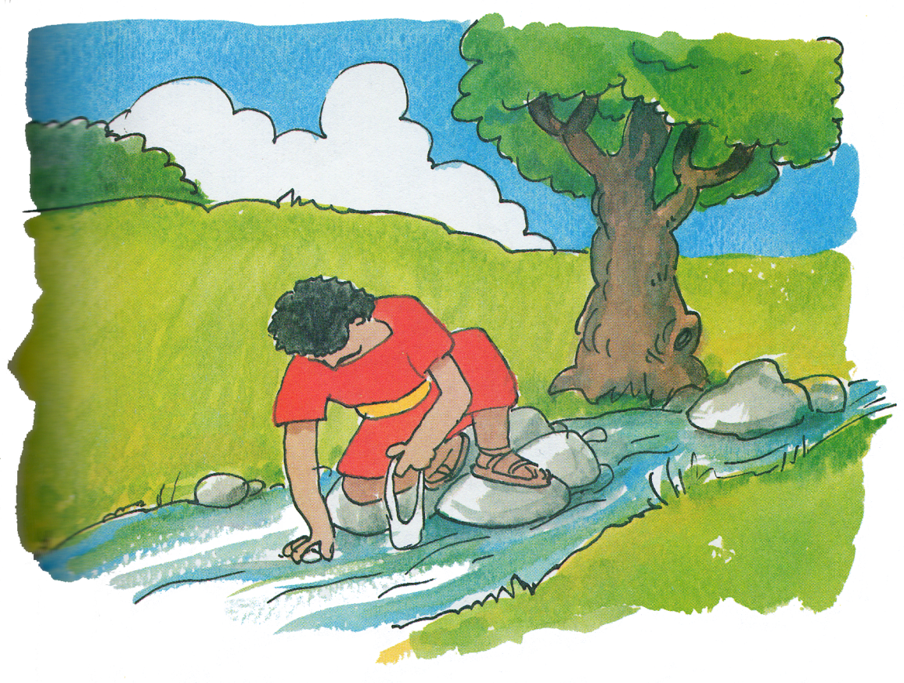
Intro
Always study the Word itself and be prepared
II Tim 2:15
II Tim 3:16-17
Act 17:10-12

Slide 3
I Samuel 17:8-10
God’s people are not exempt from trials and tribulations
Acts 20:18-20
James 1:1-3
II Cor. 11:24-26
I Pet. 1:6-7
Notes:
Jam 1:1-3 “1 James, a bondservant of God and of the Lord Jesus Christ, To the twelve tribes which are scattered abroad: greetings. ² My brethren, count it all joy when you fall into various trials, ³ knowing that the testing of your faith produces patience. “
Acts 20:18-20; 2 Cor 11:24-25: The trials and tears of Paul
Beaten
Stoned
40 lashes minus 1 (five times)
Shipwrecked
1 Pet 1:6-7: grieved by various trial…faith tested by fire found to praise honor and glory at revelation

Slide 4
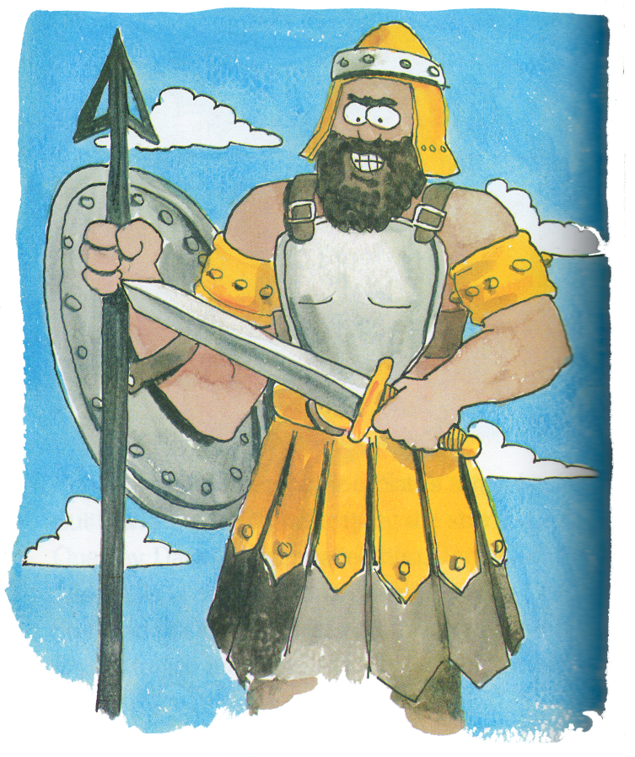
I Samuel 17:4-10
Our Challenge may be great in size
Marriage, divorce & re-marriage
Homosexuality

Slide 5
I Samuel 17:4,23
Our challengers May be “the best” in their field
Goliath is described as a “Champion”
The world will send their most educated or most influential people

Slide 6
I Samuel 17:16
Ignoring a difficult situation will not make it go away
Stand for truth & against sin / false teaching
Matt 28:18-20
Acts 20:28-30
Notes:
Mt 28:18-20 “¹⁸ And Jesus came and spoke to them, saying, “All authority has been given to Me in heaven and on earth. ¹⁹ Go therefore and make disciples of all the nations, baptizing them in the name of the Father and of the Son and of the Holy Spirit, ²⁰ teaching them to observe all things that I have commanded you; and lo, I am with you always, even to the end of the age.” Amen.
Acts 20:28-30 “²⁸ Therefore take heed to yourselves and to all the flock, among which the Holy Spirit has made you overseers, to shepherd the church of God which He purchased with His own blood. ²⁹ For I know this, that after my departure savage wolves will come in among you, not sparing the flock. ³⁰ Also from among yourselves men will rise up, speaking perverse things, to draw away the disciples after themselves.

Slide 7
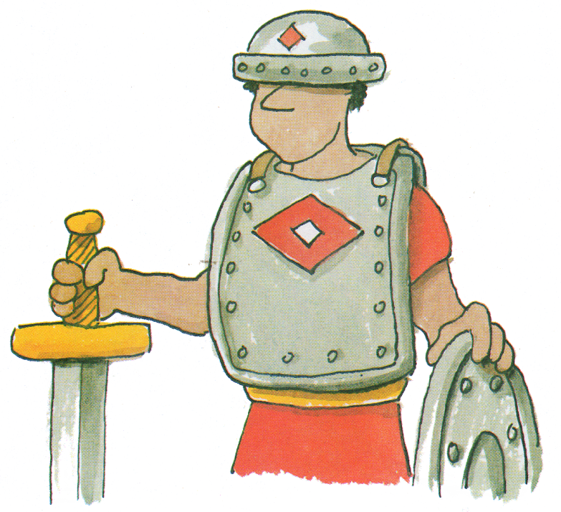
I Samuel 17:14, 32-51
With God we can overcome evil
No special skills required
We don’t need man’s methods
Prov 3:5-6
Phil 4:13
Eph 6:10-18
Notes:
Prov 3:5-6 “⁵ Trust in the Lord with all your heart, And lean not on your own understanding; ⁶ In all your ways acknowledge Him, And He shall direct your paths.

Slide 8
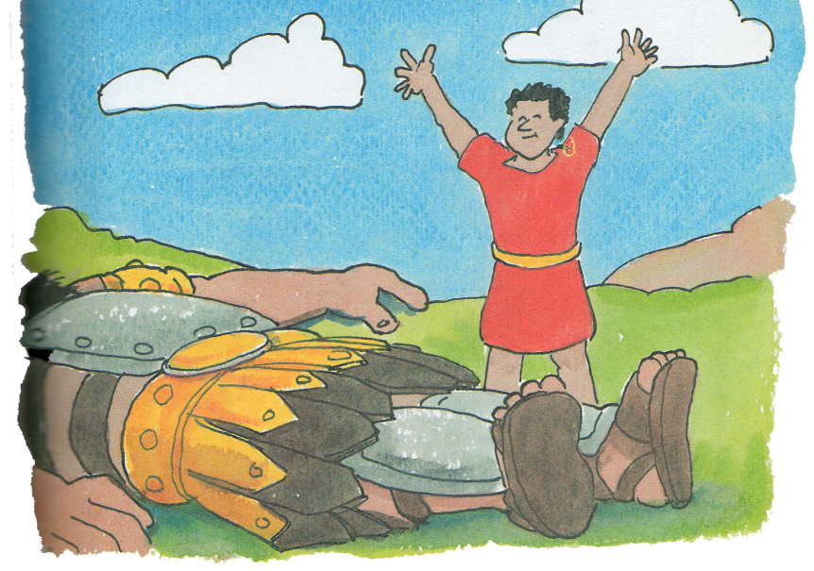
Conclusion
We can all understand God’s word
With study we can speak boldly
How can the Word of the Lord be familiar to us if we don’t spend time studying?

