Slide 1
Do you know me?
Eleazar son of dodo

Slide 2
Where can you find me?
2 Sam 23:9-10 "⁹ And after him was Eleazar the son of Dodo, the Ahohite, one of the three mighty men with David when they defied the Philistines who were gathered there for battle, and the men of Israel had retreated. ¹⁰ He arose and attacked the Philistines until his hand was weary, and his hand stuck to the sword. The Lord brought about a great victory that day; and the people returned after him only to plunder.
1 Chron 11:12-13 “¹² After him was Eleazar the son of Dodo, the Ahohite, who was one of the three mighty men. ¹³ He was with David at Pasdammim. Now there the Philistines were gathered for battle, and there was a piece of ground full of barley. So the people fled from the Philistines.”

Slide 3
That’s not a lot of information
He was one of three mighty men who stood with David
He attacked the Philistines until he was weary and stuck to the sword
He is someone we can learn from

Slide 4
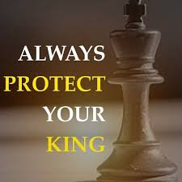
Eleazer knew his place
In this battle against the Philistines David did not have to stand alone
While all the other soldiers fled in fear, Eleazar was one of three men who stood with the king
Eleazar took his place next to his king, drew his sword, and fought to protect his king, the name of his people, and the glory of his God
His place was standing with his king

Slide 5
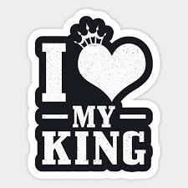
Eleazar’s motivation for standing by his king
The king was worth more than anything else in life
He loved the king more than anything else in life

Slide 6
We must know our place
Eph 6:10-18 tells us to put on the whole armor of God
1 Pet 5:8 “⁸ Be sober, be vigilant; because your adversary the devil walks about like a roaring lion, seeking whom he may devour.”
We fight against a world opposed to God’s teachings and holiness
We must stand with Christ our King

Slide 7
Our Motivation for standing by our king

Slide 8
Four key thoughts on staying close to your King
When your way is pleasant, walk with Him
When the pressure is on, stay with Him
When the enemy comes and tries to lure you away, cling to Him
When you find yourself in the heat of battle, be sure you are close to Him

Slide 9
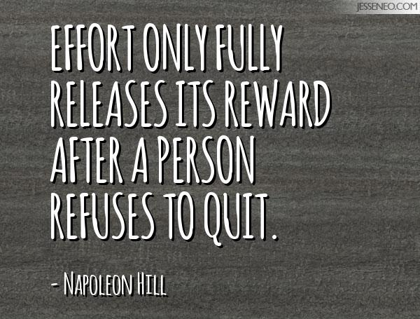
Eleazar’s Actions
2 Sam 23:10 “¹⁰ He arose and attacked the Philistines until his hand was weary, and his hand stuck to the sword.”
Eleazar “Refused to quit” until the threat was completely defeated
God used his actions to bring about “A great victory that day”

Slide 10
Our Actions
Two important questions
What would it take to stop me
One simple answer
Nothing
Let us never drop out of the battle
As a casualty to sin
Because others have pulled us away from our position near the king
Because we are just too tired
What would it take to cause me to turn away from the Lord

Slide 11
Concluding words of encouragement
I cor 15:58 “⁵⁸ Therefore, my beloved brethren, be steadfast, immovable, always abounding in the work of the Lord, knowing that your labor is not in vain in the Lord.”
Gal 6:9 “⁹ And let us not grow weary while doing good, for in due season we shall reap if we do not lose heart.”

