Slide 1
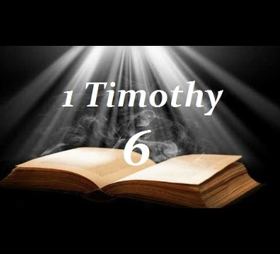
Flee, follow, fight

Slide 2
Flee these things (v.11)
Flee
verb (used without object), fled, flee·ing.
to run away, as from danger or pursuers; take flight.
to move swiftly; fly; speed.
verb (used with object), fled, flee·ing.
to run away from (a place, person, etc.).

Slide 3
Flee these things (v.11)
1 Time 6:3-5 “³ If anyone teaches otherwise and does not consent to wholesome words, even the words of our Lord Jesus Christ, and to the doctrine which accords with godliness, ⁴ he is proud, knowing nothing, but is obsessed with disputes and arguments over words, from which come envy, strife, reviling, evil suspicions, ⁵ useless wranglings of men of corrupt minds and destitute of the truth, who suppose that godliness is a means of gain. From such withdraw yourself.”

Slide 4
Flee these things (v.11)
1 Time 6:9-10 “⁹ But those who desire to be rich fall into temptation and a snare, and into many foolish and harmful lusts which drown men in destruction and perdition. ¹⁰ For the love of money is a root of all kinds of evil, for which some have strayed from the faith in their greediness, and pierced themselves through with many sorrows.”

Slide 5
Different doctrines
Love of money

Slide 6
Follow (v.11)
Pursue diligently; to earnestly endeavor to acquire
Not a lackadaisical following after

Slide 7
Follow righteousness (v.11)
Prov 14:34 “³⁴ Righteousness exalts a nation, But sin is a reproach to any people.”
Mt 5:6 “⁶ Blessed are those who hunger and thirst for righteousness, For they shall be filled.”
1 Jn 3:7 “⁷ Little children, let no one deceive you. He who practices righteousness is righteous, just as He is righteous.”

Slide 8
Follow godliness (v.11)
1 Tim 2:1-3 “2 Therefore I exhort first of all that supplications, prayers, intercessions, and giving of thanks be made for all men, ² for kings and all who are in authority, that we may lead a quiet and peaceable life in all godliness and reverence. ³ For this is good and acceptable in the sight of God our Savior,”
1 Tim 4:8 “⁸ For bodily exercise profits a little, but godliness is profitable for all things, having promise of the life that now is and of that which is to come.”

Slide 9
Follow faith (v.11)
Heb 11:6 “⁶ But without faith it is impossible to please Him, for he who comes to God must believe that He is, and that He is a rewarder of those who diligently seek Him.”
Rom 10:17 “¹⁷ So then faith comes by hearing, and hearing by the word of God.”

Slide 10
Follow love (v.11)

Slide 11
Follow patience (v.11)
Rom 12:12 “¹² rejoicing in hope, patient in tribulation, continuing steadfastly in prayer;”
Gal 6:9 “⁹ And let us not grow weary while doing good, for in due season we shall reap if we do not lose heart.”
Col 3:12 “¹² Therefore, as the elect of God, holy and beloved, put on tender mercies, kindness, humility, meekness, longsuffering;”

Slide 12
Follow gentleness (v.11)
Mt 5:5 “⁵ Blessed are the meek, For they shall inherit the earth.”
Gal 5:22-23 “²² But the fruit of the Spirit is love, joy, peace, longsuffering, kindness, goodness, faithfulness, ²³ gentleness, self-control. Against such there is no law.”
1 Pet 3:3-4 “³ Do not let your adornment be merely outward—arranging the hair, wearing gold, or putting on fine apparel— ⁴ rather let it be the hidden person of the heart, with the incorruptible beauty of a gentle and quiet spirit, which is very precious in the sight of God.”

Slide 13
Righteousness
Godliness
Faith
Love
Gentleness

Slide 14
Fight the good fight of faith (v.12)

Slide 15
Are you Ready to
Flee sin and the way of the world?
Follow God the Father and His Son?
Fight the good fight of faith?

