Slide 1
Hold to god’s unchanging hand
Song 463

Slide 2
We live in a changing world
Time is filled with swift transition

Slide 3
We live in a changing world
Time is filled with swift transition

Slide 4
We live in a changing world
Naught of earth unmoved shall stand

Slide 5
We live in a changing world
Naught of earth unmoved shall stand

Slide 6
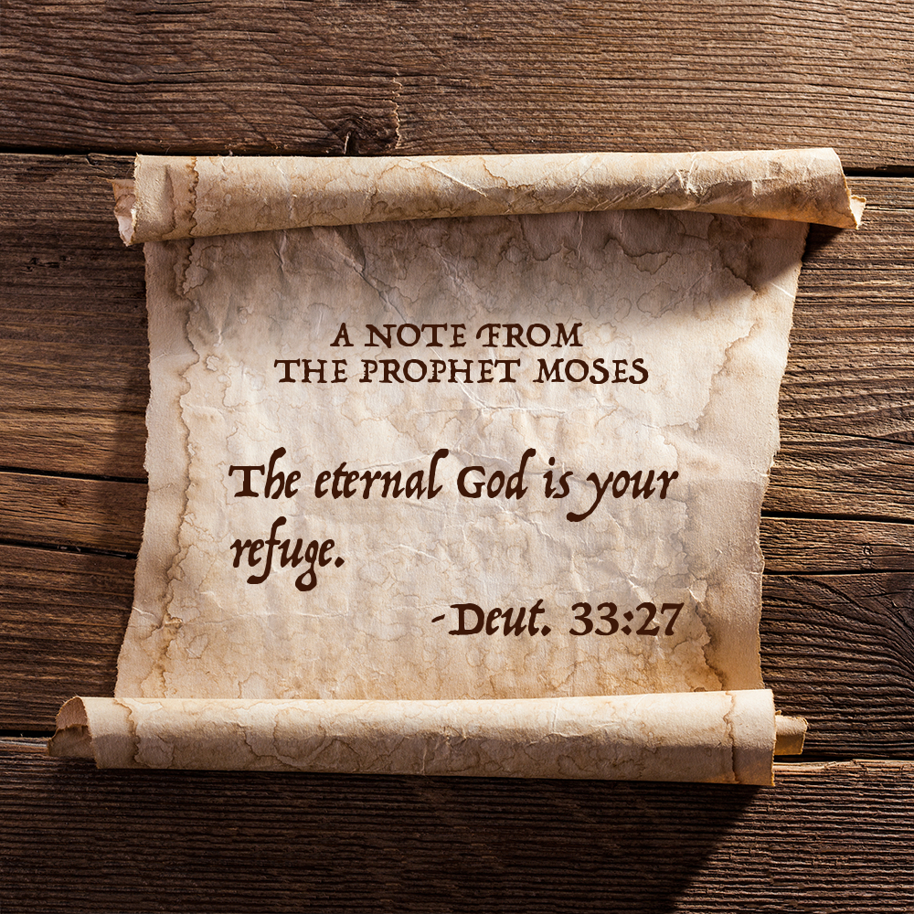
We live in a changing world
Build your hopes on things eternal

Slide 7
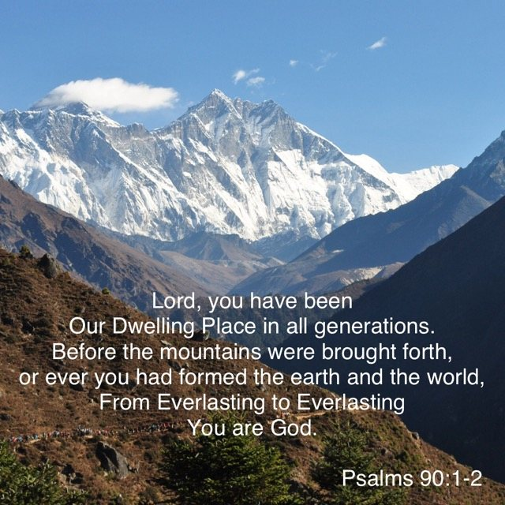
We live in a changing world
Build your hopes on things eternal

Slide 8
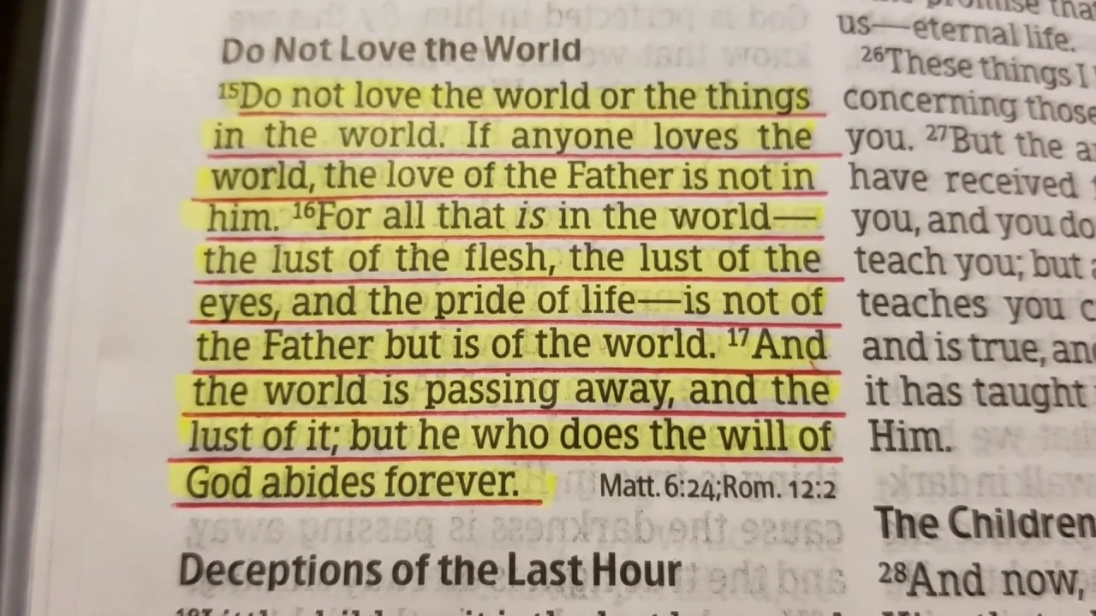
We live in a changing world
Build your hopes on things eternal

Slide 9
We live in a changing world
Hold to God’s unchanging hand

Slide 10
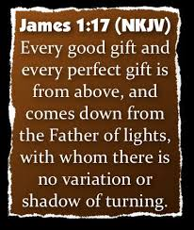
We live in a changing world
Hold to God’s unchanging hand

Slide 11
Know where to place your trust
Trust in Him who will not leave you, whatsoever years may bring

Slide 12
Know where to place your trust
Trust in Him who will not leave you, whatsoever years may bring

Slide 13
Know where to place your trust
Trust in Him who will not leave you, whatsoever years may bring

Slide 14
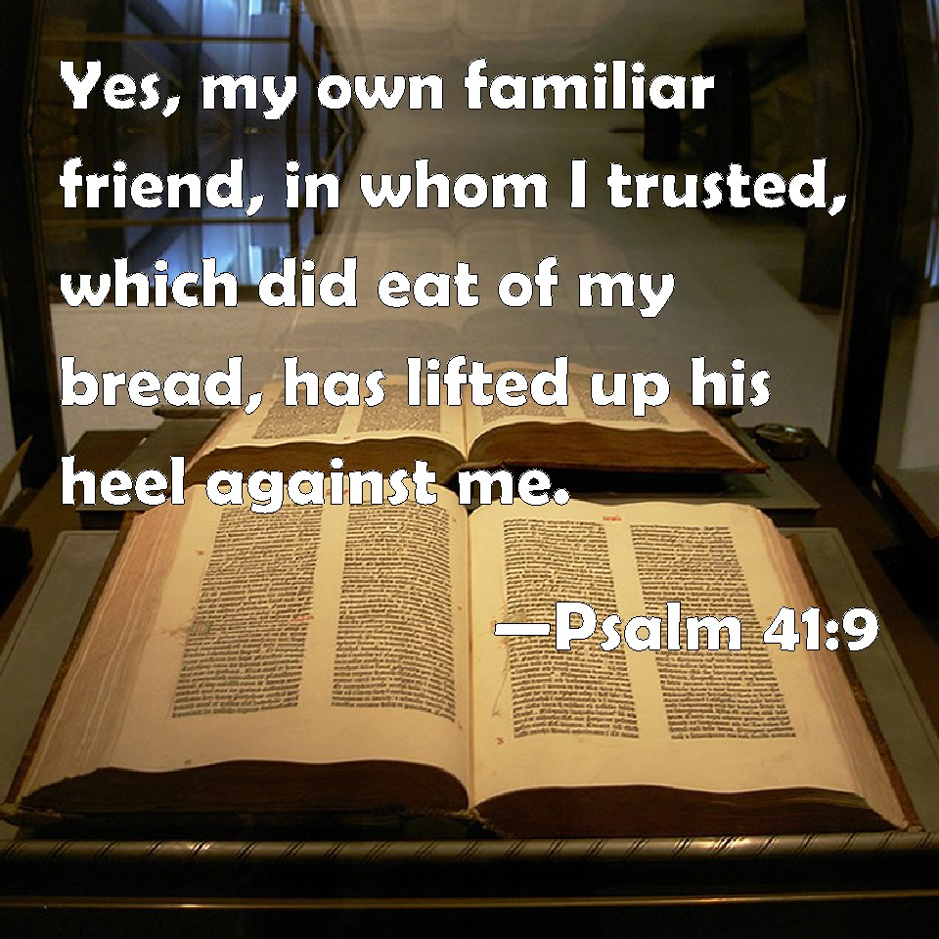
Know where to place your trust
If by earthly friends forsaken, still more closely to Him cling

Slide 15
Know where to place your trust
If by earthly friends forsaken, still more closely to Him cling

Slide 16
Your hope of Heaven if you remain faithful
When your journey is completed

Slide 17
Your hope of Heaven if you remain faithful
If to God you have been true

Slide 18
Your hope of Heaven if you remain faithful
Fair and bright the home in glory your enraptured soul will view

Slide 19
Hold to God’s unchanging hand
Build your hopes on things eternal…

Slide 20
Hold to god’s unchanging hand

