Slide 1
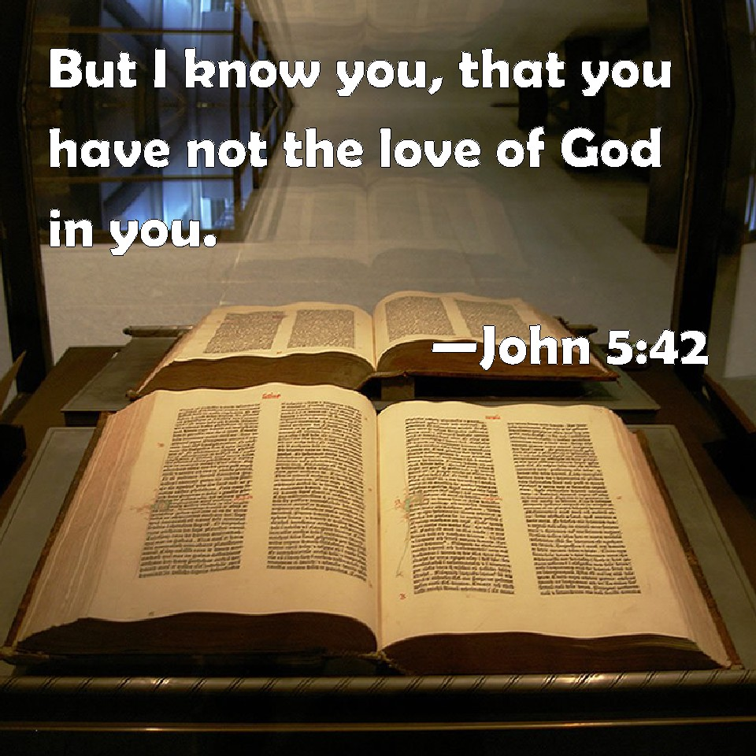
How to measure our Love for God
It’s all about our attitude

Slide 2
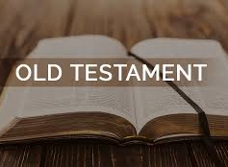
Attitude toward god
Psalm 111:9 “⁹ He has sent redemption to His people; He has commanded His covenant forever: Holy and awesome is His name.”
Prov 1:7 “⁷ The fear of the Lord is the beginning of knowledge, But fools despise wisdom and instruction.
Eccl 12:13 “¹³ Let us hear the conclusion of the whole matter: Fear God and keep His commandments, For this is man’s all.”
Notes:
Fear
Resource Toolbox
Print Article
Additional Links
Concordance Nave Topical Bible Fear of God
Fear
Scofield Reference Index Fear of the Lord
Thompson Chain Reference Fear
Fear Nots
Fear of God
(only first 3 shown)
The Topic Concordance Fear
Dictionary Encyclopedia Lexicons Synonyms
A broad range of emotions that embrace both the secular and the religious worlds. Secular fear is the natural feeling of alarm caused by the expectation of imminent danger, pain, or disaster. Religious fear appears as the result of awe and reverence toward a supreme power.
Holman Bible Dictionary

Slide 3
Attitude toward god
Mt 10:28 “²⁸ And do not fear those who kill the body but cannot kill the soul. But rather fear Him who is able to destroy both soul and body in hell.”
Rom 11:22 “²² Therefore consider the goodness and severity of God: on those who fell, severity; but toward you, goodness, if you continue in His goodness. Otherwise you also will be cut off.”

Slide 4
Attitude toward sin

Slide 5
Attitude toward sin
Prov 14:9 “⁹ Fools mock at sin, But among the upright there is favor.”
Prov 28:13 “¹³ He who covers his sins will not prosper, But whoever confesses and forsakes them will have mercy.”

Slide 6
Attitude toward sin
Rom 12:9 “⁹ Let love be without hypocrisy. Abhor what is evil. Cling to what is good.”
1 Thess 5:22 “²² Abstain from every form of evil.”
Rom 6:23 “²³ For the wages of sin is death, but the gift of God is eternal life in Christ Jesus our Lord.”
Notes:
Abhor is to hate

Slide 7
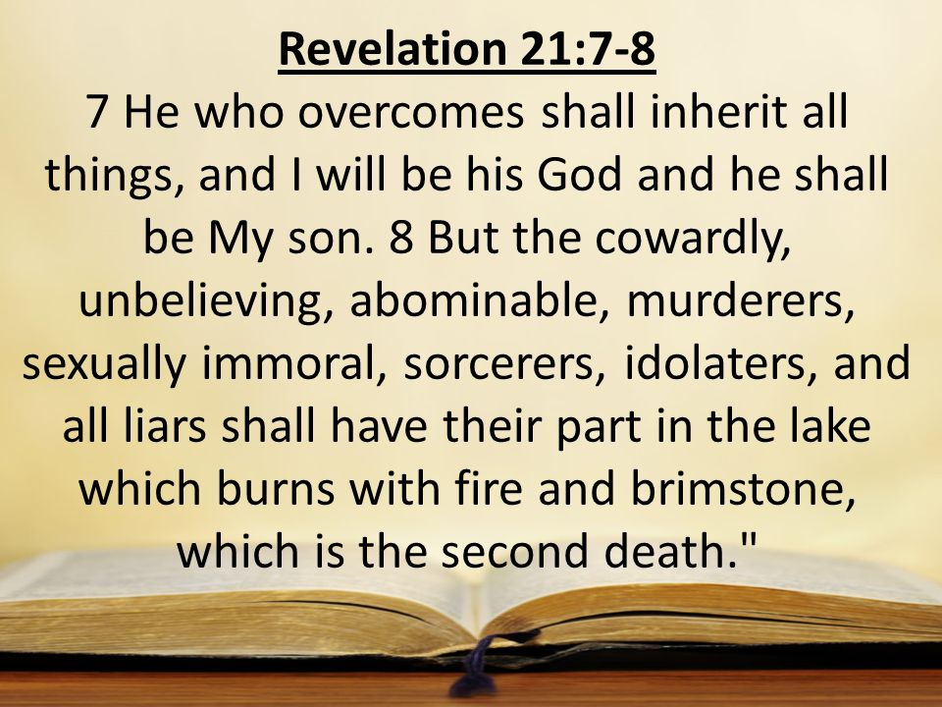
Attitude toward sin

Slide 8
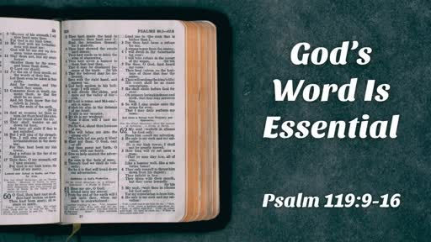
Attitude toward God’s word

Slide 9
Attitude toward God’s word
Ps 119:130 “¹³⁰ The entrance of Your words gives light; It gives understanding to the simple.”
Ps 119:60 “¹⁶⁰ The entirety of Your word is truth, And every one of Your righteous judgments endures forever.”
Is 40:8 “⁸ The grass withers, the flower fades, But the word of our God stands forever.”

Slide 10
Attitude toward god’s word

Slide 11
Attitude toward god’s word

Slide 12
Attitude toward god’s word

Slide 14
How to measure our Love for God
It’s all about our attitude

Slide 15
Attitude toward our blessings
Ps 92:1 “92 It is good to give thanks to the Lord, And to sing praises to Your name, O Most High;”
Ps 105:1-2 “105 Oh, give thanks to the Lord! Call upon His name; Make known His deeds among the peoples! ² Sing to Him, sing psalms to Him; Talk of all His wondrous works!

Slide 16
Attitude toward our blessings
Ps 118:28-29 “²⁸ You are my God, and I will praise You; You are my God, I will exalt You.
²⁹ Oh, give thanks to the Lord, for He is good! For His mercy endures forever.”

Slide 17
Attitude toward our blessings

Slide 18
Attitude toward our blessings
Mt 6:11 “¹¹ Give us this day our daily bread.”
Jam 1:17 “¹⁷ Every good gift and every perfect gift is from above, and comes down from the Father of lights, with whom there is no variation or shadow of turning.”

Slide 19
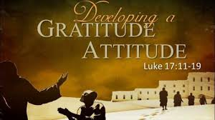
Attitude toward our blessings

Slide 20
Attitude toward god’s people

Slide 21
Attitude toward god’s people
Prov 27:5-6 “⁵ Open rebuke is better Than love carefully concealed.
⁶ Faithful are the wounds of a friend, But the kisses of an enemy are deceitful.”

Slide 22
Attitude toward god’s people

Slide 23
Attitude toward god’s people
Jn 13:34-35 “³⁴ A new commandment I give to you, that you love one another; as I have loved you, that you also love one another. ³⁵ By this all will know that you are My disciples, if you have love for one another.”
Rom 12:10 “¹⁰ Be kindly affectionate to one another with brotherly love, in honor giving preference to one another;

Slide 24
Attitude toward god’s people
Heb 10:24-25 “²⁴ And let us consider one another in order to stir up love and good works, ²⁵ not forsaking the assembling of ourselves together, as is the manner of some, but exhorting one another, and so much the more as you see the Day approaching.
Rev 3:19 “¹⁹ As many as I love, I rebuke and chasten. Therefore be zealous and repent.”

Slide 25
Attitude toward worship
Ps 122:1 “122 I was glad when they said to me, “Let us go into the house of the Lord.”

Slide 26
Attitude toward worship

Slide 27
Attitude toward worship

Slide 28
Attitude toward worship

Slide 29
Attitude toward worship

Slide 30
conclusion

