Slide 1
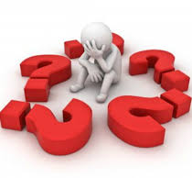
Injustice
What should I do Now?

Slide 2
Introduction
What is injustice?
What makes something an injustice?
The person performing the act?
The individual wronged?
Should I respond?
If so, how?

Slide 3
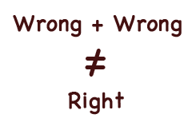
Introduction

Slide 4
Responding to injustice

Slide 5
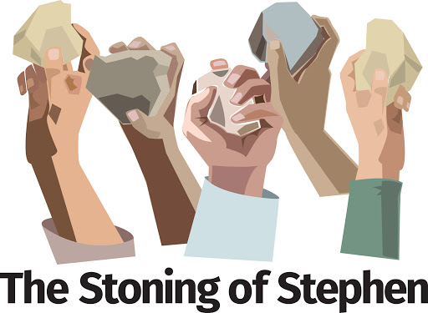
Acts 7:54-60

Slide 6
Acts 7:51-53

Slide 7
Acts 16:1-40

Slide 8
Is. 53

Slide 9
Mt 5:38-48

Slide 10
Mt 26:47-53

Slide 11
Conclusion: What should I do?
Rom 12:17-21

