Slide 2
Introduction
Something that precedes and indicates the approach of something or someone
A person who goes before or announces the coming of another

Slide 3
King’s Forerunner
Make certain the roads were passable
No delays when king passed
Clear and open a route through the kingdom
Go along the route before the king and tell the people he was coming and to get ready
Notes:
John the Baptist performed both duties Jesus Christ our King

Slide 4
Mark 1:2-3 Prophecy Fulfilled

Slide 5
John’s responsibilities involved 2 key Things
John cleared the path for Christ by appealing directly to the people
John was “the voice of one crying in the wilderness” John “Proclaimed” the coming of the king

Slide 6
Mark 1:4
“Preaching a baptism of repentance for the remission of sins.”
“John came baptizing in the wilderness”

Slide 7
Mark 1:5
“⁵ Then all the land of Judea, and those from Jerusalem, went out to him and were all baptized by him in the Jordan River, confessing their sins.”

Slide 8
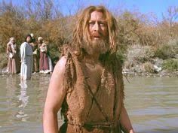
Mark 1:6
Clothing
Food

Slide 9
Mark 1:7-8
Man vs. Man
Mk 1:7 “⁷ And he preached, saying, “There comes One after me who is mightier than I, whose sandal strap I am not worthy to stoop down and loose.”

Slide 10
Mark 1:7-8
Baptism vs. Baptism
Mk 1:8 “⁸ I indeed baptized you with water, but He will baptize you with the Holy Spirit.”

