Slide 1
Jesus and Sinners
2:13-17

Slide 2
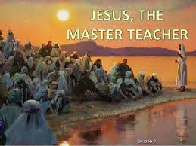
¹³ Then He went out again by the sea; and all the multitude came to Him, and He taught them.
Once again we see the multitude following Jesus wherever He goes
Jesus’ response is to “Teach them.”

Slide 3
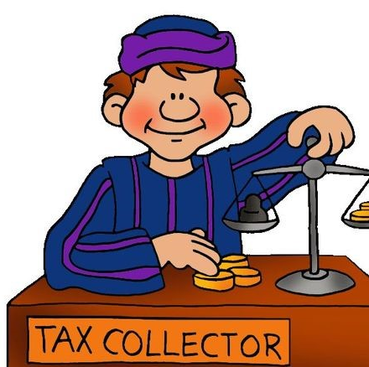
¹⁴ As He passed by, He saw Levi the son of Alphaeus sitting at the tax office. And He said to him, “Follow Me.” So he arose and followed Him.
Tax collectors worked for the Roman government
Jews viewed tax collectors as sinners as they could inflate the true taxes owed and pocket the difference

Slide 4
¹⁴ As He passed by, He saw Levi the son of Alphaeus sitting at the tax office. And He said to him, “Follow Me.” So he arose and followed Him.
Called by Jesus to follow
Arose and followed as commanded

Slide 5
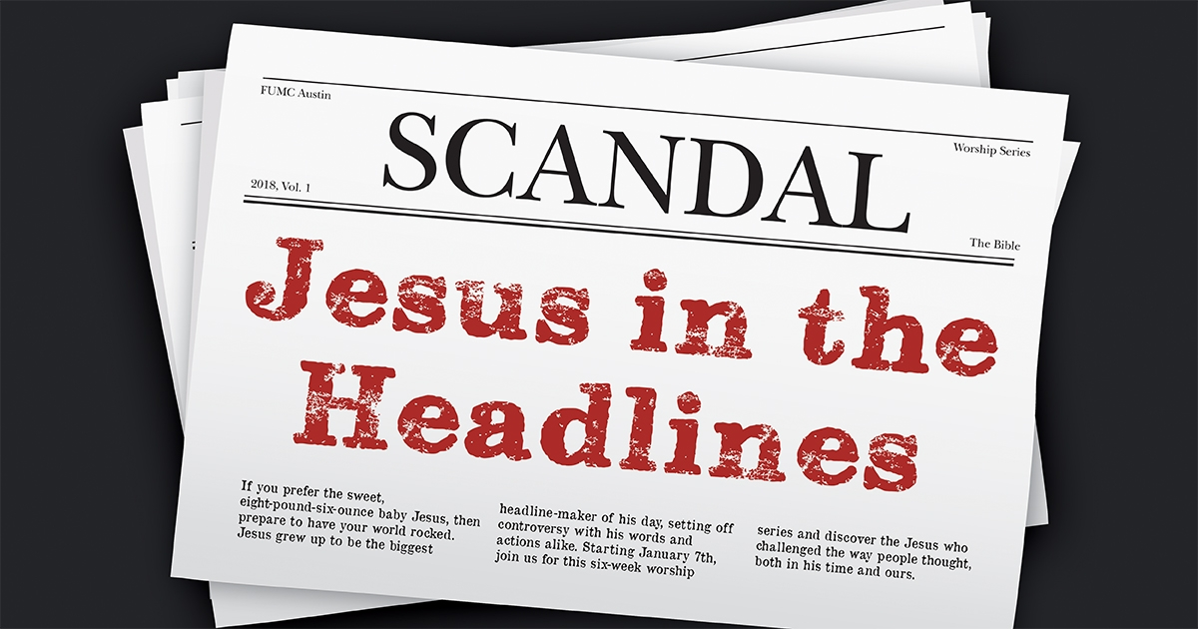
¹⁵ Now it happened, as He was dining in Levi’s house, that many tax collectors and sinners also sat together with Jesus and His disciples; for there were many, and they followed Him.
Tax collectors were despised by the Jews
Sinners could refer to grossly immoral people
Sinners could just be describing people who make themselves unclean by associating with gentiles
Sinners could just be people who were not observing the law and traditions of the elders as thoroughly as the scribes and pharisees would have liked

Slide 6
¹⁶ And when the scribes and Pharisees saw Him eating with the tax collectors and sinners, they said to His disciples, “How is it that He eats and drinks with tax collectors and sinners?”
The scribes and Pharisees were prideful in themselves and looked down on the people Jesus ate with
They did not question Jesus directly but asked His disciples

Slide 7
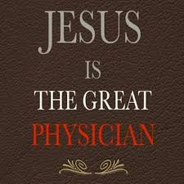
¹⁷ When Jesus heard it, He said to them, “Those who are well have no need of a physician, but those who are sick. I did not come to call the righteous, but sinners, to repentance.”
A physician would be of no use if he avoided the sick
Jesus came to heal the spiritually sick which would include those at the table with Him

