Slide 1
3:7-19

Slide 2
⁷ But Jesus withdrew with His disciples to the sea. And a great multitude from Galilee followed Him, and from Judea ⁸ and Jerusalem and Idumea and beyond the Jordan; and those from Tyre and Sidon, a great multitude, when they heard how many things He was doing, came to Him.
“Jesus withdrew with His disciples”
This was a voluntary act
He was not run out
He had the ability to continue to preach and teach wherever He wanted but He made a choice to move Himself
He did not need to fear the people who plotted against Him as He was the Son of God with all power

Slide 3
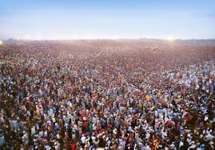
⁷ But Jesus withdrew with His disciples to the sea. And a great multitude from Galilee followed Him, and from Judea ⁸ and Jerusalem and Idumea and beyond the Jordan; and those from Tyre and Sidon, a great multitude, when they heard how many things He was doing, came to Him.
A great multitude followed after Him from all regions because they hear of all the things He was doing
We see here the great distances people travelled to see Him
This should help us recognize just how much word of Him spread

Slide 4
⁹ So He told His disciples that a small boat should be kept ready for Him because of the multitude, lest they should crush Him. ¹⁰ For He healed many, so that as many as had afflictions pressed about Him to touch Him.
The people came in large number seeking His healing
He healed so many that all wanted to get close enough to just touch Him
Jesus tells His disciples to keep a small boat ready for Him

Slide 5
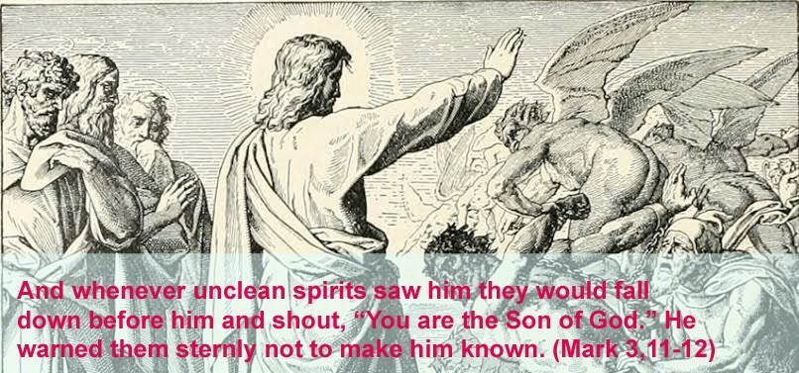
Key Points
This implies there were many times Jesus was recognized by unclean spirits
Jesus wanted His teaching and actions not the words of the words of demons proclaiming His deity

Slide 6
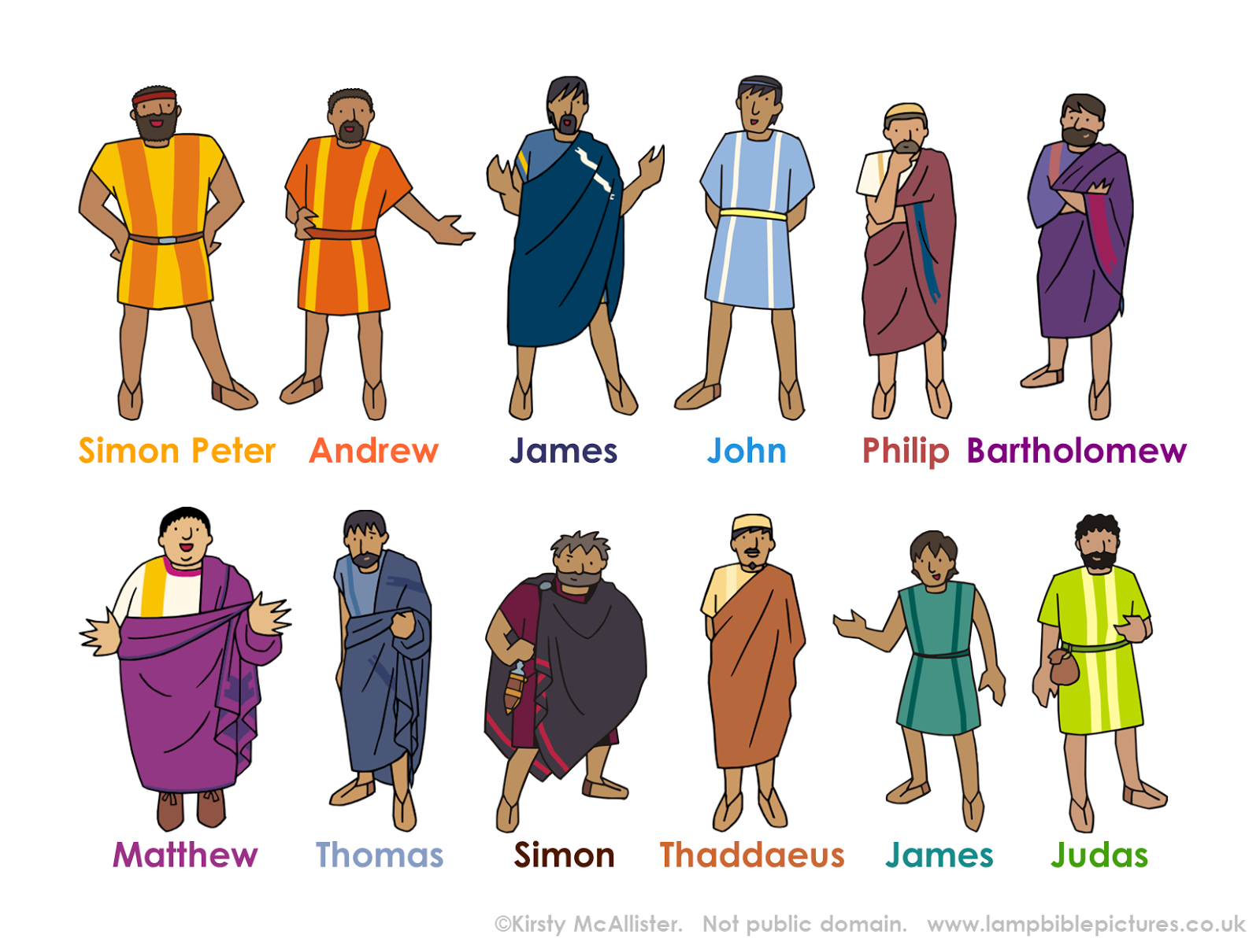
Key Points
He called to Himself those He wanted and they obeyed
He appointed 12 to…
Be with Him that He might send them out to preach
Have power to heal the sick and cast out demons
Among the 12 was the one who would betray Him

