Slide 1
4:35-41

Slide 2
Mark 4:35-36 “³⁵ On the same day, when evening had come, He said to them, “Let us cross over to the other side.” ³⁶ Now when they had left the multitude, they took Him along in the boat as He was. And other little boats were also with Him.”
On the same day…” probably refers to the same day that he had just spoken the parables to them
Jesus was tired and wanted to go to the other side of the sea to get away from the large crowds of people

Slide 3
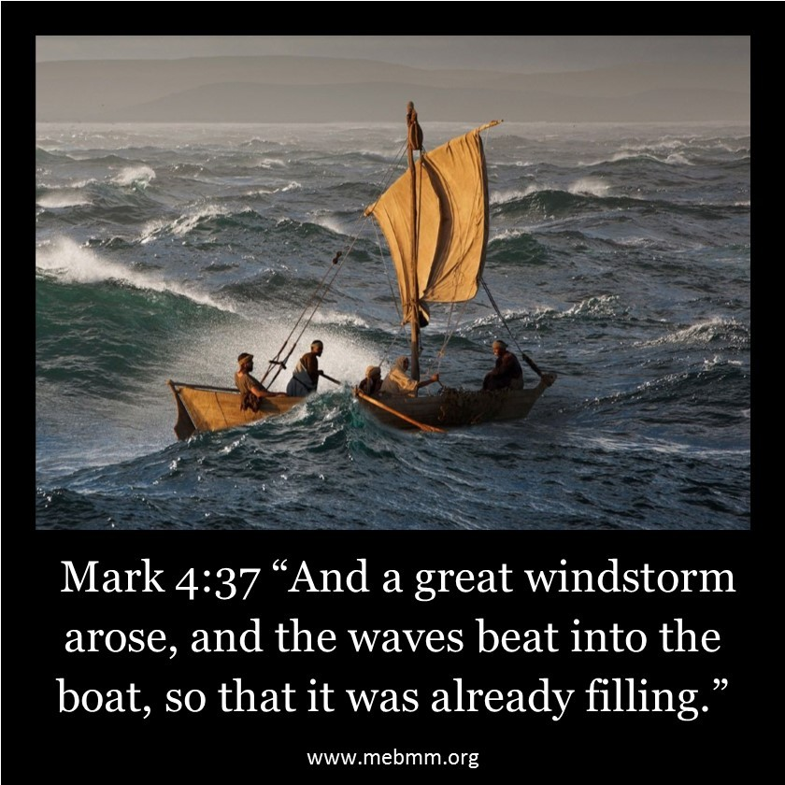
The Great Storm
Came on suddenly… while storms like this are common, they are not common at night
The waves were beginning to fill the boat
This truly was a dangerous situation

Slide 4
Mk 4:38 “³⁸ But He was in the stern, asleep on a pillow. And they awoke Him and said to Him, “Teacher, do You not care that we are perishing?”
Jesus was sleeping after a long day of preaching
The disciples question His concern for them… don’t you care that we are in trouble
They showed a lack of faith in Jesus despite everything He had done earlier in the day

Slide 5
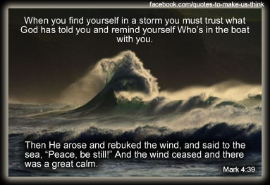
The Storm Ceased
Rebuke: To restrain; to calm
Storms normally slowly die down… this was an immediate calm and peace
We see here the great power Jesus has over the natural elements of this world

Slide 6
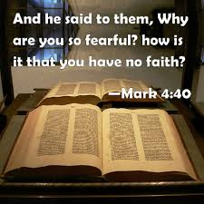
Jesus rebukes the Disciples
Rebuke: To chide; to reprove; to reprehend for a fault; to check by reproof.
Faith is the opposite of fear
Jesus scolds His disciples for their doubt
The storm didn’t bother Jesus but their lack of faith did

Slide 7
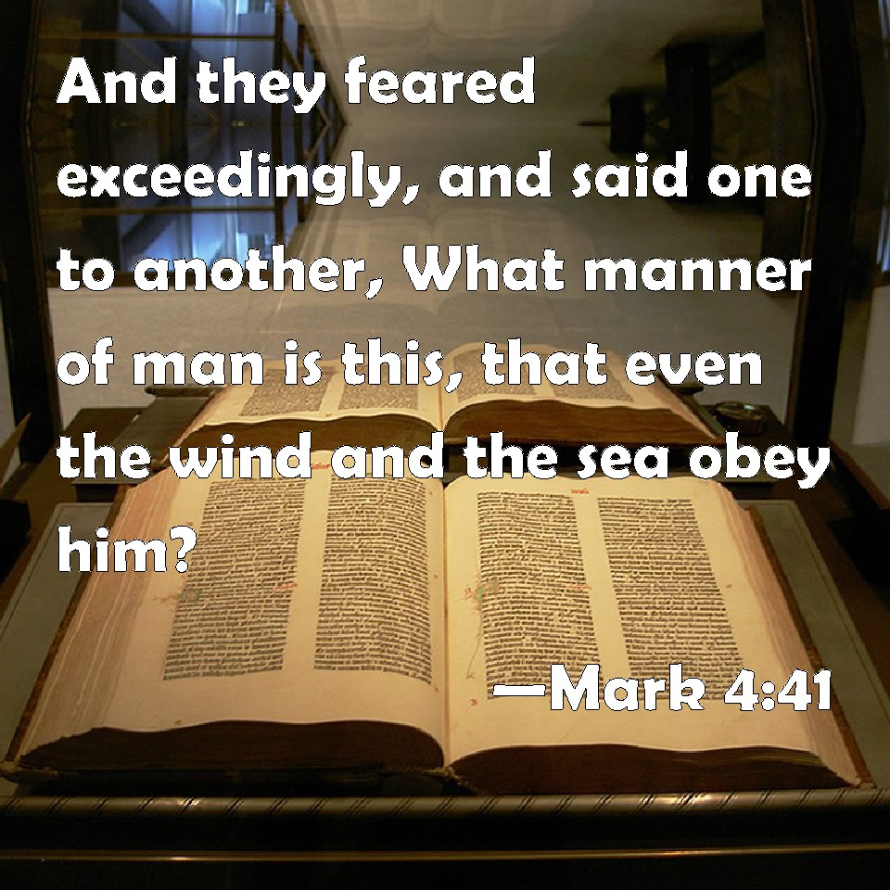
Even the wind and the sea obey Him
There was no longer fear of the storm as it was calm
This is both fear and reverential awe at the power of Jesus
Who can this be… this can only be Jesus Christ the Son of God

