Slide 3
Introduction: A Few Scriptures to Start us thinking
Psalm 100:4-5 New King James Version (NKJV)
⁴ Enter into His gates with thanksgiving, And into His courts with praise. Be thankful to Him, and bless His name. ⁵ For the Lord is good; His mercy is everlasting, And His truth endures to all generations.

Slide 4
Introduction: A Few Scriptures to Start us thinking
Psalm 107:21-22 New King James Version (NKJV)
²¹ Oh, that men would give thanks to the Lord for His goodness, And for His wonderful works to the children of men! ²² Let them sacrifice the sacrifices of thanksgiving, And declare His works with rejoicing.

Slide 5
Introduction: A Few Scriptures to Start us thinking
Ephesians 5:20 New King James Version (NKJV)
²⁰ giving thanks always for all things to God the Father in the name of our Lord Jesus Christ,
Colossians 4:2 New King James Version (NKJV)
² Continue earnestly in prayer, being vigilant in it with thanksgiving;

Slide 6
Thanksgiving is not Just a Good Idea… it is a Command to be Obeyed
Colossians 3:17 New King James Version (NKJV)
¹⁷ And whatever you do in word or deed, do all in the name of the Lord Jesus, giving thanks to God the Father through Him.
1 Thessalonians 5:16-18 New King James Version (NKJV)
¹⁶ Rejoice always, ¹⁷ pray without ceasing, ¹⁸ in everything give thanks; for this is the will of God in Christ Jesus for you.

Slide 7
Thankfulness Reminds us of God’s Benefits
Psalm 103:1-5 New King James Version (NKJV)
103 Bless the Lord, O my soul; And all that is within me, bless His holy name! ² Bless the Lord, O my soul, And forget not all His benefits: ³ Who forgives all your iniquities, Who heals all your diseases, ⁴ Who redeems your life from destruction, Who crowns you with lovingkindness and tender mercies, ⁵ Who satisfies your mouth with good things, So that your youth is renewed like the eagle’s.

Slide 8
Thankfulness Leads to Peace and Contentment
Philippians 4:6-7 New King James Version (NKJV)
⁶ Be anxious for nothing, but in everything by prayer and supplication, with thanksgiving, let your requests be made known to God; ⁷ and the peace of God, which surpasses all understanding, will guard your hearts and minds through Christ Jesus.
1 Timothy 6:6-8 New King James Version (NKJV)
⁶ Now godliness with contentment is great gain. ⁷ For we brought nothing into this world, and it is certain we can carry nothing out. ⁸ And having food and clothing, with these we shall be content.

Slide 9
Thankfulness Keeps us Humble
Proverbs 16:18 New King James Version (NKJV)
¹⁸ Pride goes before destruction, And a haughty spirit before a fall.
Daniel 4:30-33 New King James Version (NKJV)
³⁰ The king spoke, saying, “Is not this great Babylon, that I have built for a royal dwelling by my mighty power and for the honor of my majesty?”
³¹ While the word was still in the king’s mouth, a voice fell from heaven: “King Nebuchadnezzar, to you it is spoken: the kingdom has departed from you! ³² And they shall drive you from men, and your dwelling shall be with the beasts of the field. They shall make you eat grass like oxen; and seven times shall pass over you, until you know that the Most High rules in the kingdom of men, and gives it to whomever He chooses.”
³³ That very hour the word was fulfilled concerning Nebuchadnezzar; he was driven from men and ate grass like oxen; his body was wet with the dew of heaven till his hair had grown like eagles’ feathers and his nails like birds’ claws.

Slide 10
Thankfulness to God was Exemplified by Jesus
Matthew 15:36-37 New King James Version (NKJV)
³⁶ And He took the seven loaves and the fish and gave thanks, broke them and gave them to His disciples; and the disciples gave to the multitude. ³⁷ So they all ate and were filled, and they took up seven large baskets full of the fragments that were left.
John 11:41-42 New King James Version (NKJV)
⁴¹ Then they took away the stone ^{[a]}from the place where the dead man was lying. And Jesus lifted up His eyes and said, “Father, I thank You that You have heard Me. ⁴² And I know that You always hear Me, but because of the people who are standing by I said this, that they may believe that You sent Me.”

Slide 11
Thankfulness to God was Exemplified by Jesus
Mark 14:22-25 New King James Version (NKJV)
²² And as they were eating, Jesus took bread, blessed and broke it, and gave it to them and said, “Take, eat; this is My body.”
²³ Then He took the cup, and when He had given thanks He gave it to them, and they all drank from it. ²⁴ And He said to them, “This is My blood of the new covenant, which is shed for many. ²⁵ Assuredly, I say to you, I will no longer drink of the fruit of the vine until that day when I drink it new in the kingdom of God.”

Slide 12
Thankfulness is a Gift to God
Hebrews 13:15-16 New King James Version (NKJV)
¹⁵ Therefore by Him let us continually offer the sacrifice of praise to God, that is, the fruit of our lips, giving thanks to His name. ¹⁶ But do not forget to do good and to share, for with such sacrifices God is well pleased.

Slide 13
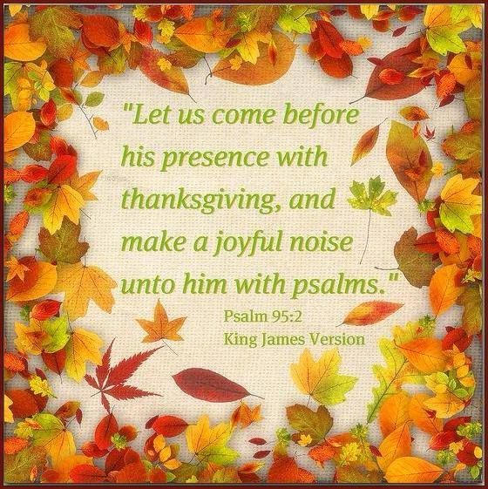
Cocnlusion

