Slide 1
The Girl Who is From the Land of Israel
2 Kings 5:1-4

Slide 2
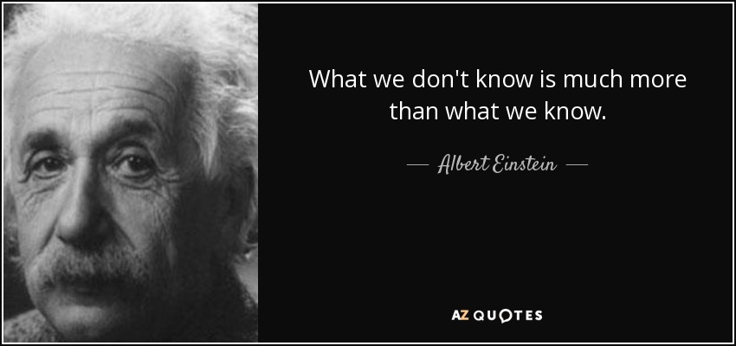
Introduction
This girl is mentioned in vs 2-4 and never spoken of again
We know nothing of her parents
We don’t know much about how she lived
We don’t know when or how she died
We don’t even know her name

Slide 3
The Conditions of Her Life (vs 2)
She was born in Israel (part of God’s special people)
She was taken “captive” during a raid
She was presented to Naaman’s wife to serve her

Slide 4
The Conditions of Her Life (vs 2)
Her life and existence appears to be hard
Her prospects for the future were bleak
She would probably live and die a “Nobody”

Slide 5
The Conditions of Our life
Most of us will never become famous
Most of us may never be known beyond our small circle of family and friends
Most of us are destined to live and die in basic anonymity like this girl

Slide 6
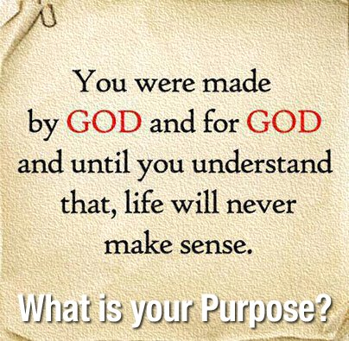
The Conditions of Our Life
Ps 37:23 “²³ The steps of a good man are [ordered by the Lord, And He delights in his way.”
Prov 16:9 “⁹ A man’s heart plans his way, But the Lord directs his steps.”

Slide 7
What She Knew About God (vs 3)
She knew there was one true God
She knew God was speaking to His people
“The prophet who is in Samaria”
She knew God had the power to heal
She knew God alone was worthy of worship
She shared her dedication to the God of Israel with her mistress
The Syrians worshipped the god Rimmon and other idols
“He would heal him of his leprosy”

Slide 8
Our Convictions About God and His Word Should Determine how we Live
If I am convinced the Bible is the Word of God, I will live my life acodring to its teachings and no one will be able to change my mind about it
A true conviction is always based on a clear word from God
If the Bible says it is right; it is right!
If the Bible says it is wrong; it is wrong!
Important questions we must ask
Does the Bible say it
Is it jut an opinion or personal preference

Slide 9
Her Compassion for Naaman
She was a slave in his house
Captured in war
Removed from her family, home, and country
Forced to live as a servant
She had every human reason to despise Naaman and his wife, but she didn’t
When she heard of Naaman’s leprosy instead of feeling like he was getting what he deserved, she told Naaman’s wife about God’s power to heal him

Slide 10
The Lesson for us
Mt 22:37-40 “³⁷ Jesus said to him, “‘You shall love the Lord your God with all your heart, with all your soul, and with all your mind.’ ³⁸ This is the first and great commandment. ³⁹ And the second is like it: ‘You shall love your neighbor as yourself.’ ⁴⁰ On these two commandments hang all the Law and the Prophets.”
Mt 5:43-44 “⁴³ “You have heard that it was said, ‘You shall love your neighbor and hate your enemy.’ ⁴⁴ But I say to you, love your enemies, bless those who curse you, do good to those who hate you, and pray for those who spitefully use you and persecute you,

Slide 11
Conclusion
What happened to the girl after the events in this chapter? We don’t know
What we need to learn is her life mattered
She made a difference
She was a “nobody” used by God
We may feel insignificant at times too, but we may not know how God is using us

