Slide 2
I need you to teach me
Prov 22:6 “⁶ Train up a child in the way he should go, and when he is old he will not depart from it.”
Eph 6:4 “⁴ And you, fathers, do not provoke your children to wrath, but bring them up in the training and admonition of the Lord.”

Slide 3
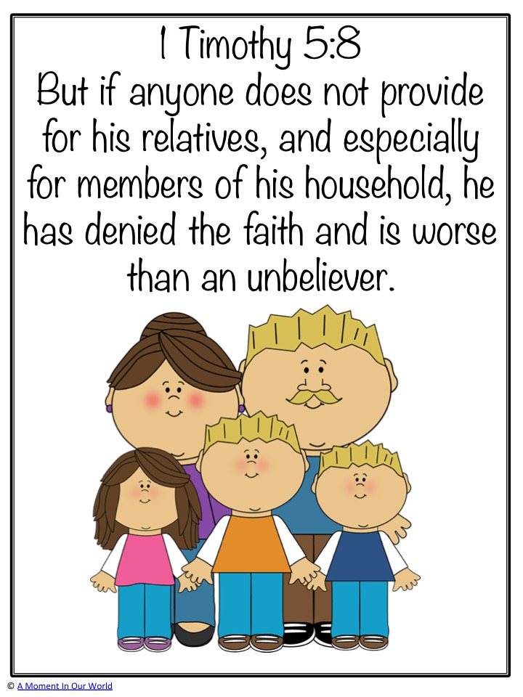
I need you to provide for me
Fathers must recognize needs vs wants and provide what is necessary
A father cannot always give a child what they want…There may be other needs that take precedent over the child’s desires
See Mt 6:8, 32-33

Slide 4
I need Correction and discipline

Slide 5
I need you to be positive example to follow
Josh 24:14-15 “¹⁴ “Now therefore, fear the Lord, serve Him in sincerity and in truth, and put away the gods which your fathers served on the other side of the River and in Egypt. Serve the Lord! ¹⁵ And if it seems evil to you to serve the Lord, choose for yourselves this day whom you will serve, whether the gods which your fathers served that were on the other side of the River, or the gods of the Amorites, in whose land you dwell. But as for me and my house, we will serve the Lord.”

Slide 6
Dorothy Law Nolte Ph.D.

