Slide 2
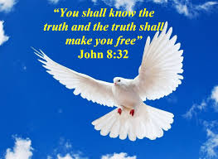
Freedom is found in Christ and his truth (Jn 8:30-32)
Abiding involves obedience
Obedience leads to greater retaining of knowledge (Jam 1:21-25)
Knowing the truth brings freedom

Slide 3
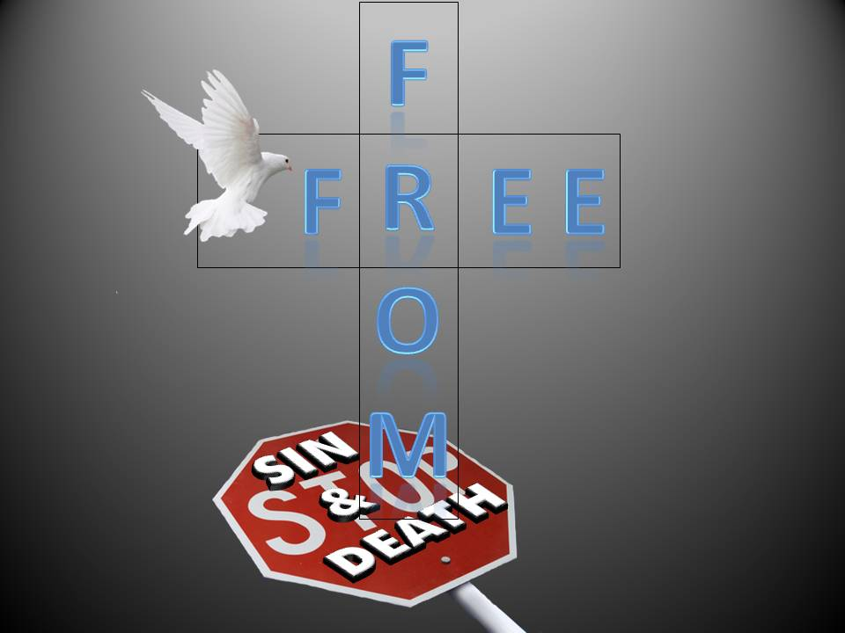
Freedom from what?
Jn 8:34 “³⁴ Jesus answered them, “Most assuredly, I say to you, whoever commits sin is a slave of sin.”
Jn 8:36 “³⁶ Therefore if the Son makes you free, you shall be free indeed.”

Slide 4
Freedom from what?
Rom 8:1-2 “² For the law of the Spirit of life in Christ Jesus has made me free from the law of sin and death.”

Slide 5
Freedom from what?
2 Tim 2:24-26 “²⁴ And a servant of the Lord must not quarrel but be gentle to all, able to teach, patient, ²⁵ in humility correcting those who are in opposition, if God perhaps will grant them repentance, so that they may know the truth, ²⁶ and that they may come to their senses and escape the snare of the devil, having been taken captive by him to do his will.”

Slide 6
Freedom from what?
1 Jn 3:7-8 “⁷ Little children, let no one deceive you. He who practices righteousness is righteous, just as He is righteous. ⁸ He who sins is of the devil, for the devil has sinned from the beginning. For this purpose the Son of God was manifested, that He might destroy the works of the devil.”

Slide 7
Freedom from what?
Heb 2:14-15 “¹⁴ Inasmuch then as the children have partaken of flesh and blood, He Himself likewise shared in the same, that through death He might destroy him who had the power of death, that is, the devil, ¹⁵ and release those who through fear of death were all their lifetime subject to bondage.”

Slide 8
Freedom from what?
1 Cor 15:55-67 “⁵⁵ “O Death, where is your sting? O Hades, where is your victory?” ⁵⁶ The sting of death is sin, and the strength of sin is the law. ⁵⁷ But thanks be to God, who gives us the victory through our Lord Jesus Christ.”

Slide 9
Freedom in Christ does not mean...
Rom 6:1-2 “6 What shall we say then? Shall we continue in sin that grace may abound? ² Certainly not! How shall we who died to sin live any longer in it?

Slide 10
Freedom in Christ does not mean...
2 Pet 2:18-20 “¹⁸ For when they speak great swelling words of emptiness, they allure through the lusts of the flesh, through lewdness, the ones who have actually escaped from those who live in error. ¹⁹ While they promise them liberty, they themselves are slaves of [corruption; for by whom a person is overcome, by him also he is brought into bondage. ²⁰ For if, after they have escaped the pollutions of the world through the knowledge of the Lord and Savior Jesus Christ, they are again entangled in them and overcome, the latter end is worse for them than the beginning.”

Slide 11
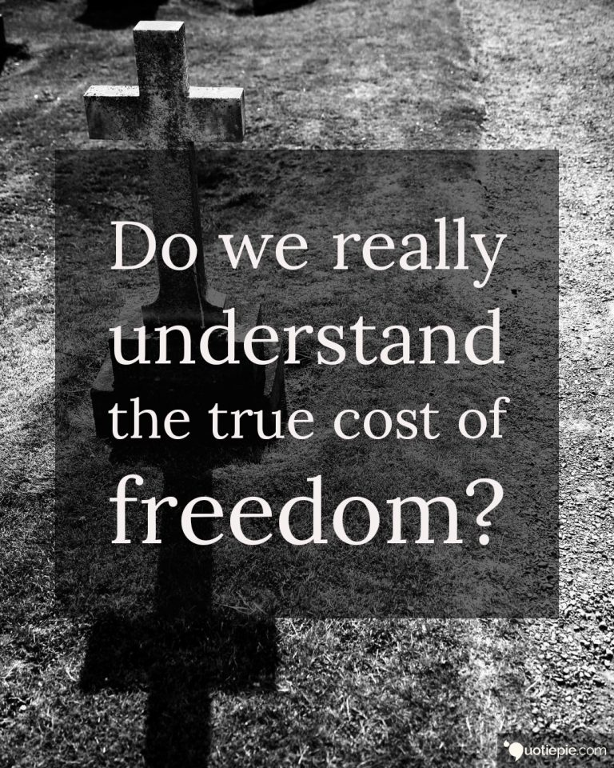
Freedom in Christ and his truth is not free

Slide 12
Freedom in Christ and his truth is not free
Rom 6:18 “¹⁸ And having been set free from sin, you became slaves of righteousness.”
Rom 6:20 “²⁰ For when you were slaves of sin, you were free in regard to righteousness.”

