Slide 3
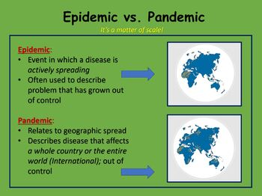
Introduction
Before we can consider the idea of sin as a pandemic we need to define what a pandemic is

Slide 4
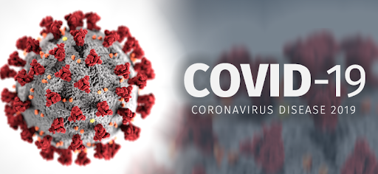
Introduction
In order to see if we can consider sin a pandemic we are going to compare it to something that has already been defined as a pandemic

Slide 5
Disease
The coronavirus is a sickness of the body that can ultimately lead to death
Sin is a sickness of the soul that can ultimately lead to death

Slide 6
Disease (Mt 9:9-13)
“⁹ As Jesus passed on from there, He saw a man named Matthew sitting at the tax office. And He said to him, “Follow Me.” So he arose and followed Him.
¹⁰ Now it happened, as Jesus sat at the table in the house, that behold, many tax collectors and sinners came and sat down with Him and His disciples. ¹¹ And when the Pharisees saw it, they said to His disciples, “Why does your Teacher eat with tax collectors and sinners?”
¹² When Jesus heard that, He said to them, “Those who are well have no need of a physician, but those who are sick. ¹³ But go and learn what this means: ‘I desire mercy and not sacrifice.’ For I did not come to call the righteous, but sinners, to repentance.”

Slide 7
Starting point
Notes:
China Nov 2019… USA Jan 2020

Slide 8
Starting Point (Gen 3)
⁶ So when the woman saw that the tree was good for food, that it was pleasant to the eyes, and a tree desirable to make one wise, she took of its fruit and ate. She also gave to her husband with her, and he ate. ⁷ Then the eyes of both of them were opened, and they knew that they were naked; and they sewed fig leaves together and made themselves coverings.
⁸ And they heard the sound of the Lord God walking in the garden in the cool of the day, and Adam and his wife hid themselves from the presence of the Lord God among the trees of the garden.
⁹ Then the Lord God called to Adam and said to him, “Where are you?”

Slide 9
Starting Point (Gen 3)
¹⁰ So he said, “I heard Your voice in the garden, and I was afraid because I was naked; and I hid myself.”
¹¹ And He said, “Who told you that you were naked? Have you eaten from the tree of which I commanded you that you should not eat?”
¹² Then the man said, “The woman whom You gave to be with me, she gave me of the tree, and I ate.”

Slide 10
Rapid Spreading
Notes:
Jam 2020

Slide 11
Rapid Spreading (Gen 6)
⁵ Then the Lord saw that the wickedness of man was great in the earth, and that every intent of the thoughts of his heart was only evil continually.
⁶ And the Lord was sorry that He had made man on the earth, and He was grieved in His heart.
⁷ So the Lord said, “I will destroy man whom I have created from the face of the earth, both man and beast, creeping thing and birds of the air, for I am sorry that I have made them.”

Slide 12
Reactions (coronavirus)
Some don’t believe it is real at all, that it’s some kind of hoax created by… (and there are various beliefs as to who created the hoax)
Some are not sure what they should believe and are waiting to see what happens
Some believe what they are hearing and are actively taking cautionary measures to stay healthy and safe

Slide 13
Reactions (Acts 17)
³⁰ Truly, these times of ignorance God overlooked, but now commands all men everywhere to repent,
³¹ because He has appointed a day on which He will judge the world in righteousness by the Man whom He has ordained. He has given assurance of this to all by raising Him from the dead.”
³² And when they heard of the resurrection of the dead, some mocked, while others said, “We will hear you again on this matter.”
³³ So Paul departed from among them.
³⁴ However, some men joined him and believed, among them Dionysius the Areopagite, a woman named Damaris, and others with them.

Slide 14
Conclusion
If there truly is a sin pandemic, what are we doing to prevent it’s spread, and protect ourselves
If there truly is a sin pandemic we need to do everything we can to bring everyone we can to the “Great Physician” before it’s too late

