Slide 1
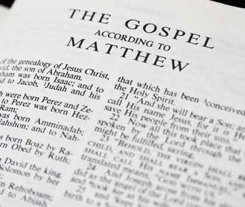
Great Expectations
Mt 5:13-48

Slide 2
Example (13-16)
Matthew 5:13-16 New King James Version (NKJV)
Believers Are Salt and Light
¹³ “You are the salt of the earth; but if the salt loses its flavor, how shall it be seasoned? It is then good for nothing but to be thrown out and trampled underfoot by men.
¹⁴ “You are the light of the world. A city that is set on a hill cannot be hidden. ¹⁵ Nor do they light a lamp and put it under a basket, but on a lampstand, and it gives light to all who are in the house. ¹⁶ Let your light so shine before men, that they may see your good works and glorify your Father in heaven.

Slide 3
Example Salt and Light
Salt tops decay
The world is in moral decay and needs Christians to keep it from going bad
Salt cleanses
As Christians we act as salt by living pure lives in the world
Salt is an anti-septic which cleans wounds and fights infection
Salt in a wound can hurt… it hurts others’ conscience when they see how Christians live

Slide 4
Example Salt and Light
Salt Preserves
Christians act as a preserving influence when we stand up for what is right and Godly
We cannot stop the world from going bad if we go along with it
Salt adds flavor (makes more attractive)
We attract people to the Word of God by how we live
Christians are to be an active positive influence

Slide 5
Example Salt and Light
The World is in darkness
The darkness of sin, ignorance, and rebellion
Light shines
We should stand out as follower of Jesus and look different then others in the world

Slide 6
Example Salt and Light
Light illuminates
Christians make the world aware of the path to God
We are to make other aware of who Jesus is an what He has done for us
Light reveals
Christians are to show by word and deed the life God wants all man to live
When a Christian’s light shines
Others see their good deeds
God is glorified

Slide 7
obedience (17-20)
Matthew 5:17-20 New King James Version
¹⁷ “Do not think that I came to destroy the Law or the Prophets. I did not come to destroy but to fulfill. ¹⁸ For assuredly, I say to you, till heaven and earth pass away, one jot or one tittle will by no means pass from the law till all is fulfilled. ¹⁹ Whoever therefore breaks one of the least of these commandments, and teaches men so, shall be called least in the kingdom of heaven; but whoever does and teaches them, he shall be called great in the kingdom of heaven. ²⁰ For I say to you, that unless your righteousness exceeds the righteousness of the scribes and Pharisees, you will by no means enter the kingdom of heaven.

Slide 8
Obedience (17-20)
Greatness follows obedience to the God’s law (19)
Whoever does and teaches God’s will shall be great in the Kingdom of heaven
Whoever breaks one of the least of God’s commandments or teaches others to do so will be called least in the Kingdom of Heaven
Jesus fulfilled the law so we can faithfully obey the commands of the Father

Slide 9
Gentleness (21-26)
Matthew 5:21-26 New King James Version
²¹ “You have heard that it was said to those of old, ‘You shall not murder, and whoever murders will be in danger of the judgment.’ ²² But I say to you that whoever is angry with his brother without a cause shall be in danger of the judgment. And whoever says to his brother, ‘Raca!’[ shall be in danger of the council. But whoever says, ‘You fool!’ shall be in danger of hell fire. ²³ Therefore if you bring your gift to the altar, and there remember that your brother has something against you, ²⁴ leave your gift there before the altar, and go your way. First be reconciled to your brother, and then come and offer your gift. ²⁵ Agree with your adversary quickly, while you are on the way with him, lest your adversary deliver you to the judge, the judge hand you over to the officer, and you be thrown into prison. ²⁶ Assuredly, I say to you, you will by no means get out of there till you have paid the last penny.

Slide 10
Gentleness (21-26)
Whoever is angry with his brother without cause shall be in danger of judgment
Whoever says “Raca” shall be in danger of the council
Whoever says “You fool!” shall be in danger of Hell fire
Be reconciled to your brother, and then come offer your gift

Slide 11
purity (27-30)
Matthew 5:27-30 New King James Version
²⁷ “You have heard that it was said to those of old, ‘You shall not commit adultery.’ ²⁸ But I say to you that whoever looks at a woman to lust for her has already committed adultery with her in his heart. ²⁹ If your right eye causes you to]sin, pluck it out and cast it from you; for it is more profitable for you that one of your members perish, than for your whole body to be cast into hell. ³⁰ And if your right hand causes you to sin, cut it off and cast it from you; for it is more profitable for you that one of your members perish, than for your whole body to be cast into hell.

Slide 12
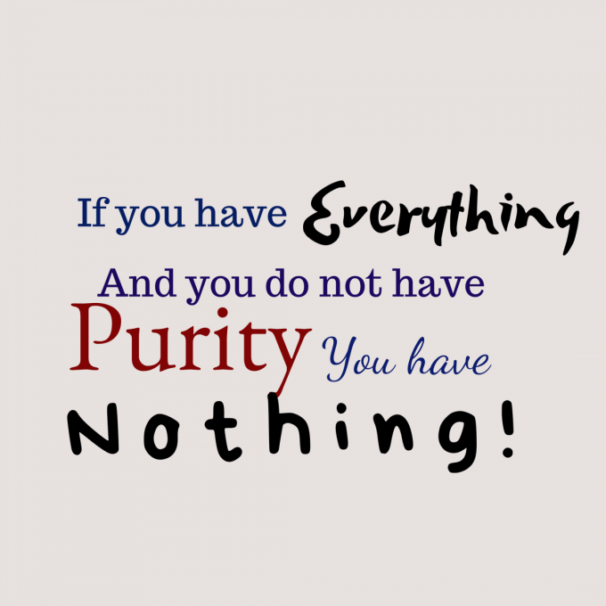
purity (27-30)
If your right eye causes you to sin, puck it out and cast it from you
If your right hand causes you to sin, cut it off and cast it from you
Beware of what you allow your eyes to see
Beware what you allow your hands to touch

Slide 13
purity (31-32)
Matthew 5:31-32 New King James Version
Marriage Is Sacred and Binding
³¹ “Furthermore it has been said, ‘Whoever divorces his wife, let him give her a certificate of divorce.’ ³² But I say to you that whoever divorces his wife for any reason except sexual immorality causes her to commit adultery; and whoever marries a woman who is divorced commits adultery.

Slide 14
truthfulness (33-37)
Matthew 5:33-37 New King James Version
³³ “Again you have heard that it was said to those of old, ‘You shall not swear falsely, but shall perform your oaths to the Lord.’ ³⁴ But I say to you, do not swear at all: neither by heaven, for it is God’s throne; ³⁵ nor by the earth, for it is His footstool; nor by Jerusalem, for it is the city of the great King. ³⁶ Nor shall you swear by your head, because you cannot make one hair white or black. ³⁷ But let your ‘Yes’ be ‘Yes,’ and your ‘No,’ ‘No.’ For whatever is more than these is from the evil one.

Slide 15
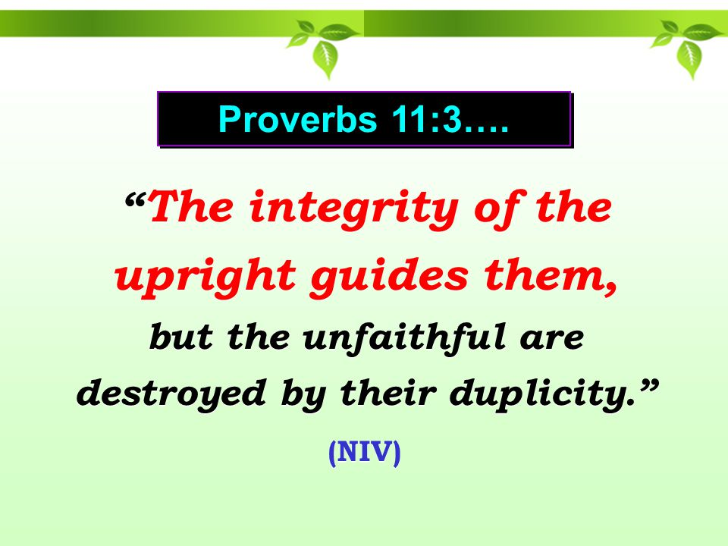
truthfulness (33-37)
Let your yes be yes and your no, no
Do not embellish your conversation with promises that are supposed to strengthen your words
Have enough integrity that people will simply believe what you say

Slide 16
Peace/assistance (38-42)
Matthew 5:38-42 New King James Version
³⁸ “You have heard that it was said, ‘An eye for an eye and a tooth for a tooth.’ ³⁹ But I tell you not to resist an evil person. But whoever slaps you on your right cheek, turn the other to him also. ⁴⁰ If anyone wants to sue you and take away your tunic, let him have your cloak also. ⁴¹ And whoever compels you to go one mile, go with him two. ⁴² Give to him who asks you, and from him who wants to borrow from you do not turn away.

Slide 17
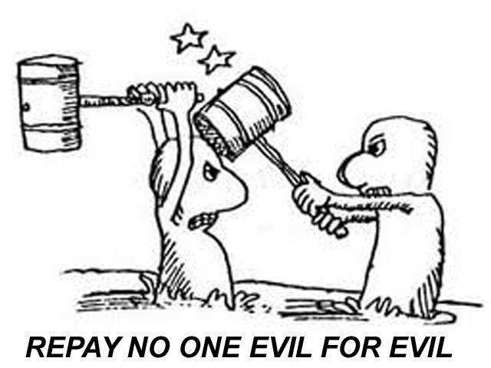
Peace/assistance (38-42)
Whoever slaps you on the right cheek, turn the other to him also
If someone wants to sue you and take your tunic, let him have your cloak also
Whoever compels you to go one mile, go with him two
Give to those who ask and do not turn away from one who wants to borrow

Slide 18
love (43-48)
Matthew 5:43-48 New King James Version
⁴³ “You have heard that it was said, ‘You shall love your neighbor and hate your enemy.’ ⁴⁴ But I say to you, love your enemies, bless those who curse you, do good to those who hate you, and pray for those who spitefully use you and persecute you, ⁴⁵ that you may be sons of your Father in heaven; for He makes His sun rise on the evil and on the good, and sends rain on the just and on the unjust. ⁴⁶ For if you love those who love you, what reward have you? Do not even the tax collectors do the same? ⁴⁷ And if you greet your brethren only, what do you do more than others? Do not even the tax collectors do so? ⁴⁸ Therefore you shall be perfect, just as your Father in heaven is perfect.

Slide 19
Love (43-48)
Not a suggestion, a command
Bless those who curse you, do good to those who hate you, pray for those who spitefully use you and persecute you
If you love those who love you, what reward have you?
If you greet your brethren only, what do you do more than others?

Slide 20
Great Expectations
How are you doing????

