Slide 2
What He didn’t ask…

Slide 3
What do people think of my teaching?
Would have been a great question
People came from all over to hear Him speak

Slide 4
What do people think of my teaching
People from all over the world have at least heard of Jesus’ teaching
People toady appreciate the various aspects of teachings attributed to Jesus

Slide 5
What are people saying about my miracles?
Jesus has performed many miracles up to this point in the book and there have been many different reactions
Many people throughout the world today will read about the miracles of Jesus and share them with their children even if they do not view them as factual

Slide 6
What are people saying about my commands?
Jesus presented many commands in His various times spent teaching and healing great crowds so there would have been a wide array of responses
Many people throughout the world today will share teachings from the sermon on the mount whether they believe Jesus is the Christ or not

Slide 7
Key Point
Jesus made the question of who He was absolutely central to His miracles, and to His teaching, and to His commands, and to everything that He did and said on this earth.
someone once said, you can remove Mohammed from his teaching and you would still have the basic tenants of Islam. You can remove Confucius from his principles and you would still have Confucianism. You can remove the Buddha from his instructions and you will still have Buddhism. You can remove almost every great philosopher in history from his or her philosophic principles and you would still leave their philosophic system intact. But if you remove Christ from Christianity, you will no longer have Christianity; because Jesus made His own identity the central theme of all that He taught and did and commanded.

Slide 8
What He did ask

Slide 9
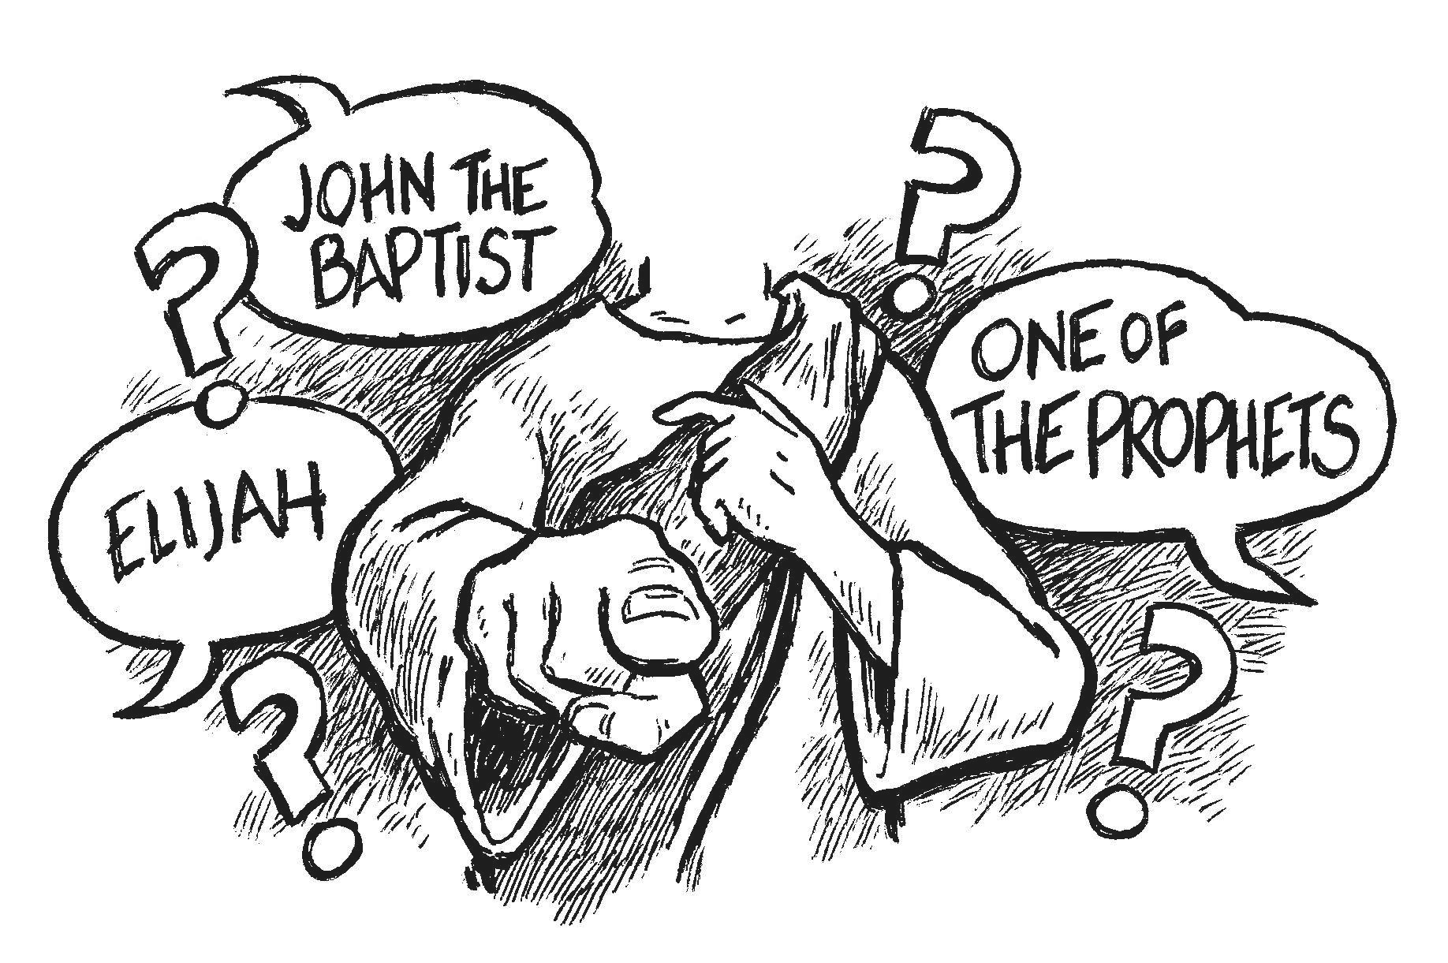
Who do men say that I am?
John the Baptist
Mark 6:14 New King James Version (NKJV)
¹⁴ Now King Herod heard of Him, for His name had become well known. And he said, “John the Baptist is risen from the dead, and therefore these powers are at work in him.”

Slide 10
Who do men say that I am?
Elijah
Malachi 4:5 New King James Version (NKJV)
⁵ Behold, I will send you Elijah the prophet Before the coming of the great and dreadful day of the Lord.

Slide 11
Who do men say that I am?
Jeremiah
Matthew 16:14 New King James Version (NKJV)
¹⁴ So they said, “Some say John the Baptist, some Elijah, and others Jeremiah or one of the prophets.”

Slide 12
Who do men say that I am?
One of the Prophets
Like Moses, Jesus declared the law of God
Like Isaiah, Jesus preached about holiness and sacrifice
Like Daniel, the message of Jesus was a prophetic message of a coming king and His kingdom

Slide 13
Who do men say that I am?
One of the Prophets
Like Jeremiah, Jesus ministry was one of compassion and brokenness
Like Hosea, Jesus loved the unlovable and desired to redeem the wretched, lost sinners

Slide 14
Who Do men today say that He is?
The Muslim says that Jesus was a prophet, but He was not crucified on a cross. He will return, but He is not God
The Hindu believes that Jesus is just one of millions of gods
The Jew believes that Jesus was a great prophet and teacher, but He is not God
The Jehovah’s Witnesses believe that Jesus was once the Archangel Michael before He came to the earth. In their view Jesus is not God in the flesh.

Slide 15
Who Do men today say that He is?
The atheist denies that Jesus ever existed at all
The agnostic just doesn’t know what to believe about Jesus
Society believes that Jesus was a great teacher; that He had some good ideas about loving your fellow man and being good to others, but they do not believe that He is the Savior, or that He is God in the flesh
Most people acknowledge His existence, but they refuse to bow to His authority or give Him the worship He deserves

