Slide 1
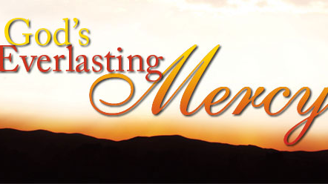

Slide 2
Introduction

Slide 3
Psalm 145:8-9 New King James Version (NKJV)
⁸ The Lord is gracious and full of compassion, Slow to anger and great in mercy. ⁹ The Lord is good to all, And His tender mercies are over all His works.

Slide 4
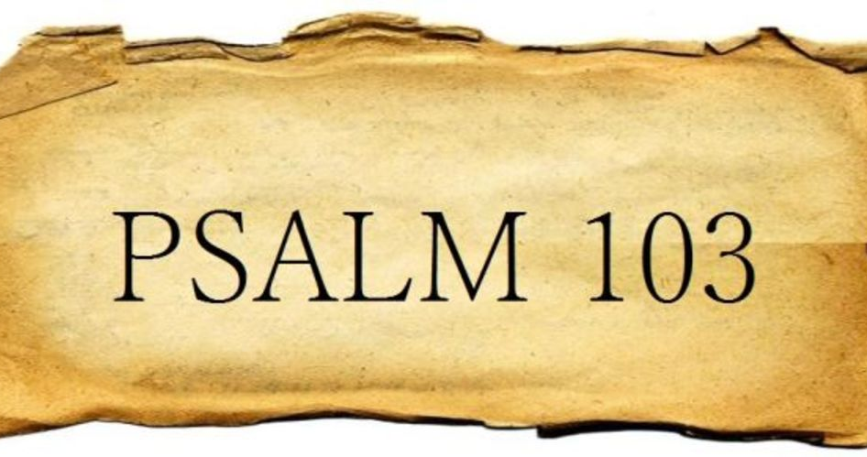

Slide 5
Mercy in Abundance
Psalm 103:8 New King James Version (NKJV)
⁸ The Lord is merciful and gracious, Slow to anger, and abounding in mercy.
Definition of abundance
1 : an ample quantity : an abundant amount
2: relative degree of plentifulness
3: an extremely plentiful or oversufficient quantity or supply

Slide 6
A Comparison
Psalm 103:11 New King James Version (NKJV)
¹¹ For as the heavens are high above the earth, So great is His mercy toward those who fear Him;
“The heavens - the starry heavens - are the highest objects of which we have any knowledge; and hence, the comparison is used to denote the great mercy of God - meaning that it is as great as can be conceived; that there is nothing beyond it; that we cannot imagine that it could be greater - as we can imagine nothing higher than the heavens. “(Banes)

Slide 7
Mercy in Regard to Anger
Psalm 103:8 New King James Version (NKJV)
⁸ The Lord is merciful and gracious, Slow to anger, and abounding in mercy.
Psalm 103:9 New King James Version (NKJV)
⁹ He will not always strive with us, Nor will He keep His anger forever.

Slide 8
Mercy in Regard to Our Sin
Psalm 103:10 New King James Version (NKJV)
¹⁰ He has not dealt with us according to our sins, Nor punished us according to our iniquities.
Psalm 103:12 New King James Version (NKJV)
¹² As far as the east is from the west, So far has He removed our transgressions from us.

Slide 9
Mercy that Requires our Response
Psalm 103:11 New King James Version (NKJV)
¹¹ For as the heavens are high above the earth, So great is His mercy toward those who fear Him;
Psalm 103:17-18 New King James Version (NKJV)
¹⁷ But the mercy of the Lord is from everlasting to everlasting On those who fear Him, And His righteousness to children’s children, ¹⁸ To such as keep His covenant, And to those who remember His commandments to do them.

