Slide 1
John 14:1-11

Slide 2
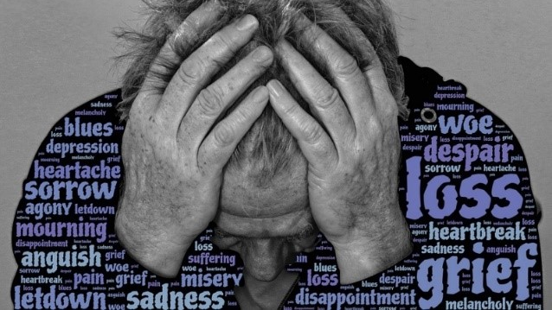

Slide 3
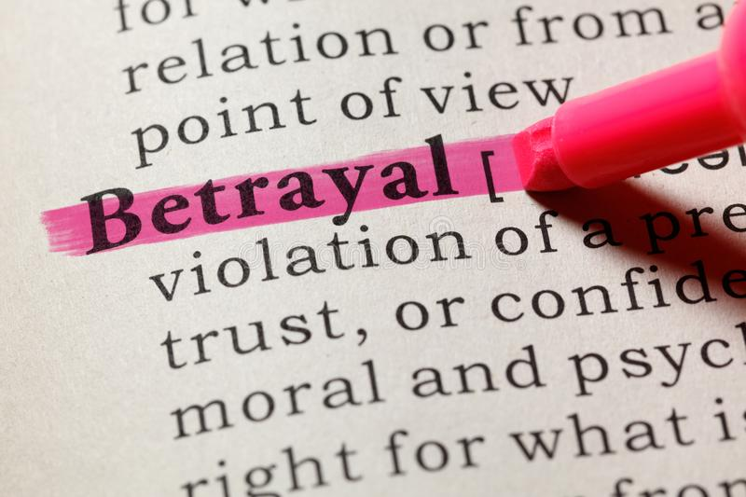
Reasons for a troubled heart
John 13:21 New King James Version (NKJV)
²¹ When Jesus had said these things, He was troubled in spirit, and testified and said, “Most assuredly, I say to you, one of you will betray Me.”

Slide 4
Reasons for a troubled heart
John 13:36 New King James Version (NKJV)
³⁶ Simon Peter said to Him, “Lord, where are You going?”
Jesus answered him, “Where I am going you cannot follow Me now, but you shall follow Me afterward.”

Slide 5
Reasons for a troubled heart
John 13:37-38 New King James Version
³⁷ Peter said to Him, “Lord, why can I not follow You now? I will lay down my life for Your sake.”
³⁸ Jesus answered him, “Will you lay down your life for My sake? Most assuredly, I say to you, the rooster shall not crow till you have denied Me three times.

Slide 6
Reasons for a troubled heart
John 14:1 New King James Version 14 “Let not your heart be troubled; you believe in God, believe also in Me.

Slide 7
Reasons to trust him
John 14:2 New King James Version
² In My Father’s house are many mansions; if it were not so, would have told you. I go to prepare a place for you.

Slide 8
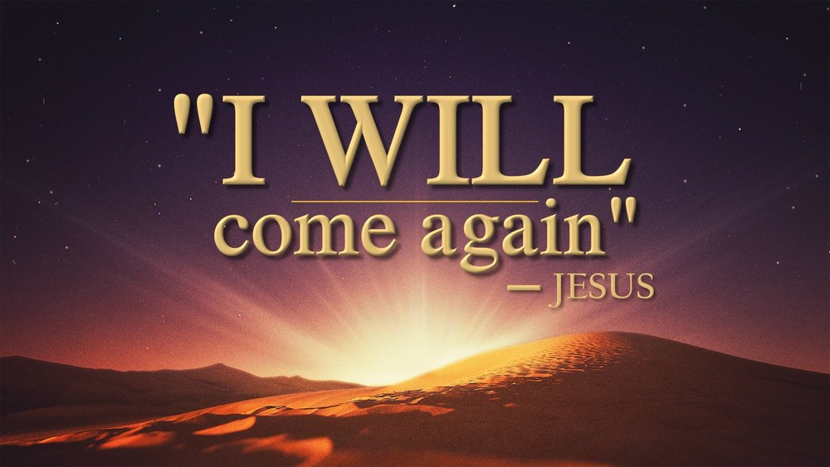
Reasons to trust him
John 14:3 New King James Version
³ And if I go and prepare a place for you, I will come again and receive you to Myself; that where I am, there you may be also.

Slide 9
Reasons to trust him
John 14:4-6 New King James Version
⁴ And where I go you know, and the way you know.”
⁵ Thomas said to Him, “Lord, we do not know where You are going, and how can we know the way?”
⁶ Jesus said to him, “I am the way, the truth, and the life. No one comes to the Father except through Me.

Slide 10
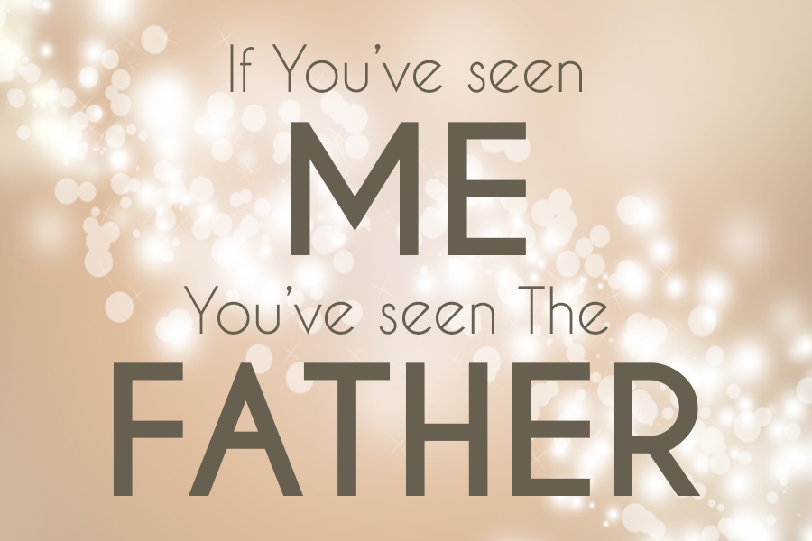
Reasons to trust him
John 14:7-11 New King James Version (NKJV)
⁷ “If you had known Me, you would have known My Father also; and from now on you know Him and have seen Him.”
⁸ Philip said to Him, “Lord, show us the Father, and it is sufficient for us.”
⁹ Jesus said to him, “Have I been with you so long, and yet you have not known Me, Philip? He who has seen Me has seen the Father; so how can you say, ‘Show us the Father’? ¹⁰ Do you not believe that I am in the Father, and the Father in Me? The words that I speak to you I do not speak on My own authority; but the Father who dwells in Me does the works. ¹¹ Believe Me that I am in the Father and the Father in Me, or else believe Me for the sake of the works themselves.

Slide 11
Key points 14:7-11
“If you had known Me, you would have known My Father also;
“from now on you know Him and have seen Him.”
“He who has seen Me has seen the Father”
“Do you not believe that I am in the Father, and the Father in Me?”
“the Father who dwells in Me does the works”
“Believe Me that I am in the Father and the Father in Me”

Slide 12
