Slide 2
Genesis 1:1 Deut. 33:27 Psalm 102:25-27
Notes:
Deut 33:27 “²⁷ The eternal God is your refuge, And underneath are the everlasting arms; He will thrust out the enemy from before you, And will say, ‘Destroy!’
Ps 102:25-27 “²⁵ Of old You laid the foundation of the earth, And the heavens are the work of Your hands. ²⁶ They will perish, but You will ^{[a]}endure; Yes, they will all grow old like a garment; Like a cloak You will change them, And they will be changed. ²⁷ But You are the same, And Your years will have no end.

Slide 3
Genesis 1:2
The earth was with out form and void
Darkness was on the face of the deep
The Spirit of God moved to bring change
The spirt of God can bring change in our lives as well

Slide 4
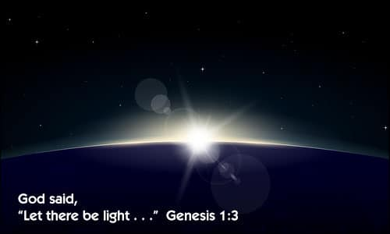
Gen 1:3-5
God is the source of light
Ex 34:28-35
1 Jn 1:5
God brings His light to us through His word
Ps 119:105
Ps 119:30

Slide 5
Genesis 1:6-8
The dividing of the waters formed the atmosphere
The earth is being prepared for life
God uses the cross as a divider
Preparing man for eternal life
There is no neutral ground with the cross
The two thieves on either side of Jesus (Lk 23:39-43)

Slide 6
Gen 1:9-13
God divided the water and the land
God called the dry land earth
God called the gathering of the waters, seas
God prepared the earth
Grass and herbs
Fruit trees
God calls mankind to bear the fruits of the Spirit
Gal 5:22-23

Slide 7
God can create a new life in you

