Slide 1
Nehemiah chapter 1
A report given
A response to this report
A request made

Slide 2
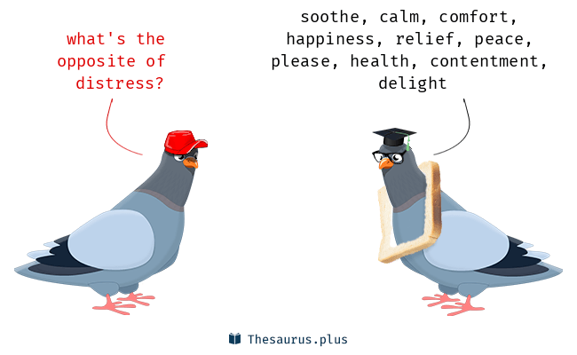
The Report (Vs 1-3)
“The survivors who are left from the captivity in the province are there in great distress and reproach.”

Slide 3
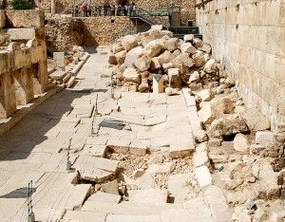
The Report (Vs 1-3)
“The wall of Jerusalem is also broken down, and its gates are burned with fire.”

Slide 4
How are our walls doing?
2 Cor. 6:17
Mt 5:14-16
Phil 2:15-16

Slide 5
Response to the report (vs 4-10)
“I sat down and wept, and mourned for many days;”

Slide 6
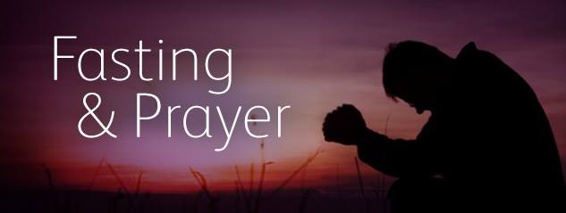
Response to the report (vs 4-10)
“I was fasting and praying before the God of heaven.”

Slide 7
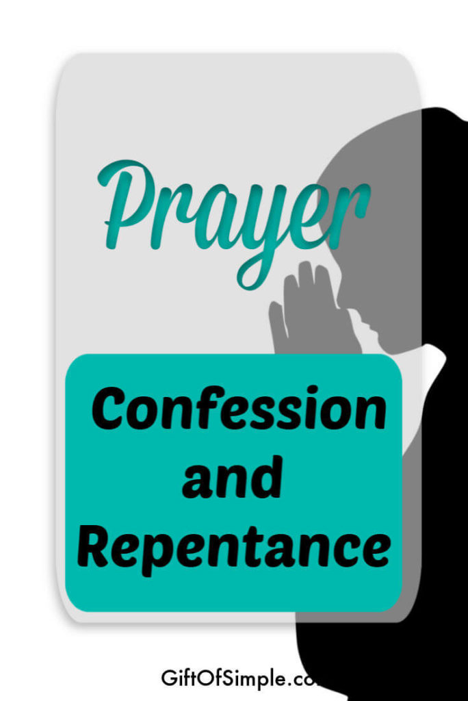
Response to the report (vs 4-10)
“I pray before You now, day and night, for the children of Israel Your servants, and confess the sins of the children of Israel which we have sinned against You. Both my father’s house and I have sinned. ⁷ We have acted very corruptly against You”

Slide 8
Response to the report (vs 4-10)
“⁸ Remember, I pray, the word that You commanded Your servant Moses,…if you return to Me, and keep My commandments and do them, though some of you were cast out to the farthest part of the heavens, yet I will gather them from there, and bring them to the place which I have chosen as a dwelling for My name.

Slide 9
How do I respond to tough reports?
Do I feel sympathy and respond to brothers and sisters in need?
Am I willing to confess my sins and repent when I have sinned?
Do I know enough about God’s promises to remember and claim them?

Slide 10
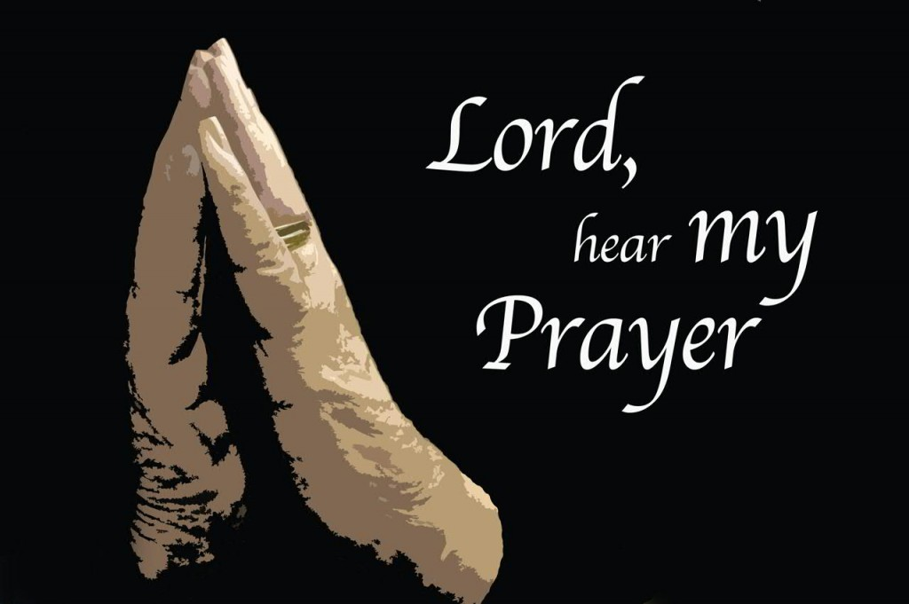
Request made (vs 11)
“I pray, please let Your ear be attentive to the prayer of Your servant, and to the prayer of Your servants who desire to fear Your name”

Slide 11
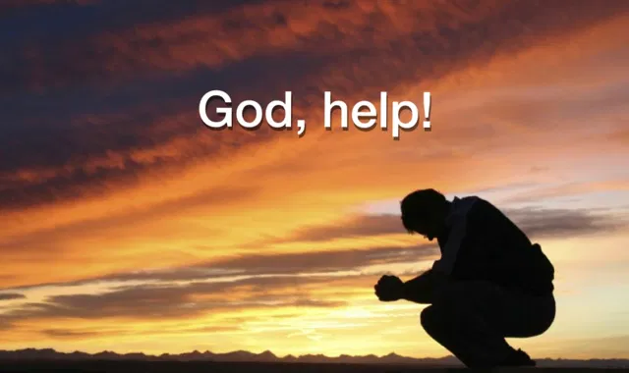
Request made (vs 11)
“let Your servant prosper this day, I pray, and grant him mercy in the sight of this man.” For I was the king’s cupbearer.

Slide 12
Nehemiah chapter 1
A report given
A response to this report
A request made

