Slide 1
LOVE

Slide 2
Facts about love
The hinge on which the law and prophets hang

Slide 3
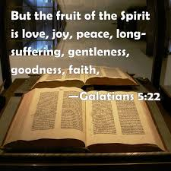
Facts about love
A part of the fruit of the Spirit

Slide 4
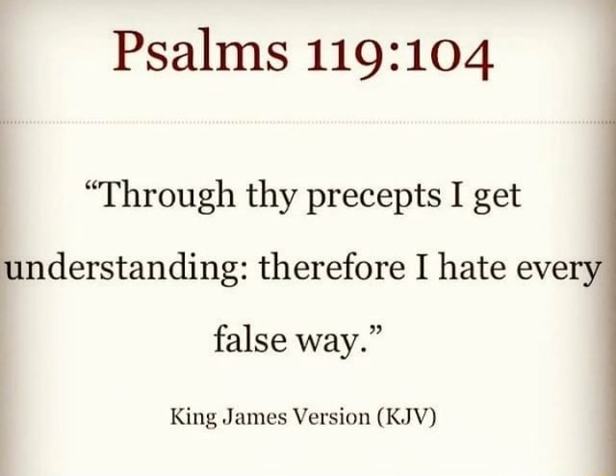
Facts about love
Demands the truth and hates what is false

Slide 5
Facts about love
Requires that we love our enemies

Slide 6
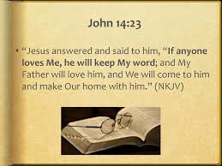
Facts about love
Motivates one to obey

Slide 7
Facts about love
How we are to speak the truth of God

Slide 8
Facts about love
Both corrects and accepts correction

Slide 9
Facts about love

Slide 10
Facts about love
Is of God and proof that one knows God

Slide 11
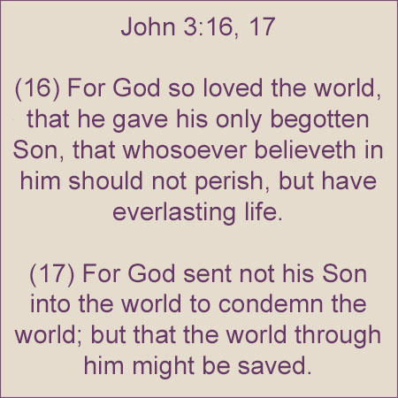
Facts about love
Is the reason God sent His son and we have a hope of salvation

