Slide 1
What is it really? Do I really need it?

Slide 2
Gentleness/meekness defined
Gentleness [N]
Sensitivity of disposition and kindness of behavior, founded on strength and prompted by love
Power under control
Synonymous with meekness

Slide 3
Examples of gentleness/meekness
Exodus 32:19 New King James Version (NKJV)
¹⁹ So it was, as soon as he came near the camp, that he saw the calf and the dancing. So Moses’ anger became hot, and he cast the tablets out of his hands and broke them at the foot of the mountain.
Exodus 32:32 New King James Version (NKJV)
³² Yet now, if You will forgive their sin—but if not, I pray, blot me out of Your book which You have written.”
Notes:
Moses was a man of passion and compassion
This combination made him a great leader

Slide 4
Examples of gentleness/meekness
Notes:
Moses was a man of passion and compassion
This combination made him a great leader

Slide 5
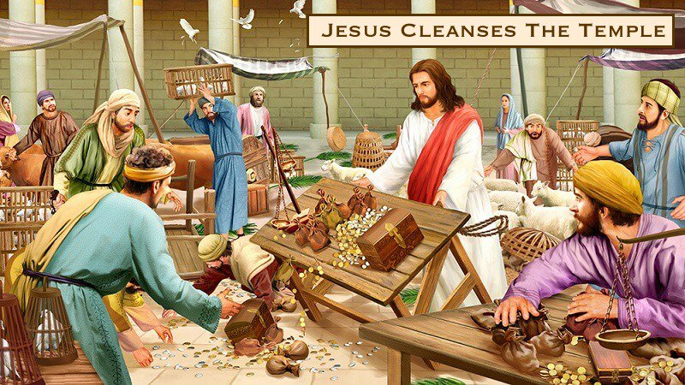
Examples of gentleness/meekness
Notes:
Mt 21: 12-13 “¹² Then Jesus went into the temple ^{[a]}of God and drove out all those who bought and sold in the temple, and overturned the tables of the money changers and the seats of those who sold doves. ¹³ And He said to them, “It is written, ‘My house shall be called a house of prayer,’ but you have made it a ‘den of thieves.’ ”

Slide 6
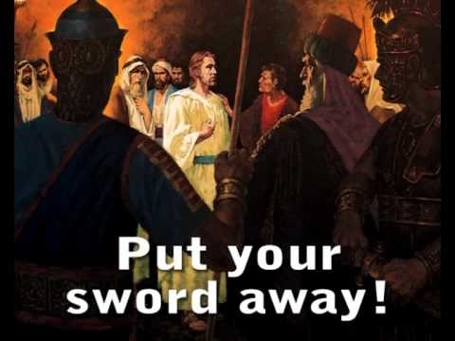
Examples of gentleness/meekness
Notes:
Mt 26:52=56 “⁵² But Jesus said to him, “Put your sword in its place, for all who take the sword will ^{[j]}perish by the sword. ⁵³ Or do you think that I cannot now pray to My Father, and He will provide Me with more than twelve legions of angels? ⁵⁴ How then could the Scriptures be fulfilled, that it must happen thus?”
⁵⁵ In that hour Jesus said to the multitudes, “Have you come out, as against a robber, with swords and clubs to take Me? I sat daily with you, teaching in the temple, and you did not seize Me. ⁵⁶ But all this was done that the Scriptures of the prophets might be fulfilled.”

Slide 7
Gentleness is needed in my life to…

Slide 8
Gentleness needed in my life when…
Galatians 6:1 New King James Version (NKJV)
“6 Brethren, if a man is overtaken in any trespass, you who are spiritual restore such a one in a spirit of gentleness, considering yourself lest you also be tempted.”

Slide 9
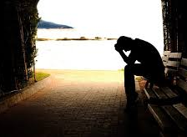
Gentleness is needed in my life when suffering for righteousness sake
1 Peter 3:14-16 New King James Version (NKJV)
¹⁴ But even if you should suffer for righteousness’ sake, you are blessed. “And do not be afraid of their threats, nor be troubled.” ¹⁵ But sanctify the Lord God in your hearts, and always be ready to give a defense to everyone who asks you a reason for the hope that is in you, with meekness and fear; ¹⁶ having a good conscience, that when they defame you as evildoers, those who revile your good conduct in Christ may be ashamed.”

Slide 10
