Slide 2
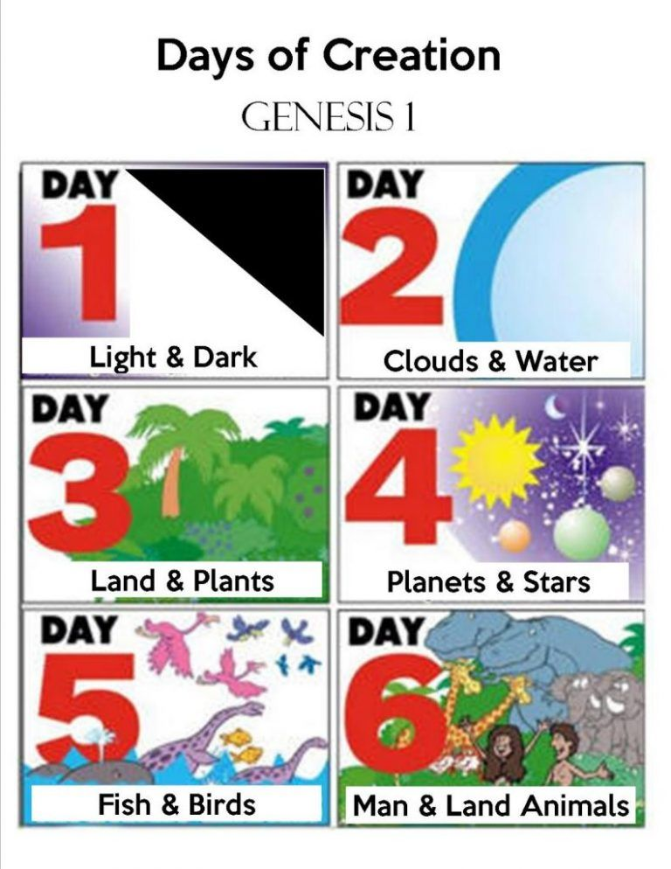
Purpose and Design (Genesis 1)

Slide 3
Purpose and design Genesis 2
Gen 2:4-6
No rain on the earth
No man to till the ground
God sent up a mist from the ground
Gen 2:7-9
God created man
God planted a garden in Eden and placed the man there
God made the trees pleasant to the eye and for food
The tree of life and the tree of the knowledge of good and evil in the garden

Slide 4
Purpose and design Genesis 2
Gen 2:15-17
Man expected to tend and keep the garden
The freedom to eat of any tree except one
The consequence stated for disobedience
Gen 2:18-24
Not good for man to be alone
God brings His creatures to Adam
No helper comparable to Adam
God created woman from man
A man shall leave father and mother and be joined to his wife

Slide 6
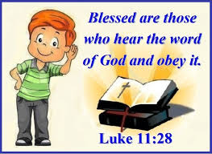
Hear God’s Word

Slide 7
Believe
John 8:23-24 New King James Version
²³ And He said to them, “You are from beneath; I am from above. You are of this world; I am not of this world. ²⁴ Therefore I said to you that you will die in your sins; for if you do not believe that I am He, you will die in your sins.”
Mark 16:16 New King James Version
¹⁶ He who believes and is baptized will be saved; but he who does not believe will be condemned.

Slide 8
Repent
Acts 2:38 New King James Version (NKJV)
³⁸ Then Peter said to them, “Repent, and let every one of you be baptized in the name of Jesus Christ for the remission of sins; and you shall receive the gift of the Holy Spirit.
2 Peter 3:9 New King James Version (NKJV)
⁹ The Lord is not slack concerning His promise, as some count slackness, but is longsuffering toward us, not willing that any should perish but that all should come to repentance.

Slide 9
Notes:
Romans 10:8-10 New King James Version (NKJV)
⁸ But what does it say? “The word is near you, in your mouth and in your heart” (that is, the word of faith which we preach): ⁹ that if you confess with your mouth the Lord Jesus and believe in your heart that God has raised Him from the dead, you will be saved. ¹⁰ For with the heart one believes unto righteousness, and with the mouth confession is made unto salvation.

Slide 10
Baptism

Slide 11
Remain Faithful
Notes:
Hebrews 12:14-15 New King James Version (NKJV)
¹⁴ Pursue peace with all people, and holiness, without which no one will see the Lord: ¹⁵ looking carefully lest anyone fall short of the grace of God; lest any root of bitterness springing up cause trouble, and by this many become defiled;

Slide 12
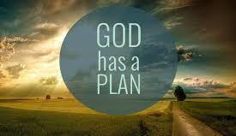
Conclusion

