Slide 1
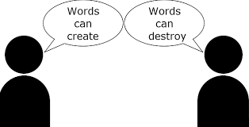
Matt 12:37

Slide 5
A Contrast

Slide 6
We are living in trying times
Do you have it?
Are you going to give it to me?
Am I touching something you touched?
Are we breathing the same air?
What about masks?

Slide 7
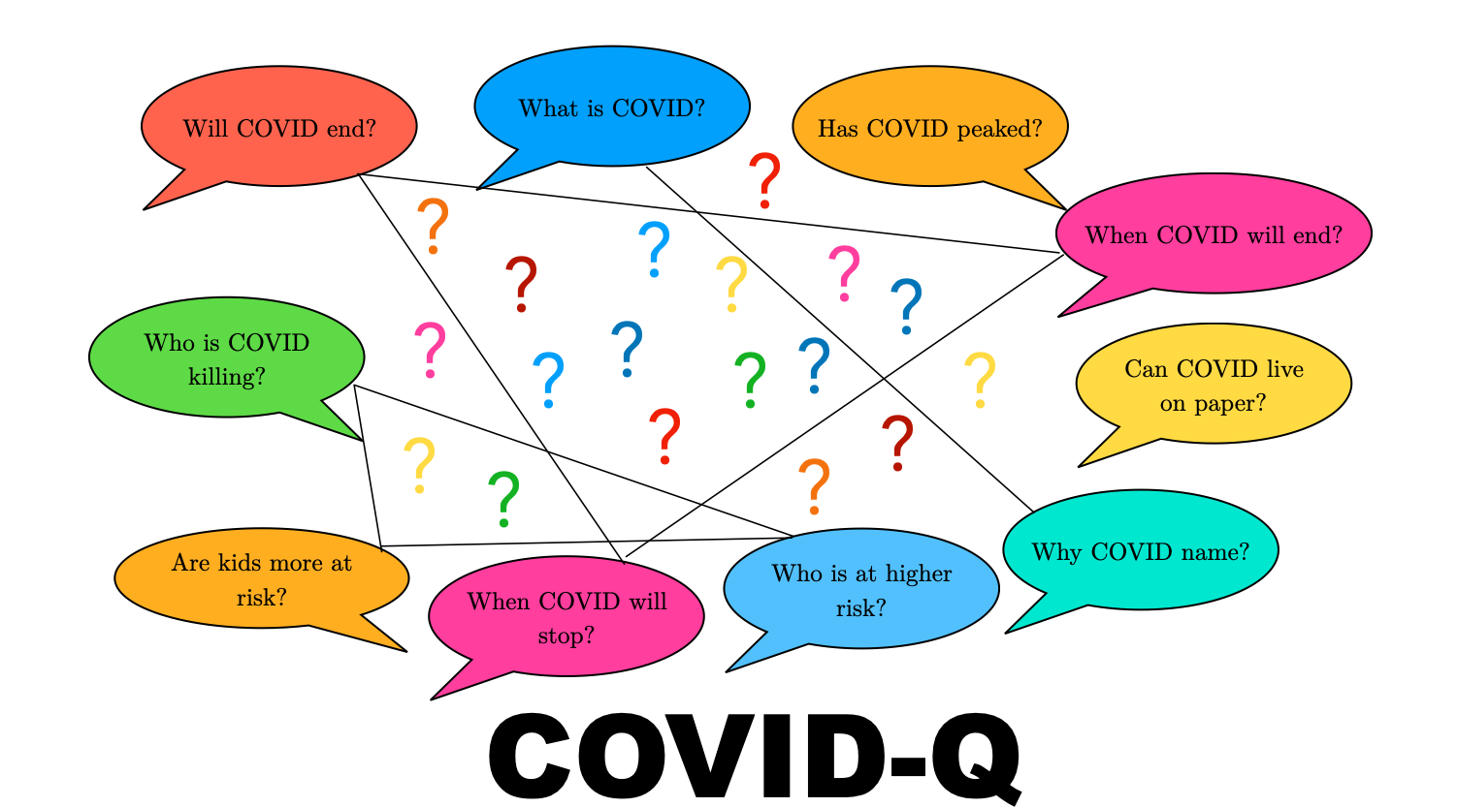

Slide 8
The solution
Are My words acceptable to Him?
Do my words bring life and hope?
Are my words an encouragement to others?
Being apart does not mean we stop encouraging others

Slide 9
Ask yourself
Am I doing all I can as a Christian?
Who can I reach out to today?
Who can I encourage with a card, call, text or email?
Who am I going to pray for today?

Slide 10
conclusion

