Slide 1
What if Christ had not risen?
1 Cor 15:12-19, 1-8

Slide 2
W - E - L - L - I - N - G - T - O - N - - D - E - F - E - A - T - E - D -
June 18, 1815
the Battle of Waterloo
- T - H - E - - -
E - N - E - M – Y-

Slide 3
What if Christ had not risen? He would be a liar
Matthew 12:40 New King James Version (NKJV)
⁴⁰ For as Jonah was three days and three nights in the belly of the great fish, so will the Son of Man be three days and three nights in the heart of the earth.
Matthew 16:21 New King James Version (NKJV)
²¹ From that time Jesus began to show to His disciples that He must go to Jerusalem, and suffer many things from the elders and chief priests and scribes, and be killed, and be raised the third day.

Slide 4
What if Christ had not risen? There is no gospel
1 Corinthians 15:3-5 New King James Version (NKJV)
³ For I delivered to you first of all that which I also received: that Christ died for our sins according to the Scriptures, ⁴ and that He was buried, and that He rose again the third day according to the Scriptures,

Slide 5
What if Christ had not risen? There is no gospel
1 Corinthians 15:3-5 New King James Version (NKJV)
³ For I delivered to you first of all that which I also received: that Christ died for our sins according to the Scriptures, ⁴ and that He was buried, and that He rose again the third day according to the Scriptures,

Slide 6
What if Christ had not risen? Our preaching and your faith is empty
1 Corinthians 15:14 New King James Version (NKJV)
¹⁴ And if Christ is not risen, then our preaching is empty and your faith is also empty.

Slide 7
What if Christ had not risen? your faith is futile
1 Corinthians 15:17 New King James Version (NKJV)
¹⁷ And if Christ is not risen, your faith is futile; you are still in your sins!

Slide 8
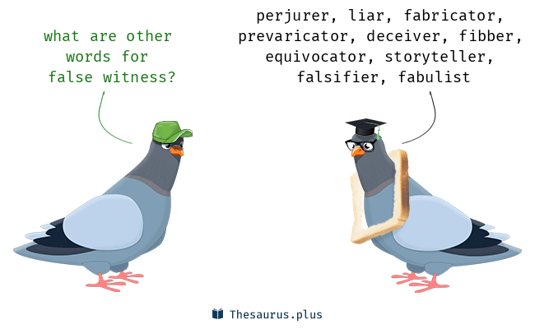
What if Christ had not risen? We are spreading a lie
1 Corinthians 15:15 New King James Version (NKJV)
¹⁵ Yes, and we are found false witnesses of God, because we have testified of God that He raised up Christ, whom He did not raise up—if in fact the dead do not rise.

Slide 9
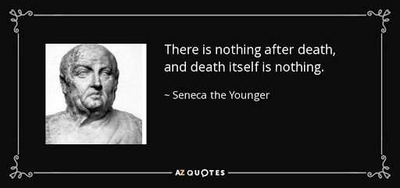
What if Christ had not risen? We have no hope for the future
1 Corinthians 15:18 New King James Version (NKJV)
¹⁸ Then also those who have fallen asleep in Christ have perished.

Slide 10
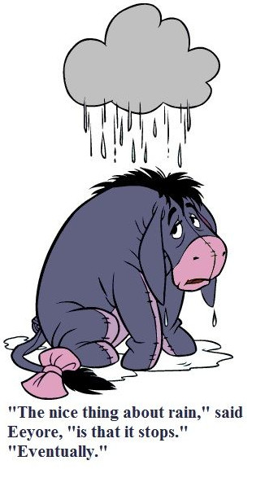
What if Christ had not risen? We are most pitiable
1 Corinthians 15:19 New King James Version (NKJV)
¹⁹ If in this life only we have hope in Christ, we are of all men the most pitiable.

Slide 11
The good news is Christ did rise from the grave

