Slide 1
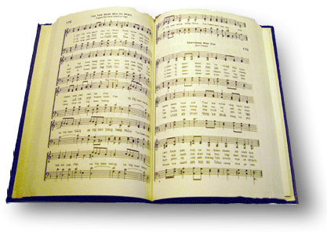
Jesus is all the World To me
Song #451

Slide 2
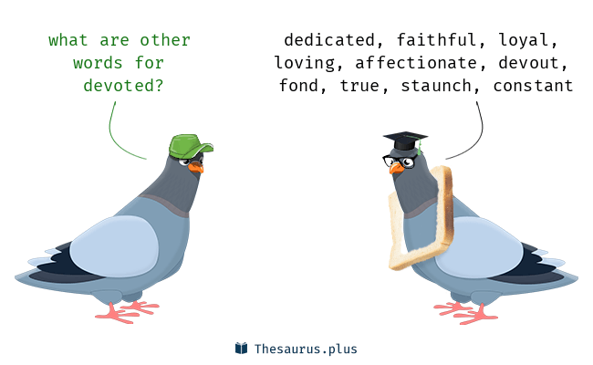
Jesus is all the world to me, and true to Him I’ll be, oh, how could I this friend deny when He’s so true to me?
Matthew 6:24 New King James Version
²⁴ “No one can serve two masters; for either he will hate the one and love the other, or else he will be loyal to the one and despise the other. You cannot serve God and mammon.”
Revelation 2:10 New King James Version
“…Be faithful until death, and I will give you the crown of life.”

Slide 3
Jesus is all the world to me, and true to Him I’ll be, oh, how could I this friend deny when He’s so true to me?
John 6:66-69 New King James Version
⁶⁶ From that time many of His disciples went back and walked with Him no more. ⁶⁷ Then Jesus said to the twelve, “Do you also want to go away?”
⁶⁸ But Simon Peter answered Him, “Lord, to whom shall we go? You have the words of eternal life. ⁶⁹ Also we have come to believe and know that You are the Christ, the Son of the living God.”

Slide 4
Jesus is all the world to me, and true to Him I’ll be, oh, how could I this friend deny when He’s so true to me?
Acts 4:18-20 New King James Version
¹⁸ So they called them and commanded them not to speak at all nor teach in the name of Jesus. ¹⁹ But Peter and John answered and said to them, “Whether it is right in the sight of God to listen to you more than to God, you judge. ²⁰ For we cannot but speak the things which we have seen and heard.”

Slide 5
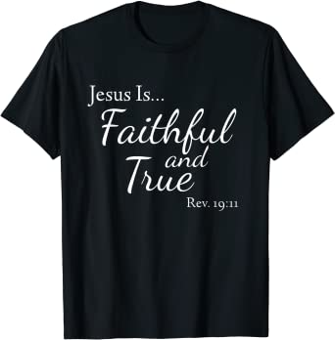
Jesus is all the world to me, and true to Him I’ll be, oh, how could I this friend deny when He’s so true to me?
2 Thessalonians 3:3 New King James Version
³ But the Lord is faithful, who will establish you and guard you from the evil one.
Hebrews 10:23 New King James Version
²³ Let us hold fast the confession of our hope without wavering, for He who promised is faithful.
1 John 1:9 New King James Version
⁹ If we confess our sins, He is faithful and just to forgive us our sins and to cleanse us from all unrighteousness.

Slide 6
Jesus is all the world to me, and true to Him I’ll be, oh, how could I this friend deny when He’s so true to me?
Revelation 19:11 New King James Version
¹¹ Now I saw heaven opened, and behold, a white horse. And He who sat on him was called Faithful and True, and in righteousness He judges and makes war.

Slide 7
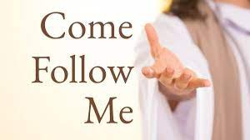
Following him I know I’m right; he watches o’er me day and night: following him, by day and night, he’s my friend
Matthew 7:13-14 New King James Version
¹³ “Enter by the narrow gate; for wide is the gate and broad is the way that leads to destruction, and there are many who go in by it. ^{14 [a]}Because narrow is the gate and ^{[b]}difficult is the way which leads to life, and there are few who find it.

Slide 8
Following him I know I’m right; he watches o’er me day and night: following him, by day and night, he’s my friend
Matthew 16:24 New King James Version
²⁴ Then Jesus said to His disciples, “If anyone desires to come after Me, let him deny himself, and take up his cross, and follow Me.
John 8:12 New King James Version
¹² Then Jesus spoke to them again, saying, “I am the light of the world. He who follows Me shall not walk in darkness, but have the light of life.”
1 Peter 2:21 New King James Version
²¹ For to this you were called, because Christ also suffered for us, leaving us an example, that you should follow His steps:

Slide 9
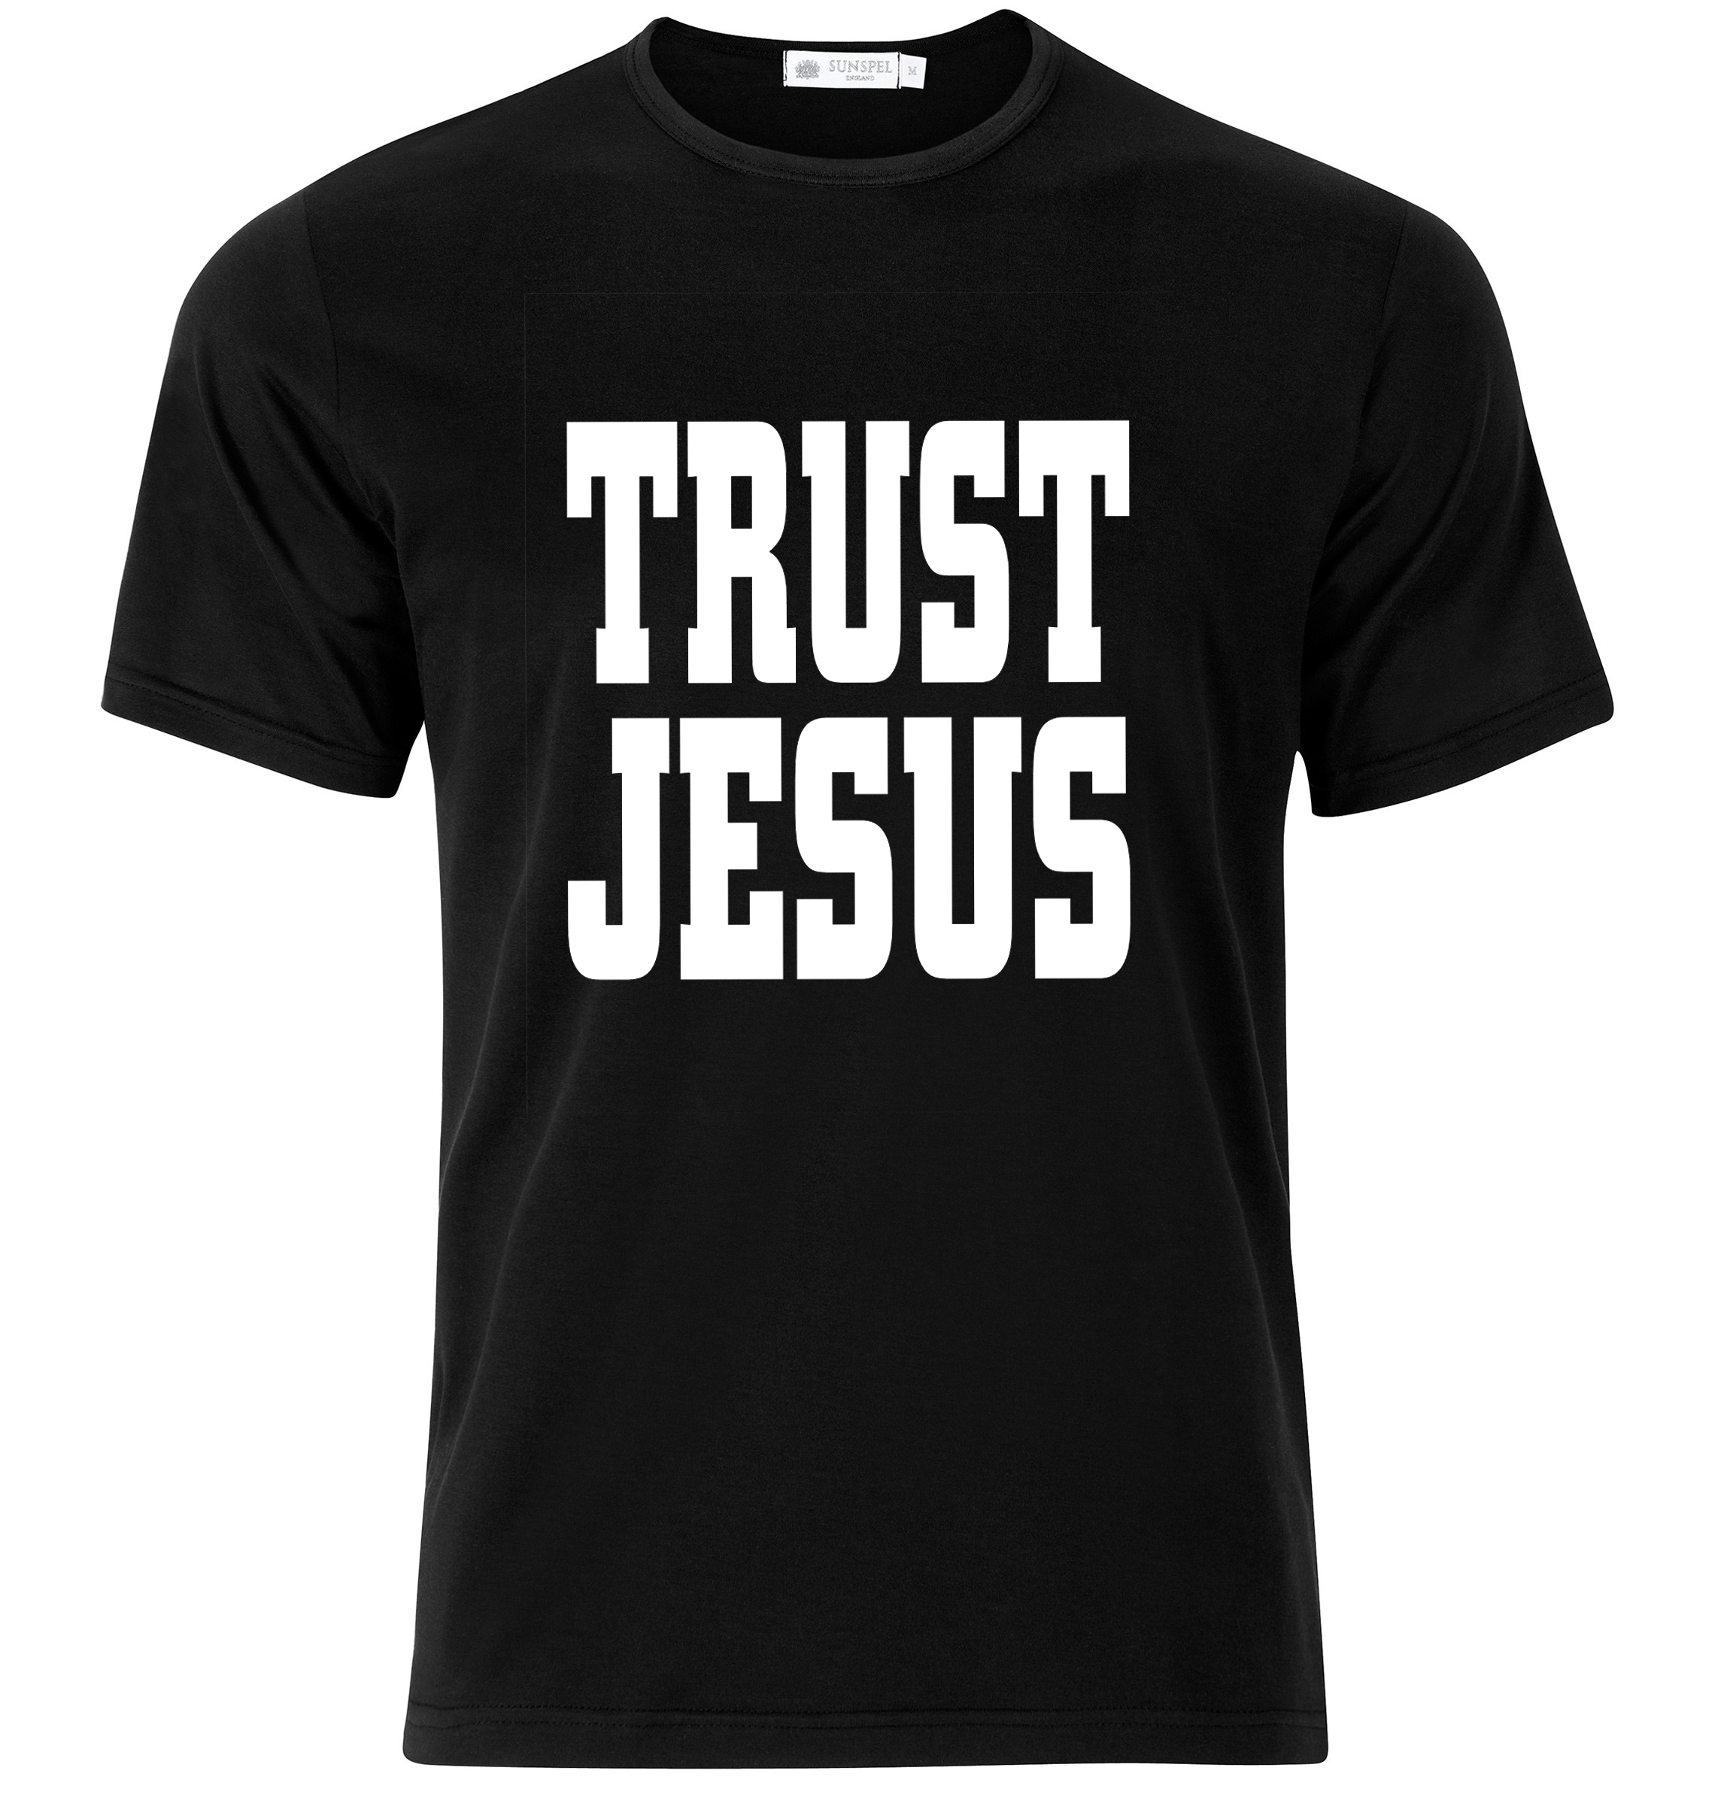
Jesus is all the world to me, I want no better friend; I trust him now, I’ll trust him when life’s fleeting days shall end
Ephesians 1:11-14 New King James Version (NKJV)
¹¹ In Him also we have obtained an inheritance, being predestined according to the purpose of Him who works all things according to the counsel of His will, ¹² that we who first trusted in Christ should be to the praise of His glory.
¹³ In Him you also trusted, after you heard the word of truth, the gospel of your salvation; in whom also, having believed, you were sealed with the Holy Spirit of promise, ¹⁴ who is the guarantee of our inheritance until the redemption of the purchased possession, to the praise of His glory.

Slide 10
Jesus is all the world to me, I want no better friend; I trust him now, I’ll trust him when life’s fleeting days shall end
James 4:14 New King James Version
¹⁴ whereas you do not know what will happen tomorrow. For what is your life? It is even a vapor that appears for a little time and then vanishes away.
Hebrews 9:27 New King James Version
²⁷ And as it is appointed for men to die once, but after this the judgment,
2 Corinthians 5:10 New King James Version (NKJV)
¹⁰ For we must all appear before the judgment seat of Christ, that each one may receive the things done in the body, according to what he has done, whether good or bad.

Slide 11
Beautiful life with such a friend; beautiful life that has no end; eternal life, eternal joy, he’s my friend
Mark 10:29-30 New King James Version
²⁹ So Jesus answered and said, “Assuredly, I say to you, there is no one who has left house or brothers or sisters or father or mother or wife or children or ands, for My sake and the gospel’s, ³⁰ who shall not receive a hundredfold now in this time—houses and brothers and sisters and mothers and children and lands, with persecutions—and in the age to come, eternal life.

Slide 12
Jesus is all the World To me

