Slide 1
Chapter 4: Nebuchadnezzar’s Second Dream

Slide 2
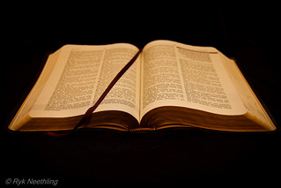
Nebuchadnezzar Declares God’s works to the people
Vs 1-3

Slide 3
Nebuchadnezzar troubled by his dream
Vs 4-18

Slide 4
Daniel interprets the dream
Vs 19-27

Slide 5
The vision becomes a reality
Vs 28-33

Slide 6
Nebuchadnezzar praises God and is restored
Vs 34-37

Slide 7
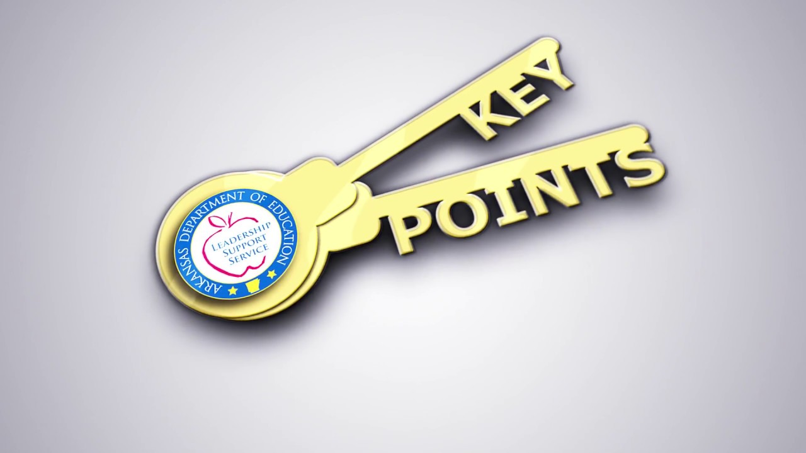
Pride and forgetting God leads to destruction
Be willing to offer Godly advice
God will do what He says He will do exactly how He says He will do it

Slide 8
Chapter 5: Belshazzar’s Feast

Slide 9
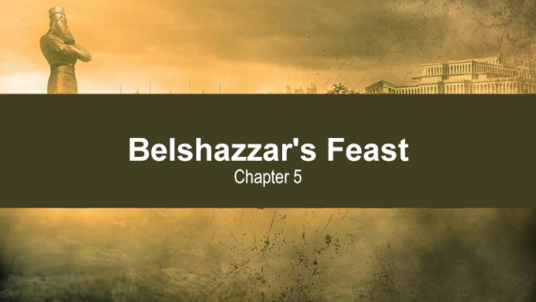
Belshazzar’s feast
Vs 1-5

Slide 10
Belshazzar is troubled by the writing and no one is able to interpret it
Vs 6-9

Slide 11
The queen advises to send for Daniel
Vs 10-12

Slide 12
The king calls for Daniel and offers a reward
Vs 13-16

Slide 13
Daniel interprets the writing
Vs 17-29

Slide 14
Belshazzar’s fall
Vs 30-31

Slide 15
Daniel’s reputation was well-known
Daniel had enough faith in God to speak directly to the king

Slide 16
Chapter 6: The Plot Against Daniel

Slide 17
King Darius places Daniel in a very high position
Vs 1-3

Slide 18
The jealousy of the governors and satraps
Vs 4-5

Slide 19
The deception by the governors and satraps
Vs 6-7

Slide 20
King Darius signs the decree
Vs 8-9

Slide 21
A trap is set based on the others’ knowledge that he prays to God regularly
Daniel continues to follow his custom of prayer to God despite his knowledge of the decree

Slide 22
How Did He Get To This Point?
Dan 6:10 Now when Daniel knew that the writing was signed, he went home. And in his upper room, with his windows open toward Jerusalem, he knelt down on his knees three times that day, and prayed and gave thanks before his God, as was his custom since early days.

Slide 23
How Did He Get To This Point?
He remembered he was a child of God
He refused worldly pleasures (didn’t follow the crowd)
He put his faith in God and was rewarded
He understood God can do what man cannot and will do what He says He will do
He chose faithful friends
He had faith to speak boldly
He made prayer a part of his daily life (habit)

Slide 24
How Do We Get To This Point?
Learn from the example of Daniel and other godly men/women and follow the godly life they model

