Slide 2
Mt 21:23-25
²³ Now when He came into the temple, the chief priests and the elders of the people confronted Him as He was teaching, and said, “By what authority are You doing these things? And who gave You this authority?”
²⁴ But Jesus answered and said to them, “I also will ask you one thing, which if you tell Me, I likewise will tell you by what authority I do these things: ²⁵ The baptism of John—where was it from? From heaven or from men?”
And they reasoned among themselves, saying, “If we say, ‘From heaven,’ He will say to us, ‘Why then did you not believe him?’ ²⁶ But if we say, ‘From men,’ we fear the multitude, for all count John as a prophet.”

Slide 4
Sources of human authority in religion
Our Parents (Mt. 10:21, 34-37)
Our Conscience (Acts 23:1; 24:16; 26:9-11)
The Majority (Mt. 7:13-14)
Religious Leaders (2 Cor. 11:13-15; 2 Pet. 2:1-3)
Tradition (Mt. 15:1-9; Col. 2:8, 18-23)

Slide 5
Sources of human authority in religion
Personal Desire (Pr. 14:12; 16:25; Phil 2:3-4)
Emotions & Feelings (Pr. 28:26; Jer. 17:9)
Churches & Denominations
(Acts 20:28-32; 1 Tim 4:1-3)
The Good End (Rom. 3:8; 6:1-4)
Human Creeds (Mt. 15:7-9)

Slide 6
Prov 16:25 “²⁵ There is a way that seems right to a man, But its end is the way of death.”
Jer 10:23 “²³ O Lord, I know the way of man is not in himself; It is not in man who walks to direct his own steps.
Written over 1500 years
1400BC to 90AD

Slide 7
Heavenly Source of authority in religion
2 Tim 3:16-17 “¹⁶ All Scripture is given by inspiration of God, and is profitable for doctrine, for reproof, for correction, for instruction in righteousness, ¹⁷ that the man of God may be complete, thoroughly equipped for every good work.
Notes:
The standard in His Word

Slide 8
Heavenly Source of authority in religion
Jn 17:17 “¹⁷ Sanctify them by Your truth. Your word is truth.
2 Pet 1:3 “³ as His divine power has given to us all things that pertain to life and godliness, through the knowledge of Him who called us by glory and virtue,
Notes:
It is the truth
It has everything we need

Slide 9
Heavenly Source of authority in religion
Jude 1:3 “³ Beloved, while I was very diligent to write to you concerning our common salvation, I found it necessary to write to you exhorting you to contend earnestly for the faith which was once for all delivered to the saints.
Notes:
Was given once for all

Slide 10
Heavenly Source of authority in religion
Jam 1:25 “²⁵ But he who looks into the perfect law of liberty and continues in it, and is not a forgetful hearer but a doer of the work, this one will be blessed in what he does.
Notes:
It is perfect

Slide 11
Heavenly Source of authority in religion
Gal 1:8-9 “⁸ But even if we, or an angel from heaven, preach any other gospel to you than what we have preached to you, let him be accursed. ⁹ As we have said before, so now I say again, if anyone preaches any other gospel to you than what you have received, let him be accursed.
Notes:
Do not preach another gospel

Slide 12
Heavenly Source of authority in religion
1 Tim 6:3-5 “ If anyone teaches otherwise and does not consent to wholesome words, even the words of our Lord Jesus Christ, and to the doctrine which accords with godliness, ⁴ he is proud, knowing nothing, but is obsessed with disputes and arguments over words, from which come envy, strife, reviling, evil suspicions, ⁵ useless wranglings of men of corrupt minds and destitute of the truth, who suppose that godliness is a means of gain. From such withdraw yourself.
Notes:
Do not teach a different doctrine

Slide 13
Heavenly Source of authority in religion
Rev 22:18-19 “¹⁸For I testify to everyone who hears the words of the prophecy of this book: If anyone adds to these things, God will add to him the plagues that are written in this book; ¹⁹ and if anyone takes away from the words of the book of this prophecy, God shall take away his part from the Book of Life, from the holy city, and from the things which are written in this book.
Notes:
Do not teach a different doctrine

Slide 14
Facts about the Bible…
Comes from the word “biblios” meaning “The Book”
Library of 66 books Broken into 2 sections
OT 39 and NT 27)
Written over 1500 years
1400BC to 90AD

Slide 15
Prophecy fulfilled

Slide 16
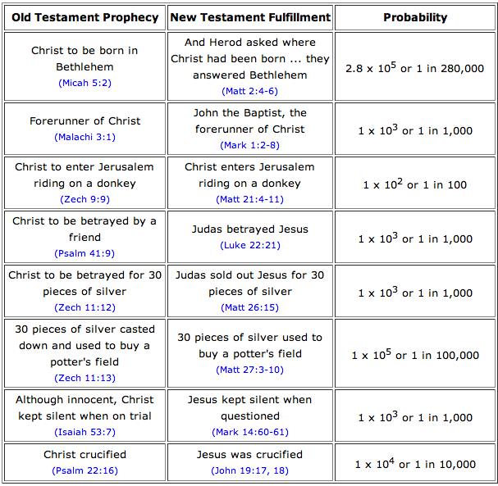

Slide 17
Science and the Bible

Slide 18
Scientific Fact or Principle | Bible reference | Discovered by man
The Earth is round | Isaiah 40:22 | 15th Century
Oceans have natural paths in them | Psalms 8:8 | 1854
Both man and woman possess the seed of life | Genesis 3:15 | 17th Century
There is a place void of stars in the North | Job 26:7 | 19th Century
Earth is held in place by invisible forces | Job 26:7 | 1650
Taxonomic classification of matter | Genesis 1 | 1735
Certain animals carry diseases harmful to man | Leviticus 11 | 16th Century
Early diagnosis of leprosy | Leviticus 13 | 17th Century
Quarantine for disease control | Leviticus 13 | 17th Century
Blood of animals carries diseases | Leviticus 17 | 17th Century

