Slide 1
The Blessings that Make up our Spiritual Wealth
Eph 1:4-14

Slide 2
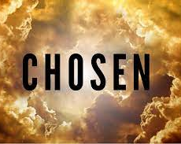
Blessings from the Father (Eph 1:4-6)
⁴ just as He chose us in Him before the foundation of the world, that we should be holy and without blame before Him in love,

Slide 3
Blessings from the Father (Eph 1:4-6)
⁴ just as He chose us in Him before the foundation of the world, that we should be holy and without blame before Him in love,

Slide 4
Blessings from the Father (Eph 1:4-6)
God in His love calls to the sinner (Mt 18:11; Lk 19:10)

Slide 5
Blessings from the Father (Eph 1:4-6)
Left to his own devices the sinner would not seek God (Rom 3:10-11)

Slide 6
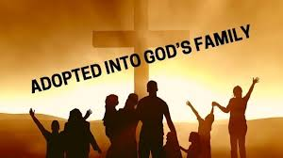
Blessings from the Father (Eph 1:4-6)
⁵ having predestined us to adoption as sons by Jesus Christ to Himself, according to the good pleasure of His will,

Slide 7
Blessings from the Father (Eph 1:4-6)
Adoption is the legal declaration that one is God’s child with all it’s rights, privileges, and duties

Slide 8
Blessings from the Father (Eph 1:4-6)
Important note: one does not get into God’s family by adoption, but through the new birth acquired through baptism, then we are adopted (Jn 3:1-18)

Slide 9
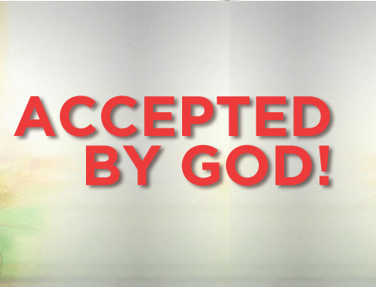
Blessings from the Father (Eph 1:4-6)
⁶ to the praise of the glory of His grace, by which He made us accepted in the Beloved.

Slide 10
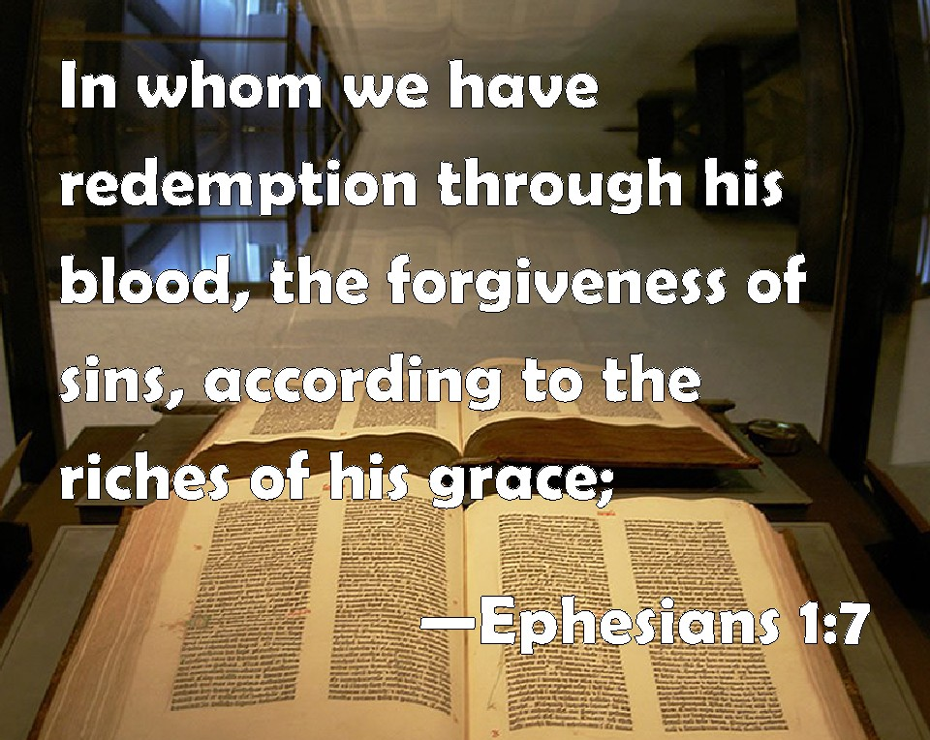
Blessings from the Son (Eph 1:7-12)
To redeem means: to purchase and set free by paying a price
The price paid was His blood (1 Pet 1:18-19)

Slide 11
Blessings from the Son (Eph 1:7-12)
The word forgive means: to carry away
Christ died to carry away our sins so they may be remembered no more (Jn 1:29)

Slide 12
Blessings from the Son (Eph 1:7-12)
No written accusation stands against the Christian because his sins have been washed away
Sin made man poor, but grace and forgiveness made him rich

Slide 13
Blessings from the Son (Eph 1:7-12)
⁹ having made known to us the mystery of His will, according to His good pleasure which He purposed in Himself, ¹⁰ that in the dispensation of the fullness of the times He might gather together in one all things in Christ, both which are in heaven and which are on earth—in Him.

Slide 14
Blessings from the Son (Eph 1:7-12)
The word “mystery” does not have to do with anything “eerie” but rather a sacred secret, once hidden, but now revealed to God’s people
God’s revealed will shows us what we must do to be saved and the riches we will receive in Heaven

Slide 15
Blessings from the Son (Eph 1:7-12)
¹¹ In Him also we have obtained an inheritance, being predestined according to the purpose of Him who works all things according to the counsel of His will, ¹² that we who first trusted in Christ should be to the praise of His glory.
Notes:
1 Pet 1:1-4 “1 Peter, an apostle of Jesus Christ, To the pilgrims of the Dispersion in Pontus, Galatia, Cappadocia, Asia, and Bithynia, ² elect according to the foreknowledge of God the Father, in sanctification of the Spirit, for obedience and sprinkling of the blood of Jesus Christ: Grace to you and peace be multiplied. ³ Blessed be the God and Father of our Lord Jesus Christ, who according to His abundant mercy has begotten us again to a living hope through the resurrection of Jesus Christ from the dead, ⁴ to an inheritance incorruptible and undefiled and that does not fade away, reserved in heaven for you,”

Slide 16
Blessings from the Holy Spirit (Eph 1:13-14)
¹³ In Him you also trusted, after you heard the word of truth, the gospel of your salvation; in whom also, having believed, you were sealed with the Holy Spirit of promise,

Slide 17
Blessings from the Holy Spirit (Eph 1:13-14)
The idea of sealing represents a finished transaction
Today when important legal documents are processed, they are stamped with a seal to signify the completion of the transaction

Slide 18
Blessings from the Holy Spirit (Eph 1:13-14)
This sealing implies ownership
God placed His seal upon us because He purchased us to be His own (1 Cor 6:19-20)

Slide 19
Blessings from the Holy Spirit (Eph 1:13-14)
¹⁴ who is the guarantee of our inheritance until the redemption of the purchased possession, to the praise of His glory.

Slide 20
Blessings from the Holy Spirit (Eph 1:13-14)
The first payment or installment of money or goods which serves as a guarantee or pledge for the completion of the transaction

Slide 21
Blessings from the Holy Spirit (Eph 1:13-14)
In the NT the term is used only figuratively of the Holy Spirit as the down payment of the blessings promised by God

Slide 22
Blessings from the Holy Spirit (Eph 1:13-14)
In the “already-not yet” scheme of the NT Possession of the Spirit now by believers (“already”) can be viewed as a guarantee that God will give them the balance of the promised blessings in the future (“not yet”)
Notes:
NET notes

