Slide 1
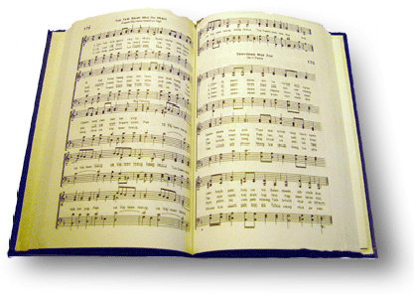
The gospel is for all
Song #424

Slide 2
Of one the lord has made his race, thro’ one has come the fall; where sin has gone must go his grace, the gospel is for all
²⁶ Then God said, “Let Us make man in Our image, according to Our likeness; let them have dominion over the fish of the sea, over the birds of the air, and over the cattle, over all the earth and over every creeping thing that creeps on the earth.” ²⁷ So God created man in His own image; in the image of God He created him; male and female He created them
Notes:
God is the father

Slide 3
Of one the lord has made his race, thro’ one has come the fall; where sin has gone must go his grace, the gospel is for all
²⁶ And He has made from one blood every nation of men to dwell on all the face of the earth, and has determined their preappointed times and the boundaries of their dwellings
Notes:
Secular scientists (like those in the human genome project) have shown conclusively from genetics all humans belong to one race. There is only one biological race of humans--we need to stop talking about different supposed races!

Slide 4
Of one the lord has made his race, thro’ one has come the fall; where sin has gone must go his grace, the gospel is for all
Notes:
²¹ For since by man came death, by Man also came the resurrection of the dead. ²² For as in Adam all die, even so in Christ all shall be made alive.

Slide 5
Of one the lord has made his race, thro’ one has come the fall; where sin has gone must go his grace, the gospel is for all
¹⁹ Go therefore and make disciples of all the nations, baptizing them in the name of the Father and of the Son and of the Holy Spirit, ²⁰ teaching them to observe all things that I have commanded you; and lo, I am with you always, even to the end of the age.” Amen.

Slide 6
Of one the lord has made his race, thro’ one has come the fall; where sin has gone must go his grace, the gospel is for all
Eph 2:-9 “For by grace you have been saved through faith, and that not of yourselves; it is the gift of God, ⁹ not of works, lest anyone should boast.

Slide 7
Of one the lord has made his race, thro’ one has come the fall; where sin has gone must go his grace, the gospel is for all
Tit 2:11 “For the grace of God has appeared, bringing salvation for all people,”

Slide 8
Say not the heathen are at home, beyond we have no call; for why should we be blest alone? The gospel is for all
According to Merriam-Webster, heathen is defined as “of or relating to people or nations that do not acknowledge the God of the Bible” as an adjective,
and “an unconverted member of a people or nation who does not acknowledge the God of the Bible” as a noun.
Commonly in modern use, a heathen is considered synonymous with a pagan or atheist.

Slide 9
Say not the heathen are at home, beyond we have no call; for why should we be blest alone? The gospel is for all
In the Bible, the meaning of "heathen" changed with the New Covenant of Jesus Christ that extended to the gentile nations that were previously considered heathens.
With the New Covenant, heathens are now those outside of faith in the Son of God, including Jews that rejected Him.

Slide 10
Say not the heathen are at home, beyond we have no call; for why should we be blest alone? The gospel is for all
Through the years, heathen has lost its original biblical meaning of “not Jewish.”
Today, heathen means “pagan” or “unbeliever,” or it is used to describe sinful or irreligious activity in general.

Slide 11
Say not the heathen are at home, beyond we have no call; for why should we be blest alone? The gospel is for all
Gal 1:15-16 “¹⁵ But when it pleased God, who separated me from my mother's womb, and called me by his grace,¹⁶ To reveal his Son in me, that I might preach him among the heathen; immediately I conferred not with flesh and blood:

Slide 12
Say not the heathen are at home, beyond we have no call; for why should we be blest alone? The gospel is for all
Gal 2:9 “And when James, Cephas, and John, who seemed to be pillars, perceived the grace that was given unto me, they gave to me and Barnabas the right hands of fellowship; that we should go unto the heathen, and they unto the circumcision.
Notes:
NKJV gentiles…

Slide 13
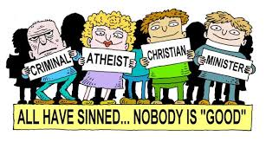
Say not the heathen are at home, beyond we have no call; for why should we be blest alone? The gospel is for all
Rom 3:23 “²³ for all have sinned and fall short of the glory of God,
Rom 6:23 “²³ For the wages of sin is death, but the gift of God is eternal life in Christ Jesus our Lord.
Notes:
NKJV gentiles…

Slide 14
Say not the heathen are at home, beyond we have no call; for why should we be blest alone? The gospel is for all
Acts 10:34-35 “³⁴ Then Peter opened his mouth and said: “In truth I perceive that God shows no partiality. ³⁵ But in every nation whoever fears Him and works righteousness is accepted by Him.
Notes:
NKJV gentiles…

Slide 15
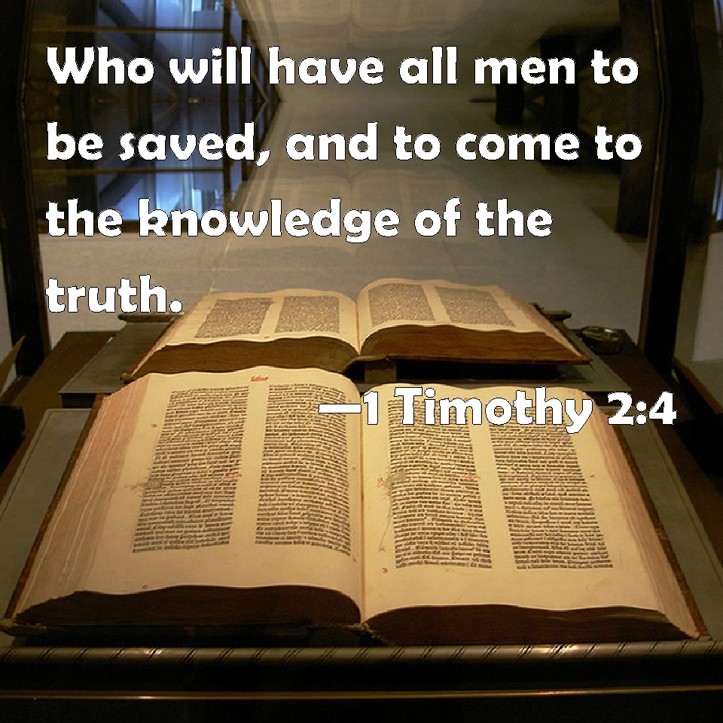
Say not the heathen are at home, beyond we have no call; for why should we be blest alone? The gospel is for all
Notes:
NKJV gentiles…

Slide 16
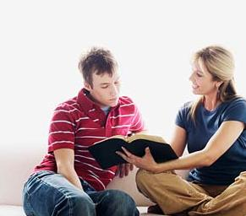
Received ye freely, freely give, from every land they call; unless they hear they cannot live; the gospel is for all
Rom 10:11-13 “¹¹ For the Scripture says, “Whoever believes on Him will not be put to shame.” ¹² For there is no distinction between Jew and Greek, for the same Lord over all is rich to all who call upon Him. ¹³ For “whoever calls on the name of the Lord shall be saved.”
Notes:
NKJV gentiles…

Slide 17
Received ye freely, freely give, from every land they call; unless they hear they cannot live; the gospel is for all
Rom 10:14-15 “¹⁴ How then shall they call on Him in whom they have not believed? And how shall they believe in Him of whom they have not heard? And how shall they hear without a preacher? ¹⁵ And how shall they preach unless they are sent? As it is written: How beautiful are the feet of those who preach the gospel of peace, Who bring glad tidings of good things!”
Notes:
NKJV gentiles…

Slide 18
Received ye freely, freely give, from every land they call; unless they hear they cannot live; the gospel is for all
Rom 10:16-17 “¹⁶ But they have not all obeyed the gospel. For Isaiah says, “Lord, who has believed our report?” ¹⁷ So then faith comes by hearing, and hearing by the word of God.
Notes:
NKJV gentiles…

Slide 19
Notes:
NKJV gentiles…

