Slide 1
Where do you draw the line?
Rom 6:1-14

Slide 2
2 Corinthians 5:17
Notes:
2 Cor 5:17 “¹⁷ Therefore, if anyone is in Christ, he is a new creation; old things have passed away; behold, all things have become new.”

Slide 3
Galatians 2:20
Notes:
Gal 2:20 “¹⁷ Therefore, if anyone is in Christ, he is a new creation; old things have passed away; behold, all things have become new.

Slide 4
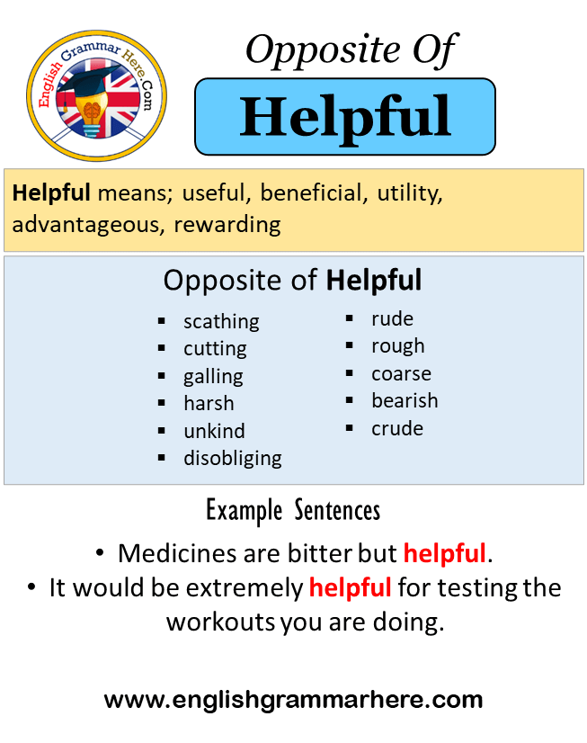
Where do you draw the line?
Helpful
Notes:
1 cor 6:9-12 “⁹ Do you not know that the unrighteous will not inherit the kingdom of God? Do not be deceived. Neither fornicators, nor idolaters, nor adulterers, nor ^{[b]}homosexuals, nor ^{[c]}sodomites, ¹⁰ nor thieves, nor covetous, nor drunkards, nor revilers, nor extortioners will inherit the kingdom of God. ¹¹ And such were some of you. But you were washed, but you were ^{[d]}sanctified, but you were justified in the name of the Lord Jesus and by the Spirit of our God.

Slide 5
Where do you draw the line?
Helpful
Notes:
Not all things contribute to growth in christ... We need to ask, Will this increase my love for Christ”
Will this help me serve Christ better

Slide 6
Where do you draw the line?
Overcome
Notes:
I will not be overpowered
Money is lawful… I will not allow it to control me
Recreation is lawful… it is not our master

Slide 7
Where do you draw the line?
Edification
Rom 14:19
Notes:
Rom 14:9 “¹⁹ Therefore let us pursue the things which make for peace and the things by which one may ^{[a]}edify another.

Slide 8
Questions we must answer
Does it help me along my Christian path?
Will it be something I allow to take control over me?
Does it build up/encourage others?

Slide 9
2 final quotes
“Whatever cools my affection towards Christ is of the world.” (John Wesley)
“Anything that dims my vision of Christ, or takes away my taste for Bible study, or cramps my prayer life, or makes Christian work more difficult is wrong for me.” (J. Wilbur Chapman)

