Slide 1
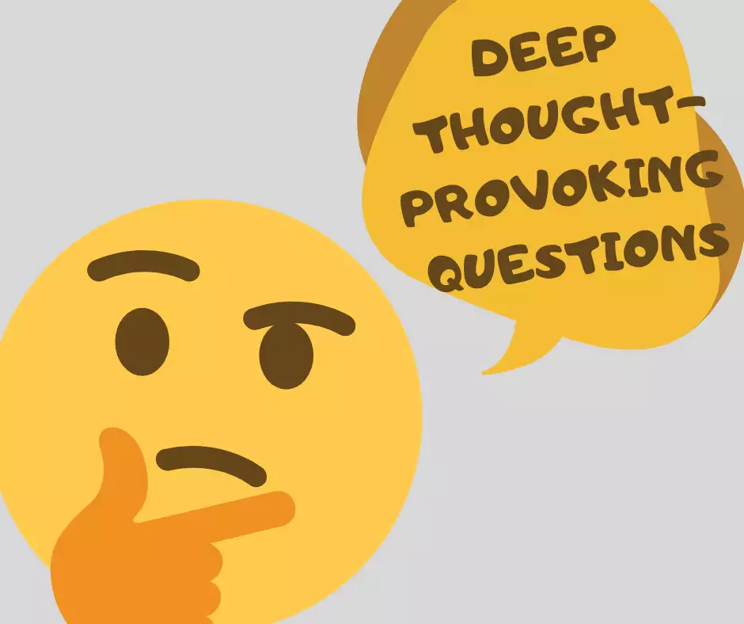
Mt 16:13-15

Slide 2
Mt 16:13 A question concerning others’ belief of who He is

Slide 3
Mt 16:14 So they said, “Some say John the Baptist, some Elijah, and others Jeremiah or one of the prophets.”
Notes:
Mt 14:1-2 “14 At that time Herod the tetrarch heard the report about Jesus ² and said to his servants, “This is John the Baptist; he is risen from the dead, and therefore these powers are at work in him.”

Slide 4
Mt 16:14 So they said, “Some say John the Baptist, some Elijah, and others Jeremiah or one of the prophets.”
Notes:
Mk 6:14-16 “¹⁴ Now King Herod heard of Him, for His name had become well known. And he said, “John the Baptist is risen from the dead, and therefore these powers are at work in him.”
¹⁵ Others said, “It is Elijah.”
And others said, “It is ^{[a]}the Prophet, or like one of the prophets.”

Slide 5
Mt 16:14 So they said, “Some say John the Baptist, some Elijah, and others Jeremiah or one of the prophets.”
Notes:
Jn 4:29 “¹⁹ The woman said to Him, “Sir, I perceive that You are a prophet.
Jn 7:40-43 “⁴⁰ Therefore ^{[a]}many from the crowd, when they heard this saying, said, “Truly this is the Prophet.” ⁴¹ Others said, “This is the Christ.”
But some said, “Will the Christ come out of Galilee? ⁴² Has not the Scripture said that the Christ comes from the seed of David and from the town of Bethlehem, where David was?” ⁴³ So there was a division among the people because of Him.

Slide 6
Other possibilities A Rabbi/teacher (Jn 3:1-2) An Innocent man (Mt 27:3-4)
Notes:
Jn 3:1-2 “3 There was a man of the Pharisees named Nicodemus, a ruler of the Jews. ² This man came to Jesus by night and said to Him, “Rabbi, we know that You are a teacher come from God; for no one can do these signs that You do unless God is with him.”

Slide 7
Other possibilities A Rabbi/teacher (Jn 3:1-2) An Innocent man (Mt 27:3-4)
Notes:
Mt 27:3-4 “³ Then Judas, His betrayer, seeing that He had been condemned, was remorseful and brought back the thirty pieces of silver to the chief priests and elders, ⁴ saying, “I have sinned by betraying innocent blood.”
And they said, “What is that to us? You see to it!”

Slide 8
Mt 16:15 A personal question concerning their individual belief of who He is
Notes:
it is similar to the first question, but yet completely different. In verse 13 Jesus had asked who do people say the Son of Man is, but here in verse 15 Jesus asked his disciples “who do you say that I am?” Jesus took a broad question and brought it down to the personal. “Who do YOU say that I am? He was not looking for what other had said, but Jesus was looking for an “I believe statement”.
Jesus is looking for a real and personal response form us. Jesus is not looking for what our parents believed about Him. Jesus is not looking for what our pastor believes about him and He is not looking for what we read about Him in the numerous books that are out there. Jesus wants to hear who we say that He is!

Slide 9
If we say that Jesus is “The Christ” then we must move aside from the throne of our own life and let Him rule. If he was the greatest offering of love that could be given to humanity, then we must embrace that love and live each day in the knowledge of just how much God loves us.
Notes:
Author unknown
it is similar to the first question, but yet completely different. In verse 13 Jesus had asked who do people say the Son of Man is, but here in verse 15 Jesus asked his disciples “who do you say that I am?” Jesus took a broad question and brought it down to the personal. “Who do YOU say that I am? He was not looking for what other had said, but Jesus was looking for an “I believe statement”.
Jesus is looking for a real and personal response form us. Jesus is not looking for what our parents believed about Him. Jesus is not looking for what our pastor believes about him and He is not looking for what we read about Him in the numerous books that are out there. Jesus wants to hear who we say that He is!

Slide 10
Notes:
Author unknown
it is similar to the first question, but yet completely different. In verse 13 Jesus had asked who do people say the Son of Man is, but here in verse 15 Jesus asked his disciples “who do you say that I am?” Jesus took a broad question and brought it down to the personal. “Who do YOU say that I am? He was not looking for what other had said, but Jesus was looking for an “I believe statement”.
Jesus is looking for a real and personal response form us. Jesus is not looking for what our parents believed about Him. Jesus is not looking for what our pastor believes about him and He is not looking for what we read about Him in the numerous books that are out there. Jesus wants to hear who we say that He is!

Slide 11
Notes:
People are watching us…Are we living lives that tell others who our Jesus is?
Do people see Jesus in us when we are at a sporting event? How about at community events; or in our business dealing? Do people see Jesus when we are out for coffee or dinner; how about at the movies? I think you get the point. Who do you say that Jesus is to you with your actions?
it is similar to the first question, but yet completely different. In verse 13 Jesus had asked who do people say the Son of Man is, but here in verse 15 Jesus asked his disciples “who do you say that I am?” Jesus took a broad question and brought it down to the personal. “Who do YOU say that I am? He was not looking for what other had said, but Jesus was looking for an “I believe statement”.
Jesus is looking for a real and personal response form us. Jesus is not looking for what our parents believed about Him. Jesus is not looking for what our pastor believes about him and He is not looking for what we read about Him in the numerous books that are out there. Jesus wants to hear who we say that He is!

Slide 12
What are your answers?

