Slide 1
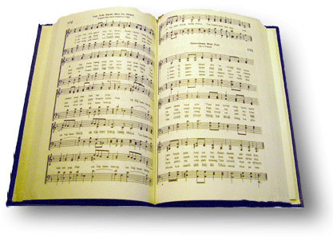
At the cross
Song #157

Slide 2
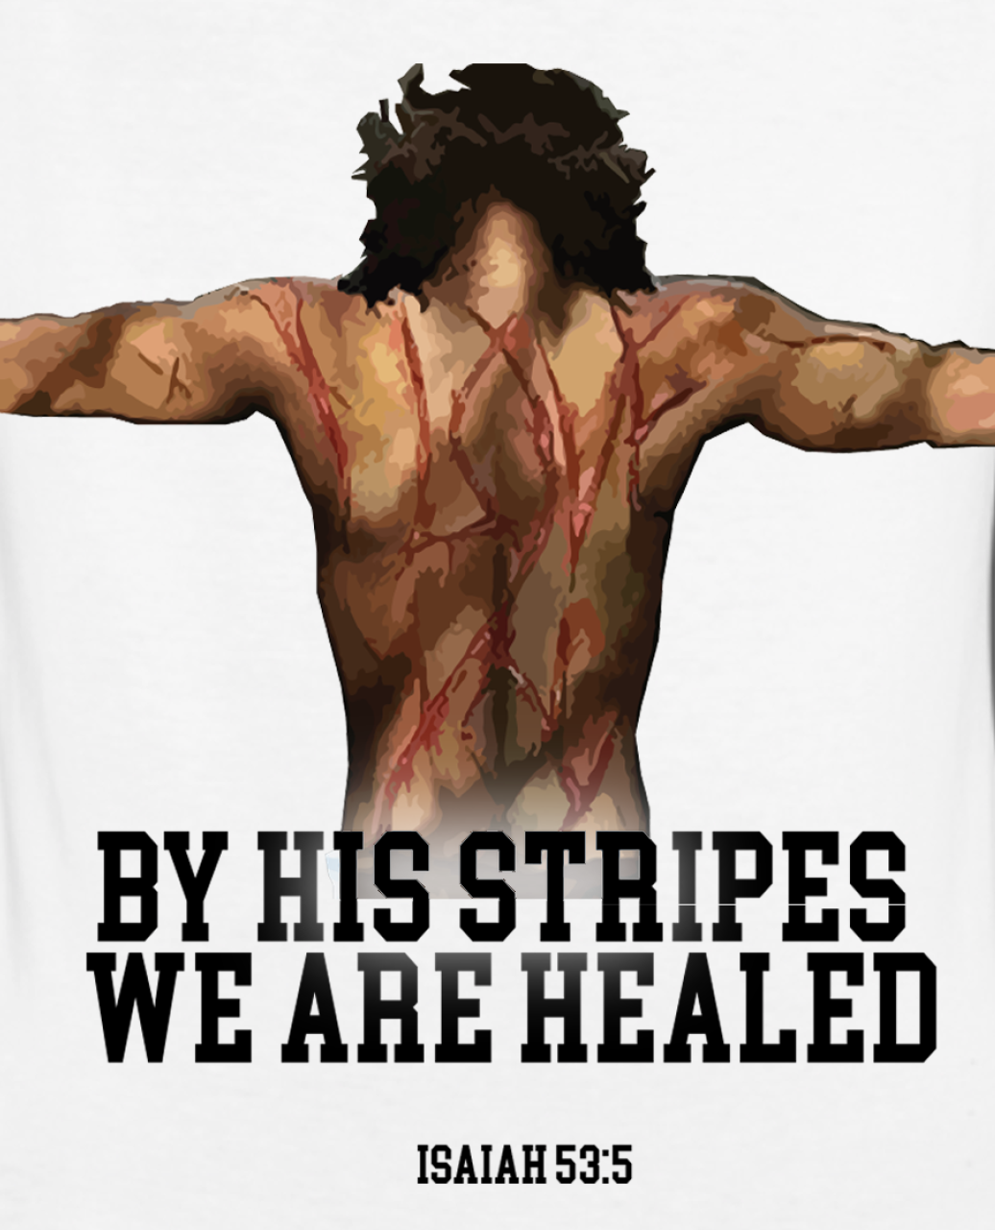
Alas and did my savior bleed and did my sovereign die
Is 53:4-5 “⁴ Surely He has borne our griefs And carried our sorrows; Yet we esteemed Him stricken, Smitten by God, and afflicted.
⁵ But He was wounded for our transgressions, He was bruised for our iniquities; The chastisement for our peace was upon Him, And by His stripes we are healed.

Slide 3
Alas and did my savior bleed and did my sovereign die
1 Pet 2:24 “²⁴ who Himself bore our sins in His own body on the tree, that we, having died to sins, might live for righteousness—by whose stripes you were healed.

Slide 4
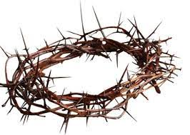
Alas and did my savior bleed and did my sovereign die
Mt 27:29 “²⁹ When they had twisted a crown of thorns, they put it on His head, and a reed in His right hand. And they bowed the knee before Him and mocked Him, saying, “Hail, King of the Jews!”

Slide 5
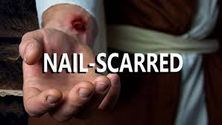
Alas and did my savior bleed and did my sovereign die
Jn 20:26-27 “²⁶ And after eight days His disciples were again inside, and Thomas with them. Jesus came, the doors being shut, and stood in the midst, and said, “Peace to you!”
²⁷ Then He said to Thomas, “Reach your finger here, and look at My hands; and reach your hand here, and put it into My side. Do not be unbelieving, but believing.”
Notes:
Jn 20:25 “²⁵ The other disciples therefore said to him, “We have seen the Lord.”
So he said to them, “Unless I see in His hands the print of the nails, and put my finger into the print of the nails, and put my hand into His side, I will not believe.”

Slide 6
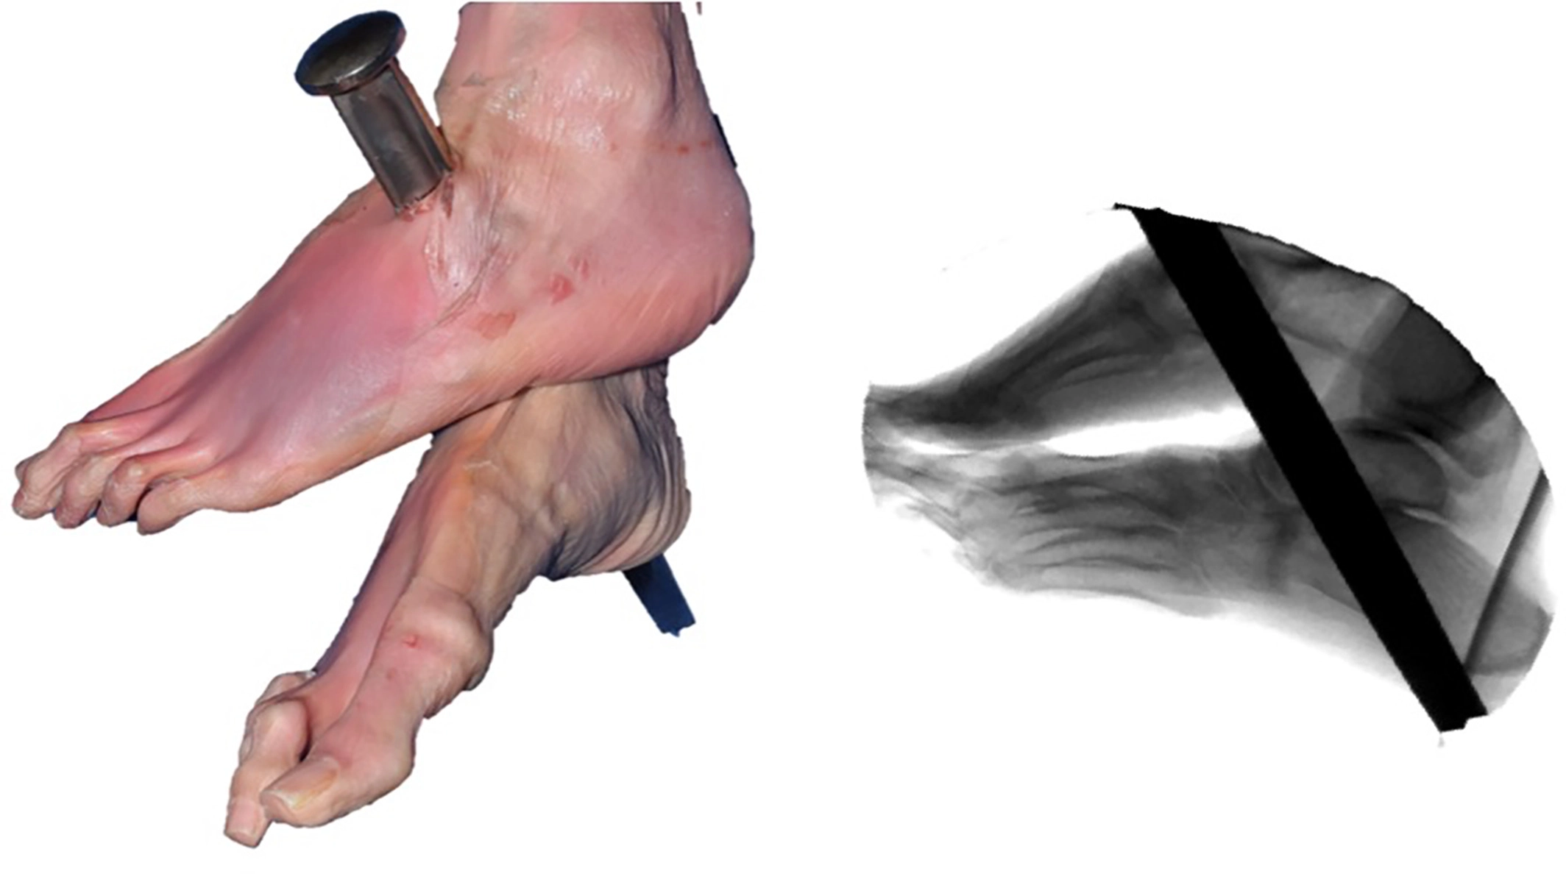
Alas and did my savior bleed and did my sovereign die
Ps 22:16-18 “¹⁶ For dogs have surrounded Me; The congregation of the wicked has enclosed Me. They pierced My hands and My feet;
¹⁷ I can count all My bones. They look and stare at Me.
¹⁸ They divide My garments among them, And for My clothing they cast lots.

Slide 7
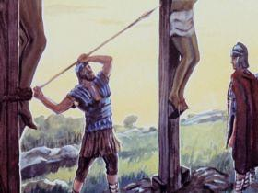
Alas and did my savior bleed and did my sovereign die
Jn 19:33-34 “³³ But when they came to Jesus and saw that He was already dead, they did not break His legs.
³⁴ But one of the soldiers pierced His side with a spear, and immediately blood and water came out.

Slide 8
Alas and did my savior bleed and did my sovereign die
Supreme or highest in power
Superior to all others
Often refers to Christ who is “King of Kings”

Slide 9
Alas and did my savior bleed and did my sovereign die
Mk 15:37-39 “³⁷ And Jesus cried out with a loud voice, and breathed His last.
³⁸ Then the veil of the temple was torn in two from top to bottom.
³⁹ So when the centurion, who stood opposite Him, saw that He cried out like this and breathed His last, he said, “Truly this Man was the Son of God!”

Slide 10
Would he devote that sacred head for such a one as i
Mt 26:28 “²⁸ For this is My blood of the new covenant, which is shed for many for the remission of sins.
Rom 3:23 “²³ for all have sinned and fall short of the glory of God,
Eph 1 :7 “⁷ In Him we have redemption through His blood, the forgiveness of sins, according to the riches of His grace

Slide 11
Was it for crimes that I have done he groaned upon the tree
Notes:
Propitiation is atoning sacrifice…turning away the divine wrath
1 Jn 2:2 “² And He Himself is the propitiation for our sins, and not for ours only but also for the whole world.”
1 Jn 4:10 “¹⁰ In this is love, not that we loved God, but that He loved us and sent His Son to be the propitiation for our sins.

Slide 12
Amazing pity, grace unknown! And love beyond degree
Eph 2:8-9 “⁸ For by grace you have been saved through faith, and that not of yourselves; it is the gift of God,
⁹ not of works, lest anyone should boast.
Notes:
1 Jn 2:2 “² And He Himself is the propitiation for our sins, and not for ours only but also for the whole world.”
1 Jn 4:10 “¹⁰ In this is love, not that we loved God, but that He loved us and sent His Son to be the propitiation for our sins.

Slide 13
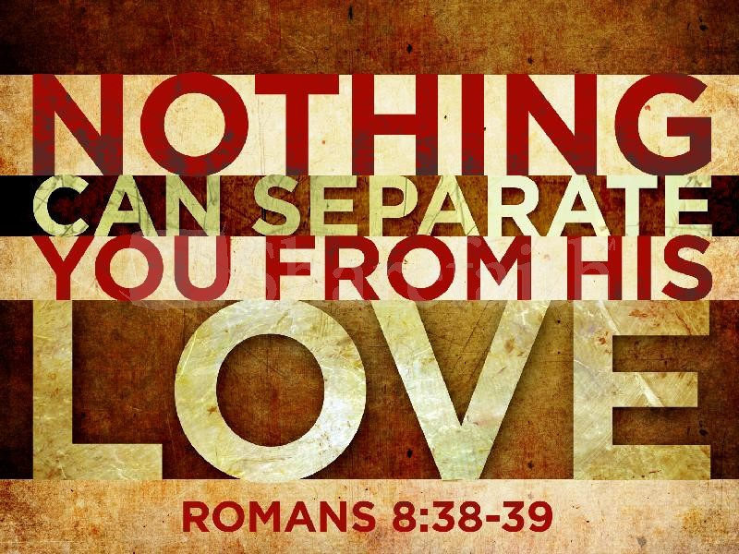
Amazing pity, grace unknown! And love beyond degree
Notes:
Rom 8:35-39 “³⁵ Who shall separate us from the love of Christ? Shall tribulation, or distress, or persecution, or famine, or nakedness, or peril, or sword? ³⁶ As it is written:
“For Your sake we are killed all day long; We are accounted as sheep for the slaughter.”
³⁷ Yet in all these things we are more than conquerors through Him who loved us. ³⁸ For I am persuaded that neither death nor life, nor angels nor principalities nor powers, nor things present nor things to come, ³⁹ nor height nor depth, nor any other created thing, shall be able to separate us from the love of God which is in Christ Jesus our Lord.

