Slide 1
Walk in Wisdom
Eph 5:15-17

Slide 2
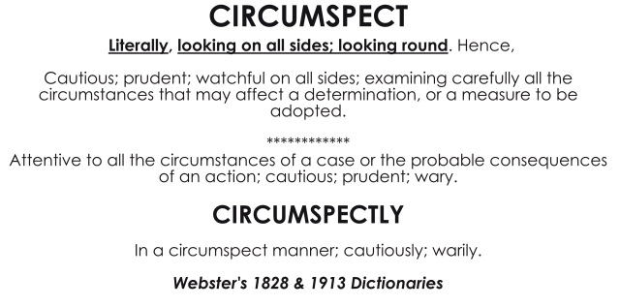
Walk in Wisdom (Eph 5:15-17)
“¹⁵ See then that you walk circumspectly, not as fools but as wise,
¹⁶ redeeming the time, because the days are evil.
¹⁷ Therefore do not be unwise, but understand what the will of the Lord is.
Notes:
The Greek word carries the idea of precision or accuracy
“See that you walk carefully, with exactness” is the meaning here

Slide 3
Walk in Wisdom (Eph 5:15-17)
“¹⁵ See then that you walk circumspectly, not as fools but as wise,
¹⁶ redeeming the time, because the days are evil.
¹⁷ Therefore do not be unwise, but understand what the will of the Lord is.
Notes:
having the power of discerning and judging properly as to what is true or right; possessing discernment, judgment, or discretion
Sophos: forming the best plans and using the best means for their execution

Slide 4
Walk in Wisdom (Eph 5:15-17)
“¹⁵ See then that you walk circumspectly, not as fools but as wise,
¹⁶ redeeming the time, because the days are evil.
¹⁷ Therefore do not be unwise, but understand what the will of the Lord is.
Notes:
redeeming (exagorazo) the time (kairos), because the days are evil“ (v. 16). The word exagorazo means to redeem something by payment of a price—such as paying the price to set a slave free. Exagorazo was also used to speak of buying something quickly while it was available—”striking while the iron is hot.”
When used for redeeming time, it means making the most of one’s time—seizing the moment—exploiting one’s opportunities.
taking advantage of every opportunity

Slide 5
Walk in Wisdom (Eph 5:15-17)
“¹⁵ See then that you walk circumspectly, not as fools but as wise,
¹⁶ redeeming the time, because the days are evil.
¹⁷ Therefore do not be unwise, but understand what the will of the Lord is.
Notes:
In a sense kairos alludes to the brevity of life, which begs one to pause and ponder his or her life like flowering grass, here today, gone tomorrow and in light of this truth to take a sincere, possibly sobering inventory of our daily activities of thought, word and deed!
Kairos does not emphasize a point of time but rather a time space filled with all kinds of possibilities. And so Kairos characteristically means an "opportunity" (and is so translated in some versions -- in in the NIV and NASB) which represents the best time to do something, the moment when circumstances are most suitable.

Slide 6
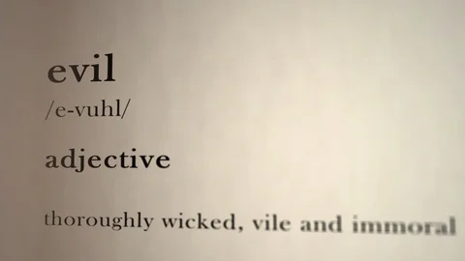
Walk in Wisdom (Eph 5:15-17)
“¹⁵ See then that you walk circumspectly, not as fools but as wise,
¹⁶ redeeming the time, because the days are evil.
¹⁷ Therefore do not be unwise, but understand what the will of the Lord is.
Notes:
the day are evil. referring to moral evil (especially to the moral evil he has described earlier in Ephesians 5). The fact that the times in which they lived were morally so corrupt was a strong reason for making every opportunity for good their own. Are you buying up the opportunities for spiritual good which the Lord is graciously giving you?
Because the times in which you live are evil. There are many allurements and temptations that would lead you away from the proper improvement of time, and that would draw you into sin. Such were those that would tempt them to go to places of sinful indulgence and revelry where their time would be wasted, and worse than wasted

Slide 7
Walk in Wisdom (Eph 5:15-17)
“¹⁵ See then that you walk circumspectly, not as fools but as wise,
¹⁶ redeeming the time, because the days are evil.
¹⁷ Therefore do not be unwise, but understand what the will of the Lord is.
Notes:
Aphron: without reason; senseless, foolish, stupid, without reflection or intelligence, acting rashly

Slide 8
Walk in Wisdom (Eph 5:15-17)
“¹⁵ See then that you walk circumspectly, not as fools but as wise,
¹⁶ redeeming the time, because the days are evil.
¹⁷ Therefore do not be unwise, but understand what the will of the Lord is.
Notes:
He is saying, don’t be foolish. Be wise. Walk wisely. How? By understanding what the will of the Lord is, and doing it.
Understanding the will of the Lord requires time and effort—studying scripture, praying, participating in worship
our efforts to understand the Lord’s will need to begin with prayers for guidance and discernment.

