Slide 1
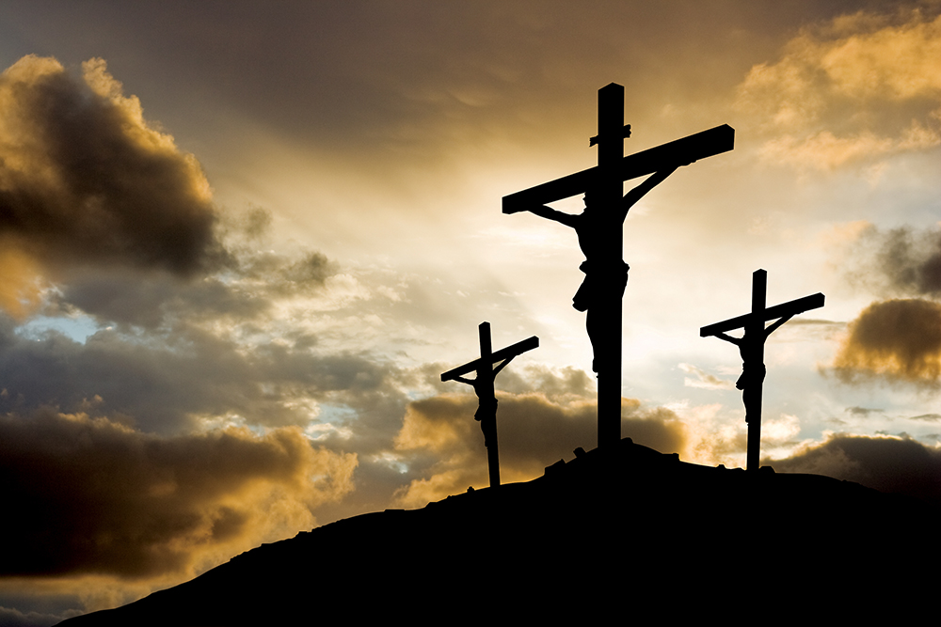
The Two Thieves
Lk 23:32-43
Notes:
Bible reading Jn 19:18

Slide 2
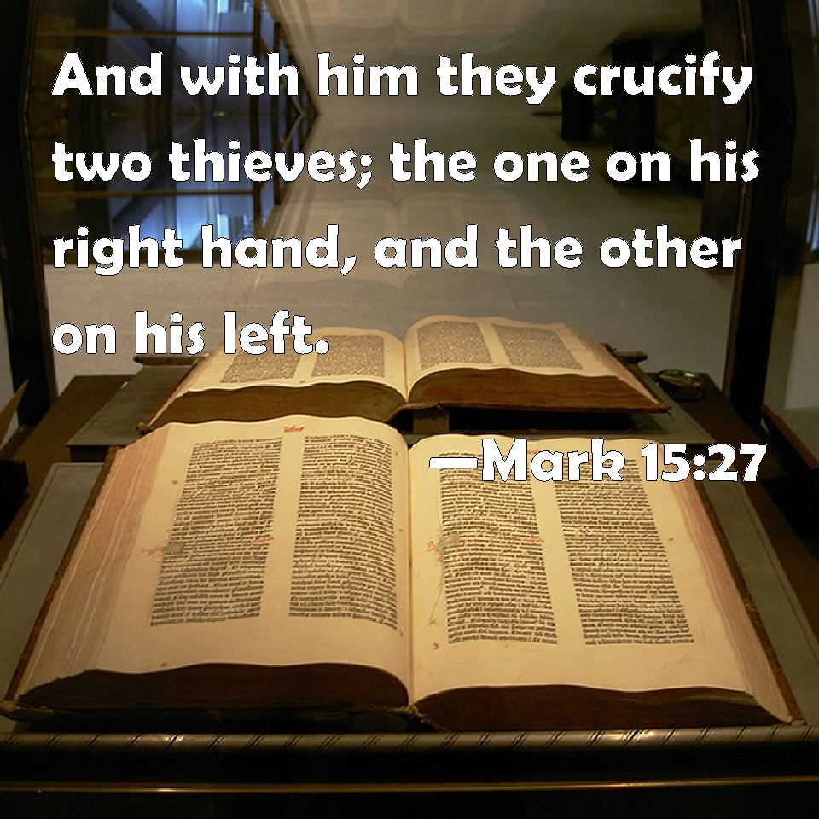
The two thieves: a fulfilled prophecy

Slide 3
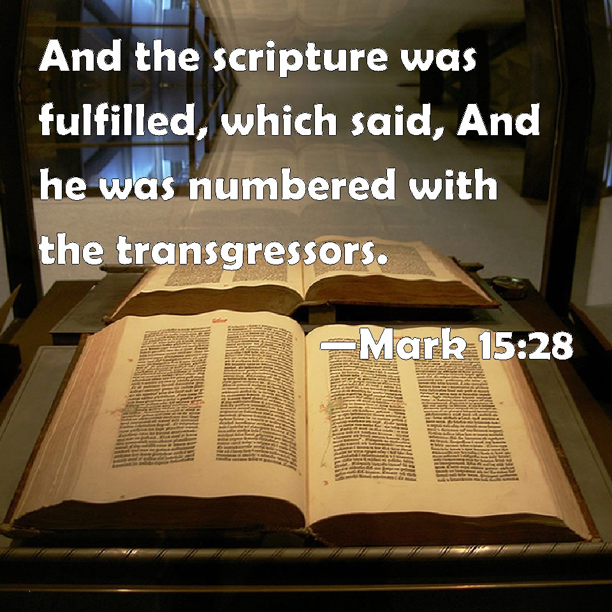
The two thieves: a fulfilled prophecy

Slide 4
The two thieves: Similarities
Mt 27:38 “³⁸ Then were there two thieves crucified with him, one on the right hand, and another on the left.”
Lk 23:32 “³² There were also two others, criminals, led with Him to be put to death.”

Slide 5
The two thieves: Similarities
Mt 27:38 -40 “ ³⁸ Then two robbers were crucified with Him, one on the right and another on the left.
³⁹ And those who passed by blasphemed Him, wagging their heads
⁴⁰ and saying, “You who destroy the temple and build it in three days, save Yourself! If You are the Son of God, come down from the cross.”
Notes:
These were two men who broke the law and were paying for it with their lives…. They were rightly being punished

Slide 6
The two thieves: Similarities
Mt 27:41 -44 “ ⁴¹ Likewise the chief priests also, mocking with the scribes and elders, said,
⁴² “He saved others; Himself He cannot save. If He is the King of Israel, let Him now come down from the cross, and we will believe Hm.
⁴³ He trusted in God; let Him deliver Him now if He will have Him; for He said, ‘I am the Son of God.’ ”
⁴⁴ Even the robbers who were crucified with Him reviled Him with the same thing.
Notes:
These were two men who broke the law and were paying for it with their lives…. They were rightly being punished

Slide 7
The two thieves: Differences
Lk 23:39-41 “³⁹ Then one of the criminals who were hanged blasphemed Him, saying, “If You are the Christ, save Yourself and us.”
⁴⁰ But the other, answering, rebuked him, saying, “Do you not even fear God, seeing you are under the same condemnation?
⁴¹ And we indeed justly, for we receive the due reward of our deeds; but this Man has done nothing wrong.”

Slide 8
The two thieves: Differences
Lk 23:34243 “⁴² Then he said to Jesus, “Lord, remember me when You come into Your kingdom.”
⁴³ And Jesus said to him, “Assuredly, I say to you,.” today you will be with Me in Paradise
Notes:
He was honest about and admitted his sins
2) He realized Jesus was the Son of God
3) He took action seeking the jelp of Jesus

Slide 9
The two thieves: Differences
Where they will spend their eternity
Notes:
He was honest about and admitted his sins
2) He realized Jesus was the Son of God
3) He took action seeking the jelp of Jesus

Slide 10
Final Thought

