Slide 1
Walk Worthy of the calling: Walk as a Soldier
Eph 6:14-17

Slide 2
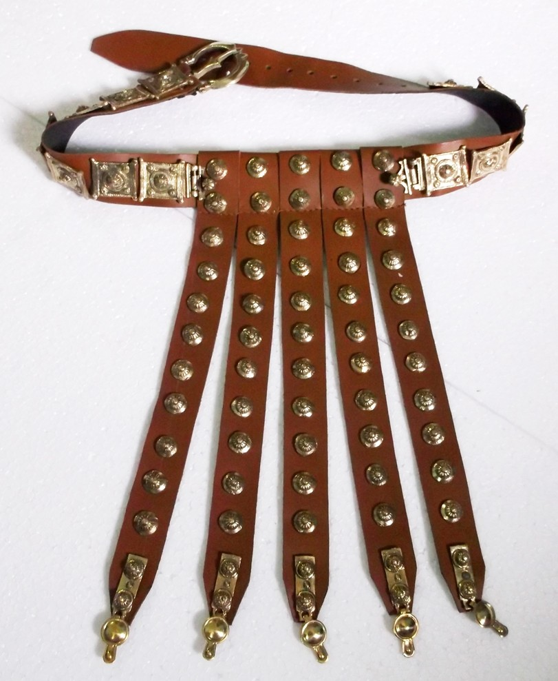
The Whole Armor of God (14)
“¹⁴ Stand therefore, having girded your waist with truth, having put on the breastplate of righteousness,
Notes:
The belt of a Roman soldier in Paul’s day was not a simple leather strap such as we wear today. It was a thick, heavy leather and metal band with a protective piece hanging down from the front of it. The belt held the soldier’s sword and other weapons…
The belt was critical for the warrior to be prepared to engage in battle. The belt is what held the tunic up and cinched everything into place. Truth performs this critical function.
If we are struggling this battle, struggling with faith, or struggling with temptation, Paul is telling us that this is the first place to look. Are we looking at the truth? Are we clinging to the truth? Is truth tied around our waist like a belt? We cannot get anything right with possessing the truth. The truth is found in Jesus and in his words

Slide 3
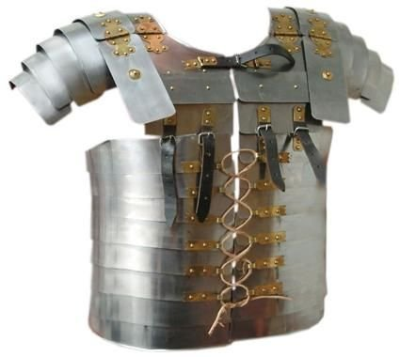
The Whole Armor of God (14)
“¹⁴ Stand therefore, having girded your waist with truth, having put on the breastplate of righteousness,
Notes:
The breastplate was a central part of the Roman soldier's armor—it provided protection for the torso, which contains vital organs like the heart, lungs and so on. Without a breastplate, a soldier would be asking for death, as any attack could instantly become fatal. With a sturdy breastplate, the very same attacks become ineffective and useless, as blows glance off the armor.
Without righteousness, we leave ourselves open to almost certain death. With righteousness—just as with a breastplate—the otherwise fatal attacks of our enemy are thwarted.
The breastplate of righteousness (right living) is a Christian’s defense against the attack of sin
There is nothing for me to take up as the armor of God if Paul is describing the righteousness or justification that God bestows on those who have faith in him. Remember, Paul is writing to Christians. They have already been justified by faith. They have already been pronounced righteous when they were saved through the blood of Jesus. But this is not the end of the concept of righteousness. Now there is a call for righteous living. Think about how this fits so well where we are in the book of Ephesians. Paul has started this section of the book calling Christians to walk worthy of the calling. The first half of the book was telling us what God has already done for us. The second half of the book is telling how to live because of what God has done. Thus, putting on the breastplate of righteousness is the need for the Christian to have right living. To live the life of victory that God wants you to have requires a life change, not based on ourselves, but based on God’s righteousness.

Slide 4
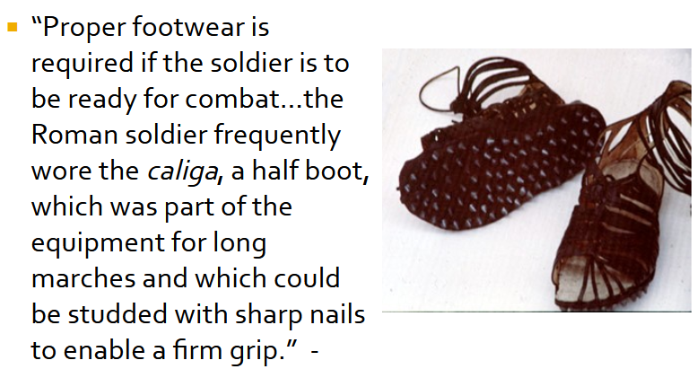
The Whole Armor of God (15)
“¹⁵ and having shod your feet with the preparation of the gospel of peace;
Notes:
The apostle figured to himself a soldier, clad in the usual manner. Christians were to resemble him. One part of his dress or preparation consisted in the covering and defense of the foot. It was to preserve the foot from danger, and to secure the facility of his march, and perhaps to make him firm in battle. Christians were to have the principles of the gospel of peace - the peaceful and pure gospel - to facilitate them; to aid them in their marches; to make them firm in the day of conflict with their foes. They were not to be furnished with carnal weapons, but with the peaceful gospel of the Redeemer; and, sustained by this, they were to go on in their march through the world. The principles of the gospel were to do for them what the greaves and iron-spiked sandals did for the soldier - to make them ready for the march, to make them firm in their foot-tread, and to be a part of their defense against their foes.
The gospel provides the footing for everything we do. However powerful the rest of your body is, if you are wounded in your feet you are easy prey for the enemy.

Slide 5
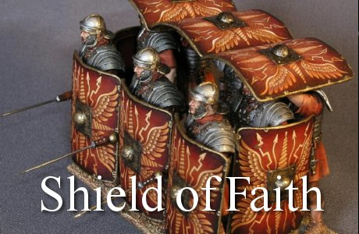
The Whole Armor of God (16)
“¹⁶ above all, taking the shield of faith with which you will be able to quench all the fiery darts of the wicked one.
Notes:
Notice how Paul begins this sentence in verse 16. “In all circumstances…” Your translation may say, “In addition to all” or “above all.” The phrase is literally, “In everything” so all of these translations are correct. In every situation and in addition to the rest of the armor of God, the shield of faith is necessary. Every day we need this shield because the attack of the devil is very real and continuous

Slide 6
The Whole Armor of God (16)
“¹⁶ above all, taking the shield of faith with which you will be able to quench all the fiery darts of the wicked one.
Notes:
The Greek word translated shield (θυρεός, thureos) refers to the Roman soldier’s large rectangular wooden shield, called in Latin scutum, about 4 ft (1.2 m) high, covered with leather on the outside. Before a battle in which flaming arrows might be shot at them, the soldiers wet the leather covering with water to extinguish the arrows. The Roman legionaries could close ranks with these shields, the first row holding theirs edge to edge in front, and the rows behind holding the shields above their heads. In this formation they were practically invulnerable to arrows, rocks, and even spears. (Called the tortoise) (NET notes)
The shield of faith has the power to extinguish all the flaming arrows of the evil one…. When put on and used properly, the shield of faith will extinguish ALL the flaming darts. Think about this: all of the arrows. God has given us a powerful shield so that we can stand spiritually

Slide 7
The Whole Armor of God (17)
“¹⁷ And take the helmet of salvation, and the sword of the Spirit, which is the word of God;
Notes:
When a soldier suited up for battle, the helmet was the last piece of armor to go on. It was the final act of readiness in preparation for combat. A helmet was vital for survival, protecting the brain, the command station for the rest of the body. If the head was badly damaged, the rest of the armor would be of little use.
As we wear the helmet of salvation every day, our minds become more insulated against the suggestions, desires, and traps the enemy lays for us. We choose to guard our minds from excessive worldly influence and instead think on things that honor Christ (Philippians 4:8). In doing so, we wear our salvation as a protective helmet that will “guard our hearts and minds in Christ Jesus” (Philippians 4:7; cf. Isaiah 26:3; 1 Peter 1:5).

Slide 8
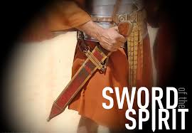
The Whole Armor of God (17)
“¹⁷ And take the helmet of salvation, and the sword of the Spirit, which is the word of God;
Notes:
The Greek term translated sword (μάχαιρα, machaira) refers to the Roman gladius, a short sword about 2 ft (60 cm) long, used for close hand-to-hand combat. This is the only clearly offensive weapon in the list of armor mentioned…
The Roman Gladius has become known as the sword that conquered the world… adapted from a Spanish design, the prowess of the gladius in close range combat made it a fearsome tool in the hand of a skilled toman warrior… when sharpened, it’s dual edges wreaked havoc on unarmored foes, while it’s tapered point could pierce through even heavy metal armor
Heb 4:12 “¹² For the word of God is living and powerful, and sharper than any two-edged sword, piercing even to the division of soul and spirit, and of joints and marrow, and is a discerner of the thoughts and intents of the heart.”

