Slide 2
Introduction: Paul’s Credentials and Preaching
Romans 1:1-7

Slide 3
Paul gives His Credentials
Paul
Paul started the churches in Corinth, Galatia, and Philippi, but not the church in Rome.
He had to introduce himself because they did not personally know him.
Notice the descriptions he used: “Paul, a servant of Christ Jesus, called to be an apostle and set apart for the gospel of God” (1:1).

Slide 4
Paul gives His Credentials
Servant of Christ Jesus
Paul drew from the Old Testament concept of servanthood:
Moses was the Lord’s servant;
The kings of Israel and Judah were God’s servants;
The prophets and priests were God’s servants.

Slide 5
Paul gives His Credentials
Called to be an Apostle
Paul was “called to be an apostle” (1:1)
An apostle is a messenger, one who brings his master’s will to others.
One of the requirements for an apostle of Christ was having seen the risen Christ
Paul saw Christ on the road to Damascus where he was called to be an apostle to the gentiles (Acts 9:1-9)

Slide 6
Paul gives His Credentials
Called to be an Apostle
“Having established his humble status as a doulos, Paul now tells the other side of the story. God has called him, just as God called Abraham (Genesis 12:1), Moses (Exodus 3), Isaiah (Isaiah 6), and other prophets—thus allying Paul with the great icons of Jewish history. God called Paul to be an apostle—a message-bearer—one of a select group privileged to see Jesus and chosen by Jesus to carry on his work.” (Sermonwriter.com)
Notes:
Serm

Slide 7
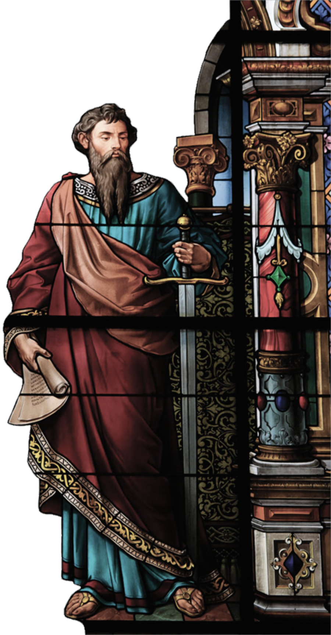
Paul gives His Credentials
Set Apart for the Gospel of God
Paul was “set apart” (1:1)
Pharisees were known as separated people…separate and holy…Paul was once separated to the law but now to the Gospel
Paul, called to be an apostle, has been set apart, not because of his own choosing, but by the will of God
Paul speaks of God setting him apart before he was born (Gal 1:15)

Slide 8
Paul gives His Credentials
Set Apart for the Gospel of God
His main calling as a servant of Christ Jesus and as an apostle was to be a witness to the gospel.
Paul’s missionary heart comes through from the beginning of the letter.

Slide 9
Paul Preached the Gospel
Set Apart for the Gospel of God
Paul offers an explanation of “the gospel of God.” The gospel:
Is about Jesus
Was Promised
Has Effects

Slide 10
Paul Preached the Gospel
Promised
The life and ministry of Jesus were anticipated in the Old Testament.
“…the gospel he promised beforehand through his prophets in the Holy Scriptures” (1:2).
Jesus is the fulfillment of God’s promises in the Old Testament.
The good news began in Genesis!

Slide 11
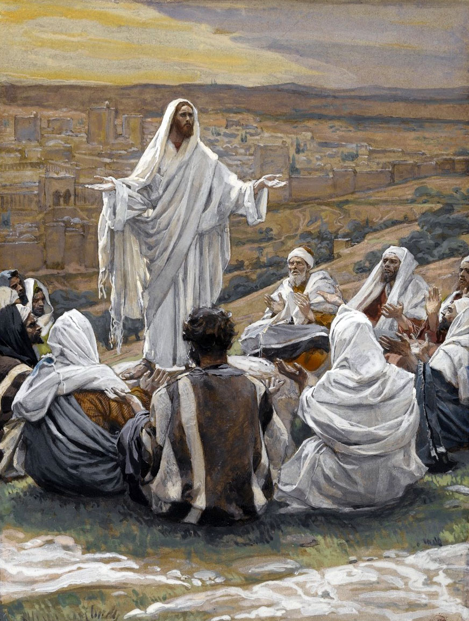
Paul Preached the Gospel
About Jesus
Jesus is the heart of the gospel. All of salvation history centers on his:
Divinity
Humanity
Ministry on earth
Death and resurrection
Jesus and His Disciples

Slide 12
Paul Preached the Gospel
About Jesus
All of it testifies to Jesus’ lordship:
Jesus is God’s Son.
Jesus was a human, descendant of David.
Jesus was resurrected from the dead.
“…regarding his Son, who as to his earthly life was a descendant of David, and who through the Spirit of holiness was appointed the Son of God in power by his resurrection from the dead: Jesus Christ our Lord.”—Romans 3:3–4

Slide 13
Paul Preached the Gospel
Effects
Paul explained that through the gospel we receive God’s grace, which makes all the difference in the world!
The effects of the gospel are central to Paul’s letter.
We, as Christians, also receive a calling: Paul was called to apostleship, but all Christians are called to belong to Jesus Christ.
Menu

Slide 14
Introduction: Paul’s Concerns
Romans 1:8-15

Slide 15
Paul’s Thankfulness (Vs 8)
Thankful to God through Jesus Christ
Your faithfulness is spoken of throughout the whole world
“Is spoken of - Is celebrated, or known. They were in the capital of the Roman Empire; in a city remarkable for its wickedness; and in a city whose influence extended everywhere. It was natural, therefore, that their remarkable conversion to God should be celebrated everywhere” (Barnes Notes)
Menu
Notes:
All Roads lead to Rome… whole world could mean the Roman Empire

Slide 16
Paul Prayed for Them (Vs 9-10)
“Without ceasing I make mention of you always in my prayers”
“At last I may find a way in the will of God to come to you”
Menu
Notes:
All Roads lead to Rome… whole world could mean the Roman Empire

Slide 17
Paul’s Love for Them (Vs 11-12)
“¹¹ For I long to see you, that I may impart to you some spiritual gift, so that you may be established—”
We see in this verse Paul’s desire to share with them “Some spiritual gift” to help establish (strengthen) them
“that I with you may be encouraged in you”
Paul is not only going there just to encourage them… he is going that he also may be encouraged by their faith and the time spent with them
Menu
Notes:
All Roads lead to Rome… whole world could mean the Roman Empire

Slide 18
Paul’s Debt to Them (Vs 14)
“¹⁴ I am a debtor both to Greeks and to barbarians, both to wise and to unwise”
Debtor is an unfortunate translation of the Greek word opheiletes in this verse
When Paul says that he is opheiletes to Greeks, barbarians, wise, and foolish, he is saying that he is obligated to them––morally bound to perform some sort of service in their behalf.
CHRIST has laid the obligation on Paul TO PREACH THE GOSPEL to Greeks and non-Greeks (barbarous) alike––to wise and foolish alike––to all people and every sort of person alike. (Sermonwriter.com)
Menu
Notes:
All Roads lead to Rome… whole world could mean the Roman Empire

Slide 19
Introduction: Paul’s Confidence in the Gospel
Romans 1:16-17

Slide 20
The Origin, Operation, Outcome , & Outreach of the Gospel (Vs 16-17)
“gospel of Christ”
“power of God”
“Salvation”
“everyone who believes…The just shall live by faith.”
Menu

