Slide 1
Make your Declaration
“I live in Dependence on God”

Slide 2
Practical ways to Depend on God alone
Phil 4:6 “Be careful for nothing; but in every thing by prayer and supplication with thanksgiving let your requests be made known unto God.”

Slide 3
Practical ways to Depend on God alone
Notes:
Jam 5:13-16 “¹³ Is anyone among you suffering? Let him pray. Is anyone cheerful? Let him sing psalms. ¹⁴ Is anyone among you sick? Let him call for the elders of the church, and let them pray over him, anointing him with oil in the name of the Lord. ¹⁵ And the prayer of faith will save the sick, and the Lord will raise him up. And if he has committed sins, he will be forgiven. ^{16 [a]}Confess your trespasses to one another, and pray for one another, that you may be healed. The effective, ^{[b]}fervent prayer of a righteous man avails much. “

Slide 4
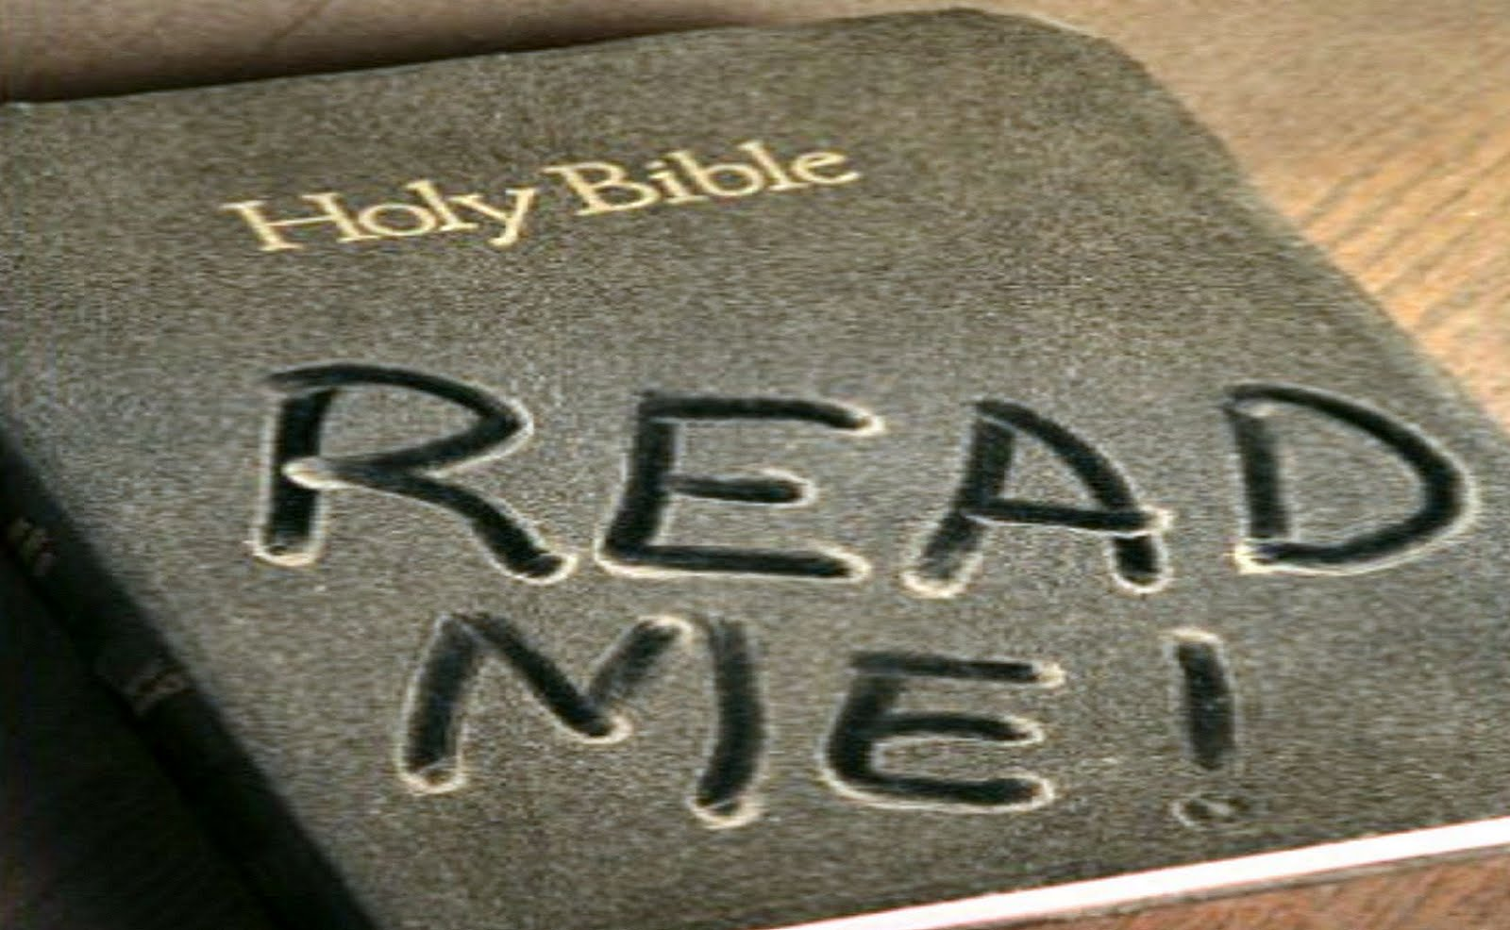
Practical ways to Depend on God alone
Josh 1:8 “This book of the law shall not depart out of thy mouth; but thou shalt meditate therein day and night, that thou mayest observe to do according to all that is written therein: for then thou shalt make thy way prosperous, and then thou shalt”

Slide 5
Practical ways to Depend on God alone
Mt 4:4 “But He answered and said, “It is written, ‘Man shall not live by bread alone, but by every word that proceeds from the mouth of God.’ ”

Slide 6
Practical ways to Depend on God alone
Jn 15:7 “If you abide in Me, and My words abide in you, you will ask what you desire, and it shall be done for you.”

Slide 7
Practical ways to Depend on God alone
Rom 10:17 “So then faith comes by hearing, and hearing by the word of God.”

Slide 8
Practical ways to Depend on God alone
Acts 17:11 “These were more fair-minded than those in Thessalonica, in that they received the word with all readiness, and searched the Scriptures daily to find out whether these things were so. “

Slide 9
Practical ways to Depend on God alone
2 Tim 2:15 “Be diligent to present yourself approved to God, a worker who does not need to be ashamed, rightly dividing the word of truth. “

Slide 10
Practical ways to Depend on God alone
2 Tim 3:16-17 “All Scripture is given by inspiration of God, and is profitable for doctrine, for reproof, for correction, for instruction in righteousness, ¹⁷ that the man of God may be complete, thoroughly equipped for every good work.”

Slide 11
Practical ways to Depend on God alone
Jochabed
did right by saving her baby Moses (Ex 2:1-10)

Slide 12
Practical ways to Depend on God alone
David
did right by standing up to Goliath (1 Sam 17)

Slide 13
Practical ways to Depend on God alone
Daniel
did right by ignoring the king’s decree and still prayed to God (Dan 6)

Slide 14
Practical ways to Depend on God alone
Rom 12:1 “I beseech you therefore, brethren, by the mercies of God, that you present your bodies a living sacrifice, holy, acceptable to God, which is your ]reasonable service.

Slide 15
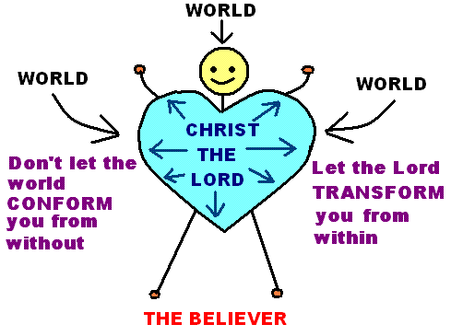
Practical ways to Depend on God alone
Rom 12:2 “And do not be conformed to this world, but be transformed by the renewing of your mind, that you may prove what is that good and acceptable and perfect will of God.”

Slide 16
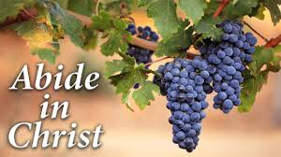
Practical ways to Depend on God alone
Jn 15:4 “Abide in Me, and I in you. As the branch cannot bear fruit of itself, unless it abides in the vine, neither can you, unless you abide in Me.”

Slide 17
Practical ways to Depend on God alone
Jn 15:5 “I am the vine, you are the branches. He who abides in Me, and I in him, bears much fruit; for without Me you can do nothing.”

Slide 18
Practical ways to Depend on God alone
Phil 4:6-7 “Be anxious for nothing, but in everything by prayer and supplication, with thanksgiving, let your requests be made known to God;
⁷ and the peace of God, which surpasses all understanding, will guard your hearts and minds through Christ Jesus.

Slide 19
Practical ways to Depend on God alone
Phil 4:19 “And my God shall supply all your need according to His riches in glory by Christ Jesus. “

Slide 20
Practical ways to Depend on God alone
1 Pet 5:6-7 “Therefore humble yourselves under the mighty hand of God, that He may exalt you in due time,
⁷ casting all your care upon Him, for He cares for you.”

