Slide 1
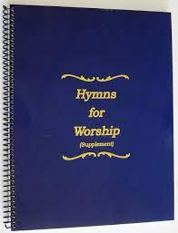
Remember who you are
Song #20

Slide 2
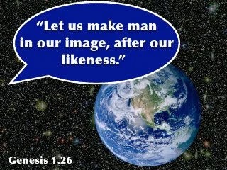
In his image god created you; in new birth he gave you life anew
Gen 1:26-27 “²⁶ Then God said, “Let Us make man in Our image, according to Our likeness; let them have dominion over the fish of the sea, over the birds of the air, and over the cattle, over all the earth and over every creeping thing that creeps on the earth.” ²⁷ So God created man in His own image; in the image of God He created him; male and female He created them.
Gen 5:1 “5 This is the book of the genealogy of Adam. In the day that God created man, He made him in the likeness of God.”
Notes:
We are made to resemble God… not in the sense of physical appearance… man was made distinct from all the rest of creation

Slide 3
In his image god created you; in new birth he gave you life anew
Rom 6:4 “⁴ Therefore we were buried with Him through baptism into death, that just as Christ was raised from the dead by the glory of the Father, even so we also should walk in newness of life.
2 Cor 5:17 “¹⁷ Therefore, if anyone is in Christ, he is a new creation; old things have passed away; behold, all things have become new.
Notes:
Gal 2:20 “²⁰ I have been crucified with Christ; it is no longer I who live, but Christ lives in me; and the life which I now live in the flesh I live by faith in the Son of God, who loved me and gave Himself for me.

Slide 4
And his matchless love you now proclaim; you must live to glorify His name
Jn 3:16 “¹⁶ For God so loved the world that He gave His only begotten Son, that whoever believes in Him should not perish but have everlasting life.
Jn 15:13 “¹³ Greater love has no one than this, than to lay down one’s life for his friends.

Slide 5
And his matchless love you now proclaim; you must live to glorify His name
Rom 5:5-8 “⁵ Now hope does not disappoint, because the love of God has been poured out in our hearts by the Holy Spirit who was given to us. ⁶ For when we were still without strength, in due time Christ died for the ungodly. ⁷ For scarcely for a righteous man will one die; yet perhaps for a good man someone would even dare to die. ⁸ But God demonstrates His own love toward us, in that while we were still sinners, Christ died for us.

Slide 6
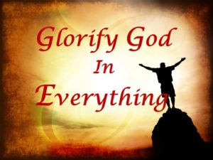
And his matchless love you now proclaim; you must live to glorify His name
Ps 115:1 “115 Not unto us, O Lord, not unto us, But to Your name give glory, Because of Your mercy, Because of Your truth.
1 Cor 10:31 “³¹ Therefore, whether you eat or drink, or whatever you do, do all to the glory of God.

Slide 7
And his matchless love you now proclaim; you must live to glorify His name
Rev 4:11 “¹¹ “You are worthy, O Lord ,To receive glory and honor and power; For You created all things, And by Your will they exist and were created.”
Rev 5:12-13 “¹² saying with a loud voice: “Worthy is the Lamb who was slain To receive power and riches and wisdom, And strength and honor and glory and blessing!” ¹³ And every creature which is in heaven and on the earth and under the earth and such as are in the sea, and all that are in them, I heard saying: “Blessing and honor and glory and power Be to Him who sits on the throne, And to the Lamb, forever and ever!”

Slide 8
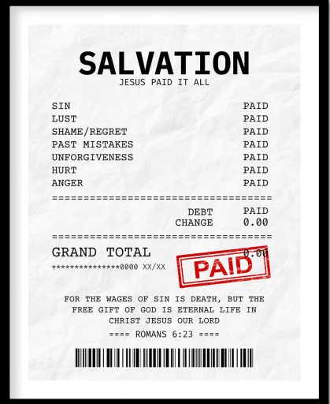
You were bought at such an awful price; christ redeemed you by his sacrifice
Mt 20:28 “²⁸ just as the Son of Man did not come to be served, but to serve, and to give His life a ransom for many.”
1 Cor 6:19-20 “¹⁹ Or do you not know that your body is the temple of the Holy Spirit who is in you, whom you have from God, and you are not your own? ²⁰ For you were bought at a price; therefore glorify God in your body and in your spirit, which are God’s.
1 Pet 2:24 “²⁴ who Himself bore our sins in His own body on the tree, that we, having died to sins, might live for righteousness—by whose stripes you were healed.

Slide 9
You were bought at such an awful price; christ redeemed you by his sacrifice
Gal 3:13 “¹³ Christ has redeemed us from the curse of the law, having become a curse for us (for it is written, “Cursed is everyone who hangs on a tree”),
Heb 9:12 “¹² Not with the blood of goats and calves, but with His own blood He entered the Most Holy Place once for all, having obtained eternal redemption.
1 Pet 1:18-20 “¹⁸ knowing that you were not redeemed with corruptible things, like silver or gold, from your aimless conduct received by tradition from your fathers, ¹⁹ but with the precious blood of Christ, as of a lamb without blemish and without spot. ²⁰ He indeed was foreordained before the foundation of the world, but was manifest in these last times for you ²¹ who through Him believe in God, who raised Him from the dead and gave Him glory, so that your faith and hope are in God.

Slide 10
You obeyed him and were free from sin; peace and hope and joy and love within
Mt 7:21 “²¹ “Not everyone who says to Me, ‘Lord, Lord,’ shall enter the kingdom of heaven, but he who does the will of My Father in heaven.
Lk 6:46 “⁴⁶ “But why do you call Me ‘Lord, Lord,’ and not do the things which I say?
Lk 11:28 “²⁸ But He said, “More than that, blessed are those who hear the word of God and keep it!”
Jn 14:15 “¹⁵ “If you love Me, keep My commandments.

Slide 11
You obeyed him and were free from sin; peace and hope and joy and love within
Acts 2:38 “³⁸ Then Peter said to them, “Repent, and let every one of you be baptized in the name of Jesus Christ for the remission of sins; and you shall receive the gift of the Holy Spirit.
Rom 6:16 “¹⁶ Do you not know that to whom you present yourselves slaves to obey, you are that one’s slaves whom you obey, whether of sin leading to death, or of obedience leading to righteousness?
Heb 5:8 “⁸ though He was a Son, yet He learned obedience by the things which He suffered. ⁹ And having been perfected, He became the author of eternal salvation to all who obey Him,

Slide 12
You obeyed him and were free from sin; peace and hope and joy and love within
Jn 8:34-36 “³⁴ Jesus answered them, “Most assuredly, I say to you, whoever commits sin is a slave of sin. ³⁵ And a slave does not abide in the house forever, but a son abides forever. ³⁶ Therefore if the Son makes you free, you shall be free indeed.
Rom 8:2 “² For the law of the Spirit of life in Christ Jesus has made me free from the law of sin and death.
1 Jn 1:9 “⁹ If we confess our sins, He is faithful and just to forgive us our sins and to cleanse us from all unrighteousness.

Slide 13
You obeyed him and were free from sin; peace and hope and joy and love within
Phil 4: 6-7 “⁶ Be anxious for nothing, but in everything by prayer and supplication, with thanksgiving, let your requests be made known to God; ⁷ and the peace of God, which surpasses all understanding, will guard your hearts and minds through Christ Jesus.
Rom 15:13 “¹³ Now may the God of hope fill you with all joy and peace in believing, that you may abound in hope by the power of the Holy Spirit.
1 Pet 1:8-9 “⁸ whom having not seen you love. Though now you do not see Him, yet believing, you rejoice with joy inexpressible and full of glory, ⁹ receiving the end of your faith—the salvation of your souls.

Slide 14
You obeyed him and were free from sin; peace and hope and joy and love within
1 jn 4:19-21 “¹⁹ We love Him because He first loved us.
²⁰ If someone says, “I love God,” and hates his brother, he is a liar; for he who does not love his brother whom he has seen, how can he love God whom he has not seen?
²¹ And this commandment we have from Him: that he who loves God must love his brother also.

Slide 15
