Slide 1
The Three I AM’s of Paul
Rom 1:14-16

Slide 2
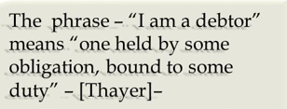
I am a Debtor (Rom 1:14)
^{Called by God}
^{1 Cor 9:16}
^{Acts 9:15}
^{Rom 11:13}
^{The need of Sinners}
^{2 Thes 1:8-9}
Notes:
1 Cor 9:16 “¹⁶ For if I preach the gospel, I have nothing to boast of, for necessity is laid upon me; yes, woe is me if I do not preach the gospel! “
Rom 11:13 “¹³ For I speak to you Gentiles; inasmuch as I am an apostle to the Gentiles, I magnify my ministry, “
2 thes 1:8-9 “⁸ in flaming fire taking vengeance on those who do not know God, and on those who do not obey the gospel of our Lord Jesus Christ. ⁹ These shall be punished with everlasting destruction from the presence of the Lord and from the glory of His power,”

Slide 3
We are Debtors Also
^{Debtors to God}
^{Rom 5:8; 8:12-14}
^{Our Call to Serve}
^{Mk 16:15}
^{The Need of the Lost}
^{Rom 3:23; 6:23}
^{Mt 9:35-38}
Notes:
Rom 8:12-14 “¹² Therefore, brethren, we are debtors—not to the flesh, to live according to the flesh. ¹³ For if you live according to the flesh you will die; but if by the Spirit you put to death the deeds of the body, you will live. ¹⁴ For as many as are led by the Spirit of God, these are sons of God.
Mt 9:35-38 “³⁵ Then Jesus went about all the cities and villages, teaching in their synagogues, preaching the gospel of the kingdom, and healing every sickness and every disease ^{[a]}among the people. ³⁶ But when He saw the multitudes, He was moved with compassion for them, because they were ^{[b]}weary and scattered, like sheep having no shepherd. ³⁷ Then He said to His disciples, “The harvest truly is plentiful, but the laborers are few. ³⁸ Therefore pray the Lord of the harvest to send out laborers into His harvest.”

Slide 4
I am a Ready (Rom 1:15)
^{Focused on the task to preach}
Willing: Desire to serve the Lord
Prepared: He knew the value of the message because he lived it himself
Eager: Paul desired to see others come to Jesus
^{Rom 10:1}
Notes:
Rom 10:1 “10” Brethren, my heart’s desire and prayer to God for ^{[a]}Israel is that they may be saved.

Slide 5
We Must be Ready Also (Rom 1:15)
^{Focused on the task to preach}
^{Willing:}
^{Is 6:8}
^{Prepared:}
^{1 Pet 3:15}
^{Eager}
Notes:
Is 6:8 “⁸ Also I heard the voice of the Lord, saying: “Whom shall I send, And who will go for Us?” Then I said, “Here am I! Send me.”
1 Pet 3:15 “¹⁵ But ^{[a]}sanctify ^{[b]}the Lord God in your hearts, and always be ready to give a defense to everyone who asks you a reason for the hope that is in you, with meekness and fear;

Slide 6
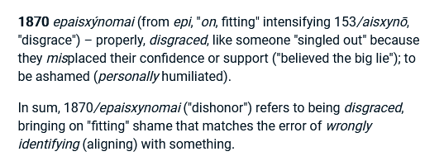
I am not Ashamed (Rom 1:16)
Not Ashamed of the Gospel because…
It is Christ's gospel - It is all about Him and His sacrifice for us.
It is God's power - The greatest demonstration is in the saving of a soul.
It brings salvation - It keeps sinners out of hell and carries them to Heaven.
It reaches all - There is not a person in the world who cannot be saved!
His personal experience (Act 9)
Notes:
^{Paul was not Embarrassed}
^{1 Cor 2:1-5}
^{2 Cor 4:7-14; 11:23-28}

Slide 7
Final Thought

