Slide 1
The Future of the Church

Slide 4
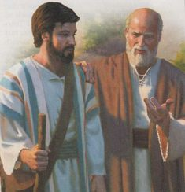

Slide 5
A Mentor Seeks out Mentees
Acts 16:1-3 “16 Then he came to Derbe and Lystra. And behold, a certain disciple was there, named Timothy, the son of a certain Jewish woman who believed, but his father was Greek ² He was well spoken of by the brethren who were at Lystra and Iconium. ³ Paul wanted to have him go on with him. And he took him and circumcised him because of the Jews who were in that region, for they all knew that his father was Greek.

Slide 6
A Mentor Recognizes Potential
Timothy was timid and fearful (2 Tim 1:7)
His spiritual heritage was divided having a Greek father and a Jewish mother (Acts 16:1)
He was young and inexperienced ( 1 Tim 4:12)
Paul recognized other believers spoke well of him (Acts 16:2)
Notes:
2 Tim 1:7 “⁷ For God has not given us a spirit of fear, but of power and of love and of a sound mind.”
1 Tim 4:12 “¹² Let no one ^{[a]}despise your youth, but be an example to the believers in word, in conduct, in love, ^{[b]}in spirit, in faith, in purity.”

Slide 7
A Mentor Prays for a Mentee
2 Tim 3:1-3 “³ I thank God, whom I serve with a pure conscience, as my forefathers did, as without ceasing I remember you in my prayers night and day,
Notes:
2 Tim 1:7 “⁷ For God has not given us a spirit of fear, but of power and of love and of a sound mind.”
1 Tim 4:12 “¹² Let no one ^{[a]}despise your youth, but be an example to the believers in word, in conduct, in love, ^{[b]}in spirit, in faith, in purity.”

Slide 8
A Mentor Spends Time With a Mentee
Acts 16:3-5 “³ Paul wanted to have him go on with him. And he took him and circumcised him because of the Jews who were in that region, for they all knew that his father was Greek. ⁴ And as they went through the cities, they delivered to them the decrees to keep, which were determined by the apostles and elders at Jerusalem. ⁵ So the churches were strengthened in the faith, and increased in number daily.
2 Tim 1:4 “Greatly desiring to see you…”

Slide 9
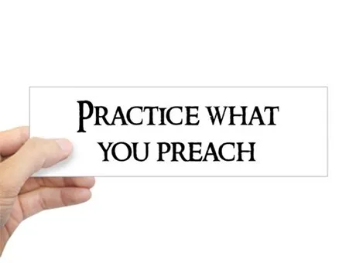
A Mentor Lives and Leads by Example
2 Tim 3:10-11 “¹⁰ But you have carefully followed my doctrine, manner of life, purpose, faith, longsuffering, love, perseverance, ¹¹ persecutions, afflictions, which happened to me at Antioch, at Iconium, at Lystra—what persecutions I endured. And out of them all the Lord delivered me.”

Slide 10
A Mentor Lives and Leads by Example
2 Tim 4:6-8 “⁶ For I am already being poured out as a drink offering, and the time of my departure is at hand. ⁷ I have fought the good fight, I have finished the race, I have kept the faith. ⁸ Finally, there is laid up for me the crown of righteousness, which the Lord, the righteous Judge, will give to me on that Day, and not to me only but also to all who have loved His appearing.

Slide 11
A Mentor Provides Opportunities for Growth
Acts 17:13-14 “¹³ But when the Jews from Thessalonica learned that the word of God was preached by Paul at Berea, they came there also and stirred up the crowds. ¹⁴ Then immediately the brethren sent Paul away, to go to the sea; but both Silas and Timothy remained there.
1 Tim 1:3-4 “³ As I urged you when I went into Macedonia—remain in Ephesus that you may charge some that they teach no other doctrine, ⁴ nor give heed to fables and endless genealogies, which cause disputes rather than godly edification which is in faith

Slide 12
A Mentor Encourages a Mentee to persevere in their work for the Lord
2 Tim 1:6-8 “⁶ Therefore I remind you to stir up the gift of God which is in you through the laying on of my hands. ⁷ For God has not given us a spirit of fear, but of power and of love and of a sound mind. ⁸ Therefore do not be ashamed of the testimony of our Lord, nor of me His prisoner, but share with me in the sufferings for the gospel according to the power of God,
Notes:
1 Tim 4:12 “¹² Let no one ^{[a]}despise your youth, but be an example to the believers in word, in conduct, in love, ^{[b]}in spirit, in faith, in purity.”

Slide 13
A Mentor Encourages a Mentee to persevere in their work for the Lord
2 Tim 2:3-7 “³ You therefore must endure hardship as a good soldier of Jesus Christ. ⁴ No one engaged in warfare entangles himself with the affairs of this life, that he may please him who enlisted him as a soldier. ⁵ And also if anyone competes in athletics, he is not crowned unless he competes according to the rules. ⁶ The hardworking farmer must be first to partake of the crops. ⁷ Consider what I say, and may the Lord give you understanding in all things.”
Notes:
A soldier isn’t distracted from his duty by the ordinary concerns of life. An athlete exercises careful self-discipline in order to compete. A farmer expects results and waits patiently for the produce. That’s how a good servant of Christ is to endure

Slide 14
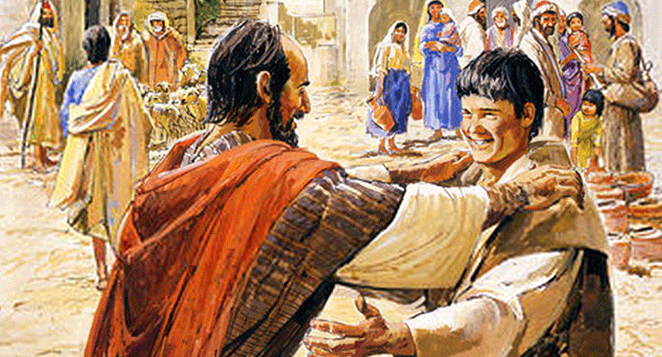
A Mentor Truly Loves their Mentee
1 Tim 1:2 “² To Timothy, a true son in the faith:…”
1 Tim 2:18 “…”son Timothy,…”
2 Tim 2:1 “…My son…”
2 Tim 4:9 “⁹ Be diligent to come to me quickly;”

Slide 15
A Mentor Truly Loves their Mentee
1 Cor 4:17 “¹⁷ For this reason I have sent Timothy to you, who is my beloved and faithful son in the Lord, who will remind you of my ways in Christ, as I teach everywhere in every church.”
Phil 2:19-22 “¹⁹ But I trust in the Lord Jesus to send Timothy to you shortly, that I also may be encouraged when I know your state. ²⁰ For I have no one like-minded, who will sincerely care for your state. ²¹ For all seek their own, not the things which are of Christ Jesus. ²² But you know his proven character, that as a son with his father he served with me in the gospel. “

Slide 16
Final Question

