Slide 2
Introduction: Historical Background
Babylon was taking over Jerusalem (Jer 37:5)
Babylon received news Egypt was coming to help Jerusalem, so they temporarily stopped their siege (Jer 37:5)
Jeremiah prophesies during this time period that Babylon will return and destroy Jerusalem (Jer 37:1-10)
Jeremiah is arrested and charged with being a traitor (Jer 37: 11-16)
The king sends for Jeremiah and upon hearing his message decides to return him to prison
Jeremiah is thrown into a pit to die (Jer 38:1-6)

Slide 3
Ebed-Melech heard of Jeremiah’s situation (Jer 38:7-10)
Ebed-Melech doesn’t wait but takes action
Upon hearing of Jeremiah’s treatment he immediately goes to the king
He recognizes if he does not act Jeremiah may lose his life

Slide 4
Ebed-Melech heard of Jeremiah’s situation (Jer 38:7-10)
When we hear of someone’s spiritual life in danger, do we respond
Are we ready to take action immediately
Do we stand up for our bothers and sisters when they are mistreated for teaching the truth
Do we hear and just ignore the situation or think someone else can take care of it (not my problem)

Slide 5
Ebed-Melech heard of Jeremiah’s situation (Jer 38:7-10)
Ebed-Melech took his case before the king
This could have placed him in danger but he had enough compassion for Jeremiah and personal courage he took action
The King responded in mercy and encouraged Ebed-Melech to get help and free Jeremiah before he dies

Slide 6
Ebed-Melech heard of Jeremiah’s situation (Jer 38:7-10)
We too can take our case before our Lord and King
We must have a true compassion and love for mankind as well as courage and confidence in God to hear and care for us
Our Lord and King will also respond in grace and mercy to rescue from spiritual death
Do we love others enough to act

Slide 7
Ebed-Melech heard of Jeremiah’s situation (Jer 38:7-10)
Ebed-Melech sought the help of others
This was done under the authority of the king
The King understood there is strength and value in people working together

Slide 8
Ebed-Melech heard of Jeremiah’s situation (Jer 38:7-10)
Do we seek the help of others
Do we recognize the strength and power that comes from working together
We have the authority of our Lord and King to work together to help save lost from death
Are we ready, willing, and able to work and serve with others as our King would have us do

Slide 9
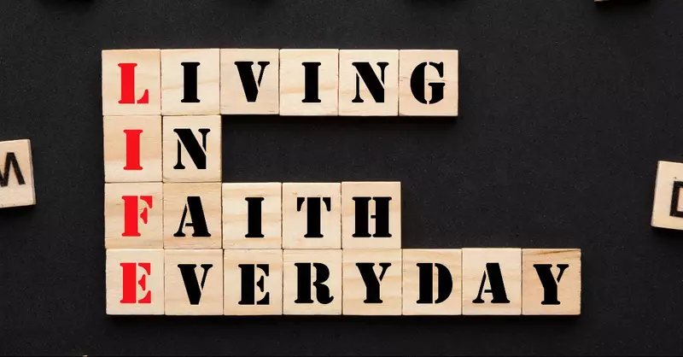
Ebed-Melech Obeyed the King (Jer 38:7-10)
Notice the faith Ebed-Melech has in the ropes
We do not see him testing them
He believes that they have the power and strength necessary to remove Jeremiah from the pit
There is absolute faith that Jeremiah will be saved through this process

Slide 10
Ebed-Melech Knew how to Explain (Jer 38:11)
Do we have the same faith and trust in God’s plan to save mankind as Ebed-Melech had in the ropes
Do we question the strength of the rope (Gospel)
Are we fully ready and confident to “let down the rope of salvation” to help save the lives of sinners
Do we act upon this faith

Slide 11
Ebed-Melech Knew how to Explain (Jer 38:12)
Ebed-Melech knew how to explain the process to Jeremiah of how he would be saved
Verse 12 shows just how clear and simple the directions were
Jeremiah is able to easily understand and take the necessary steps that lead to his salvation from the pit

Slide 12
Ebed-Melech Knew how to Explain (Jer 38:12)
Do we know God’s plan for the salvation of souls
Are we able to explain it in a manner that is simple for the hearer to understand act upon
Will those who hear our explanation be able to follow it as easy as Jeremiah followed the direction of Ebed-Melech

Slide 13
Ebed-Melech a Man Rewarded(Jer 39:15-18)
Ebed-Melech heard the words of Jeremiah the prophet concerning the Lord and believed them and put his trust in the Lord
Because of his trust and faith in the Lord Ebed-Mech’s life was spared in the conquest of the Babylonians
Without this faith and his actions Ebed-Melech would have perished

Slide 14
Ebed-Melech a Man Rewarded(Jer 39:15-18)
When we hear the word of the Lord in His book do we find them to be true and therefore put our trust in Him
If we believe and act in faith as Ebed-Melech did we will be spared from a spiritual death
If we refuse to listen and trust in what the Lord has said we will perish with all those who do not trust in Him

Slide 15
Ebed-Melech An Example for us Today
The account of Ebed-Melech serves as a reminder for each of us today
It reminds us we not only need to hear and put our trust in the Lord, but we must also take action in faith
If we do good and follow the Lord’s will we will be saved
If we choose not to listen or not to act we will surely perish

