Slide 1
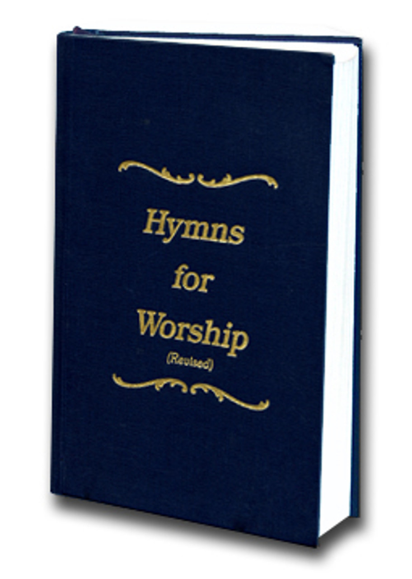
I am Resolved
Song # 325

Slide 2
INTRODUCTION
Resolution
a formal expression of opinion or intention made
A resolve; a decision or determination
Resolved
firm in purpose or intent; determined.

Slide 3
I AM RESOLVED NO LONGER TO LINGER CHARMED BY THE WORLD’S DELIGHTS
Linger
to remain or stay on in a place longer than is usual or expected
to dwell in contemplation, thought, or enjoyment:
to linger over the beauty of a painting.
Acts 2:42-44 ⁴⁰ And with many other words he testified and exhorted them, saying, “Be saved from this perverse generation.” ⁴¹ Then those who gladly received his word were baptized; and that day about three thousand souls were added to them. ⁴² And they continued steadfastly in the apostles’ doctrine and fellowship, in the breaking of bread, and in prayers.

Slide 4
I AM RESOLVED NO LONGER TO LINGER CHARMED BY THE WORLD’S DELIGHTS
Linger
to remain or stay on in a place longer than is usual or expected
to dwell in contemplation, thought, or enjoyment:
to linger over the beauty of a painting.
2 Cor 6:2 ² For He says: “In an acceptable time I have heard you, And in the day of salvation I have helped you.” Behold, now is the accepted time; behold, now is the day of salvation.

Slide 5
I AM RESOLVED NO LONGER TO LINGER CHARMED BY THE WORLD’S DELIGHTS
Linger
to remain or stay on in a place longer than is usual or expected
to dwell in contemplation, thought, or enjoyment:
to linger over the beauty of a painting.
Jam 4:4 ¹⁴ whereas you do not know what will happen tomorrow. For what is your life? It is even a vapor that appears for a little time and then vanishes away.

Slide 6
I AM RESOLVED NO LONGER TO LINGER CHARMED BY THE WORLD’S DELIGHTS
Do not Love the World
1 Jn 2:15-17 ¹⁵ Do not love the world or the things in the world. If anyone loves the world, the love of the Father is not in him. ¹⁶ For all that is in the world—the lust of the flesh, the lust of the eyes, and the pride of life—is not of the Father but is of the world. ¹⁷ And the world is passing away, and the lust of it; but he who does the will of God abides forever.
Jam 4:3-4 ³ You ask and do not receive, because you ask amiss, that you may spend it on your pleasures. ⁴ Adulterers and adulteresses! Do you not know that friendship with the world is enmity with God? Whoever therefore wants to be a friend of the world makes himself an enemy of God.
Mk 8:36 ³⁶ For what will it profit a man if he gains the whole world, and loses his own soul?

Slide 7
THINGS THAT ART HIGHER, THINGS THAT ARE NOBLER, THESE HAVE ALURED MY SIGHT
Change Your way of Thinking
Rom 12:1-2 12 I beseech you therefore, brethren, by the mercies of God, that you present your bodies a living sacrifice, holy, acceptable to God, which is your reasonable service. ² And do not be conformed to this world, but be transformed by the renewing of your mind, that you may prove what is that good and acceptable and perfect will of God.
Col 3:1-2 3 If then you were raised with Christ, seek those things which are above, where Christ is, sitting at the right hand of God. ² Set your mind on things above, not on things on the earth.
Phil 4:8 ⁸ Finally, brethren, whatever things are true, whatever things are noble, whatever things are just, whatever things are pure, whatever things are lovely, whatever things are of good report, if there is any virtue and if there is anything praiseworthy—meditate on these things.

Slide 8
I AM RESOLVED TO GO TO THE SAVIOR LEAVING MY SIN AND STRIFE
Jesus came to be our Savior
Mt 1:21 ²¹ And she will bring forth a Son, and you shall call His name Jesus, for He will save His people from their sins.”
Lk 19:10 ¹⁰ for the Son of Man has come to seek and to save that which was lost.”
Mt 11:28 ²⁸ Come to Me, all you who labor and are heavy laden, and I will give you rest.
Mt 16:24 ²⁴ Then Jesus said to His disciples, “If anyone desires to come after Me, let him deny himself, and take up his cross, and follow Me.

Slide 9
HE IS THE TRUE ONE, HE IS THE JUST ONE, HE HATH THE WORDS OF LIFE
Jesus has the Words of Life
Jn 6:61-63 ⁶¹ When Jesus knew in Himself that His disciples complained about this, He said to them, “Does this offend you? ⁶² What then if you should see the Son of Man ascend where He was before? ⁶³ It is the Spirit who gives life; the flesh profits nothing. The words that I speak to you are spirit, and they are life.
Jn 6:67-69 ⁶⁷ Then Jesus said to the twelve, “Do you also want to go away?” ⁶⁸ But Simon Peter answered Him, “Lord, to whom shall we go? You have the words of eternal life. ⁶⁹ Also we have come to believe and know that You are the Christ, the Son of the living God.”

Slide 10
I AM RESOLVED TO FOLLOW THE SAVIOR, FAITHFUL AND TRUE EACH DAY
Jesus came not only to be our Savior, but Lord as Well
Lk 2:11 ¹¹ For there is born to you this day in the city of David a Savior, who is Christ the Lord.
Rom 1:4 ⁴ and declared to be the Son of God with power according to the Spirit of holiness, by the resurrection from the dead.
1 Cor 8:6 ⁶ yet for us there is one God, the Father, of whom are all things, and we for Him; and one Lord Jesus Christ, through whom are all things, and through whom we live.

Slide 11
HEED WHAT HE SAYETH, DO WHAT HE WILLETH, HE IS THE LIVING WAY
He Left us an Example to Follow
Jn 13:13-15 ¹³ You call Me Teacher and Lord, and you say well, for so I am. ¹⁴ If I then, your Lord and Teacher, have washed your feet, you also ought to wash one another’s feet. ¹⁵ For I have given you an example, that you should do as I have done to you.
1 Pet 2:21 ²¹ For to this you were called, because Christ also suffered for us, leaving us an example, that you should follow His steps:
He is the living way
Jn 14:5-6 ⁵ Thomas said to Him, “Lord, we do not know where You are going, and how can we know the way?”⁶ Jesus said to him, “I am the way, the truth, and the life. No one comes to the Father except through Me.

Slide 12
I AM RESOLVED TO ENTER THE KINGDOM LEAVING THE PATHS OF SIN, FRIENDS MAY OPPOSE ME, FOES MAY BESET ME, STILL WILL I ENTER IN
The Kingdom of the Lord is His Church
Col 1:13 ¹³ He has delivered us from the power of darkness and conveyed us into the kingdom of the Son of His love,
Rev 1:9 ⁹ I, John, both your brother and companion in the tribulation and kingdom and patience of Jesus Christ, was on the island that is called Patmos for the word of God and for the testimony of Jesus Christ.

Slide 13
I AM RESOLVED TO ENTER THE KINGDOM LEAVING THE PATHS OF SIN, FRIENDS MAY OPPOSE ME, FOES MAY BESET ME, STILL WILL I ENTER IN
Resolving to Live Godly Lives Leads to Entrance into the Eternal Kingdom of Heaven
2 Pet 1:5-11 ⁵ But also for this very reason, giving all diligence, add to your faith virtue, to virtue knowledge, ⁶ to knowledge self-control, to self-control perseverance, to perseverance godliness, ⁷ to godliness brotherly kindness, and to brotherly kindness love. ⁸ For if these things are yours and abound, you will be neither barren nor unfruitful in the knowledge of our Lord Jesus Christ. ⁹ For he who lacks these things is shortsighted, even to blindness, and has forgotten that he was cleansed from his old sins. ¹⁰ Therefore, brethren, be even more diligent to make your call and election sure, for if you do these things you will never stumble; ¹¹ for so an entrance will be supplied to you abundantly into the everlasting kingdom of our Lord and Savior Jesus Christ.

