Slide 1
Mk 8:27-30

Slide 2
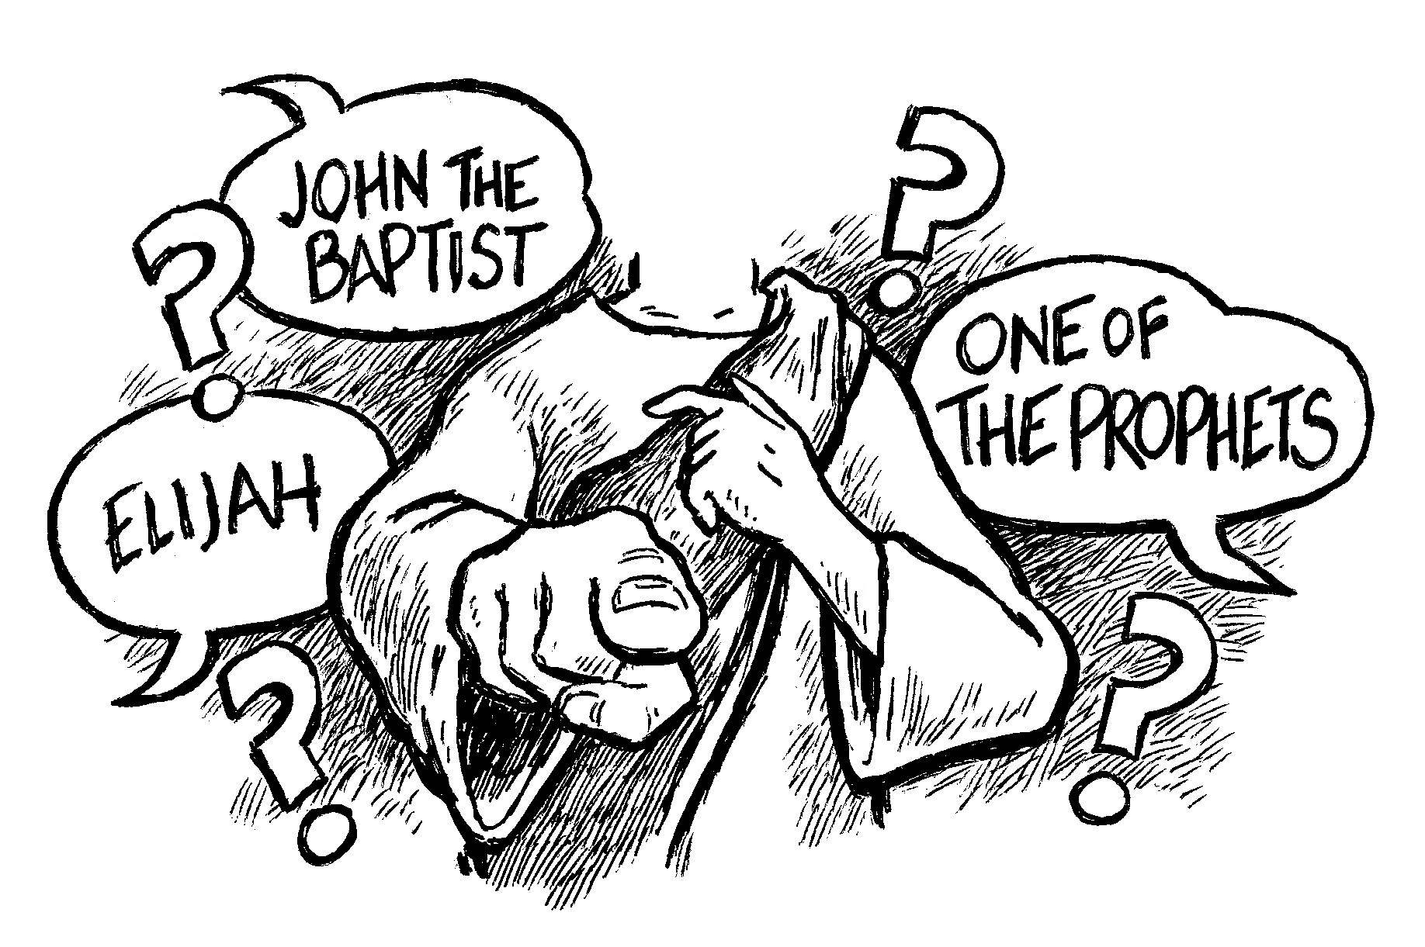
Question 1: “Who do men say that I am?”

Slide 3
Question 1: “Who do men say that I am?”
• The Pharisees and other religious elitists of the day said,“. . .He hath a devil, and is mad; why hear ye him?” (Jn 10:20).
• The Scribes, the men viewed as great teachers of the Law, said, “He hath Beelzebub, and by the prince of the devils casteth he out devils,” (Mk 3:22).
• The Sanhedrin, the ruling body of the Jewish religion, said, “. . .He hath spoken blasphemy; what further need have we of witnesses? behold, now ye have heard his blasphemy. What think ye? They answered and said, He is guilty of death. Then did they spit in his face, and buffeted him; and others smote him with the palms of their hands, Saying, Prophesy unto us, thou Christ, Who is he that smote thee?” (Mt 26:65-68).

Slide 4
Question 1: “Who do men say that I am?”
• His Own family and friends said, “He is beside himself,” (Mk 3:21).
• Even as Jesus hung on the cross, giving His life a ransom for sin, the religious elite continued to express their evil opinion of Him. “Likewise also the chief priests mocking said among themselves with the scribes, He saved others; himself he cannot save. Let Christ the King of Israel descend now from the cross, that we may see and believe. And they that were crucified with him reviled him,” (Mk 15:31-32).

Slide 5
Question 2: “But who do you say that I am?”
Peter answered and said to Him, “You are the Christ.”

Slide 6
Question 3: Who do people today say that He is?
Many in religious world preach and teach from pulpit to pulpit, week after week, across the world that Jesus is a loving, forgiving, gentle, caring, and patient Lord.
The preachers and teachers are not deceiving people by saying Jesus IS that way; He certainly is.
They are deceiving people by what they DO NOT say…
As a result many are deceived into thinking this is who Jesus is; ALL He is.

Slide 7
Question 3: Who do people today say that He is?
When Jesus was here on earth He was here to save the world, so certainly those aspects of Him were present (Jn. 3:17).
But when He returns it is to judge the world according to His word (Jn. 12:48).
They focus their teaching on some aspects of Him and leave an impression of Jesus not found in Scripture.
Some will defend their beliefs by saying, “My Jesus would never put a soul in Hell!”
“The God I believe in would never hurt His creation with an eternity of punishment!”

Slide 8
People today are not saying Jesus said…
²¹ “Not everyone who says to Me, ‘Lord, Lord,’ shall enter the kingdom of heaven, but he who does the will of My Father in heaven. ²² Many will say to Me in that day, ‘Lord, Lord, have we not prophesied in Your name, cast out demons in Your name, and done many wonders in Your name?’ ²³ And then I will declare to them, ‘I never knew you; depart from Me, you who practice lawlessness!’ (Mt 7:21-23)

Slide 9
People today are not saying Jesus said…
³⁷ He who loves father or mother more than Me is not worthy of Me. And he who loves son or daughter more than Me is not worthy of Me. ³⁸ And he who does not take his cross and follow after Me is not worthy of Me. ³⁹ He who finds his life will lose it, and he who loses his life for My sake will find it. (Mt 10:37-39)

Slide 10
People today are not saying Jesus said…
³¹ “When the Son of Man comes in His glory, and all the holy angels with Him, then He will sit on the throne of His glory. ³² All the nations will be gathered before Him, and He will separate them one from another, as a shepherd divides his sheep from the goats. ³³ And He will set the sheep on His right hand, but the goats on the left. ³⁴ Then the King will say to those on His right hand, ‘Come, you blessed of My Father, inherit the kingdom prepared for you from the foundation of the world:…⁴¹ “Then He will also say to those on the left hand, ‘Depart from Me, you cursed, into the everlasting fire prepared for the devil and his angels:…⁴⁶ And these will go away into everlasting punishment, but the righteous into eternal life.”
(Mt. 25:31-34, 41, 46)

Slide 11
People today are not saying Jesus said…
¹⁶ He who believes and is baptized will be saved; but he who does not believe will be condemned.
(Mk 16:16)

Slide 12
People today are not saying Jesus said…
¹⁵ “I know your works, that you are neither cold nor hot. I could wish you were cold or hot. ¹⁶ So then, because you are lukewarm, and neither cold nor hot, I will vomit you out of My mouth¹⁹ As many as I love, I rebuke and chasten. Therefore be zealous and repent.
(Rev 3:15-16, 19)

Slide 13
Conclusion
We must make sure that we are speaking the Jesus of the Bible, All of who He is and all of what He has said
⁴⁸ He who rejects Me, and does not receive My words, has that which judges him—the word that I have spoken will judge him in the last day. (Jn 12:48)
Who are you proclaiming Jesus is?

