Slide 1
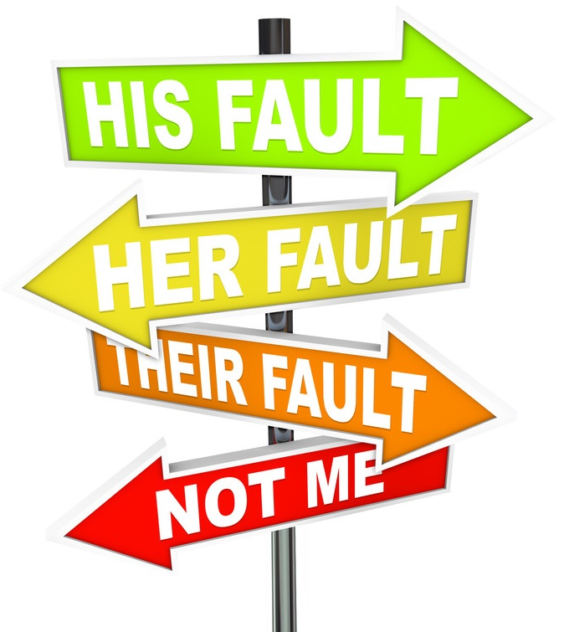
A False
Proverb Refuted
Ezekiel 18:1-3

Slide 2
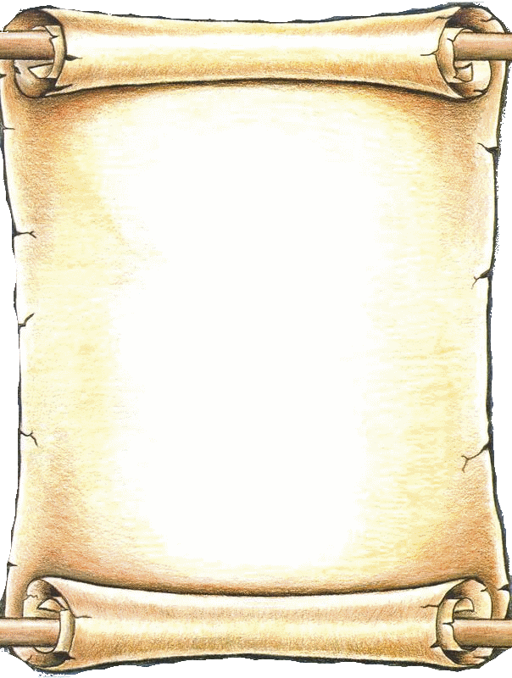
A False Proverb Refuted
“The word of the Lord came to me again, saying, “What do you mean when you use this proverb concerning the land of Israel, saying: ‘The fathers have eaten sour grapes, And the children’s teeth are set on edge’?
“As I live,” says the Lord God, “you shall no longer use this proverb in Israel..”
Ezekiel 18:1-3

Slide 3
A False Proverb Refuted
“The word of the Lord came to me again, saying, “What do you mean when you use this proverb concerning the land of Israel, saying: ‘The fathers have eaten sour grapes, And the children’s teeth are set on edge’?
“As I live,” says the Lord God, “you shall no longer use this proverb in Israel..”
Ezekiel 18:1-3

Slide 4
# 1
Cannot Blame Our Sin and Death on Our Parents
A
False Proverb Refuted

Slide 5
Cannot Blame Our Sin and Death on Our Parents
“You shall teach them diligently to your children, and shall talk of them when you sit in your house, when you walk by the way, when you lie down, and when you rise up.”
Deuteronomy 6:7
A
False Proverb Refuted

Slide 6
Cannot Blame Our Sin and Death on Our Parents
“And you, fathers, do not provoke your children to wrath, but bring them up in the training and admonition of the Lord.”
Ephesians 4:6
A
False Proverb Refuted

Slide 7
Cannot Blame Our Sin and Death on Our Parents
“Train up a child in the way he should go,
And when he is old he will not depart from it.”
Proverbs 22:6
A
False Proverb Refuted

Slide 8
Cannot Blame Our Sin and Death on Our Parents
“The fear of the Lord prolongs days, But the years of the wicked will be shortened.”
Proverbs 10:27
A
False Proverb Refuted

Slide 9
Cannot Blame Our Sin and Death on Our Parents
“He who loves pleasure will be a poor man;
He who loves wine and oil will not be rich.”
Proverbs 21:17
A
False Proverb Refuted

Slide 10
Cannot Blame Our Sins and Death on Our Parents
“Behold, all souls are Mine;
The soul of the father
As well as the soul of the son is Mine;
The soul who sins shall die.”
Ezekiel 18:4
A
False Proverb Refuted

Slide 11
Cannot Blame Our Sin and Death on Our Parents
“Yet you say, ‘Why should the son not bear the guilt of the father?’ Because the son has done what is lawful and right, and has kept all My statutes and observed them, he shall surely live.”
Ezekiel 18:19
A
False Proverb Refuted

Slide 12
Cannot Blame Our Sin and Death on Our Parents
“The soul who sins shall die. The son shall not bear the guilt of the father, nor the father bear the guilt of the son. The righteousness of the righteous shall be upon himself, and the wickedness of the wicked shall be upon himself.”
Ezekiel 18:20
A
False Proverb Refuted

Slide 13
#2
Cannot Blame Our Sin and Death on Our Past
A
False Proverb Refuted

Slide 14
Cannot Blame Our Sin and Death on Our Past
If one repents of his sins, his past need not burden him!
A
False Proverb Refuted

Slide 15
Cannot Blame Our Sin and Death on Our Past
If one repents, and now lives right, his past cannot condemn him!
A
False Proverb Refuted

Slide 16
Cannot Blame Our Sin and Death on Our Past
“But when a righteous man turns away from his righteousness and commits iniquity, and does according to all the abominations that the wicked man does, shall he live? All the righteousness which he has done shall not be remembered; because of the unfaithfulness of which he is guilty and the sin which he has committed, because of them he shall die.”
Ezekiel 18:24
A
False Proverb Refuted

Slide 17
Cannot Blame Our Sin and Death on Our Past
If one has turned to sin, a past life of righteousness will not save him!
A
False Proverb Refuted

Slide 18
Cannot Blame Our Sin and Death on Our Past
If have turned to error, past years of teaching truth will not count!
A
False Proverb Refuted

Slide 19
#3
Cannot Blame Our Sin and Death on Our God
A
False Proverb Refuted

Slide 20
Cannot Blame Our Sin and Death on Our Past
“Yet you say, ‘The way of the Lord is not fair.’ Hear now, O house of Israel, is it not My way which is fair, and your ways which are not fair?”
Ezekiel 18:25
A
False Proverb Refuted

Slide 21
Cannot Blame Our Sin and Death on Our Past
“Yet the house of Israel says, ‘The way of the Lord is not fair.’ O house of Israel, is it not My ways which are fair, and your ways which are not fair?”
Ezekiel 18:29
A
False Proverb Refuted

Slide 22
A False Proverb Refuted
Each one must give account for himself before God…

Slide 23
A False Proverb Refuted
No one inherits guilt from their parents, every person is only responsible for their own guilt…

Slide 24
A False Proverb Refuted
Each one can turn from sin to God, and be saved…

Slide 25
A False Proverb Refuted
No one can depend on their past, or their parents to save them

Slide 26
A False
Proverb Refuted
Ezekiel 18

