Slide 1
HOW TO DEAL WITH

Slide 2
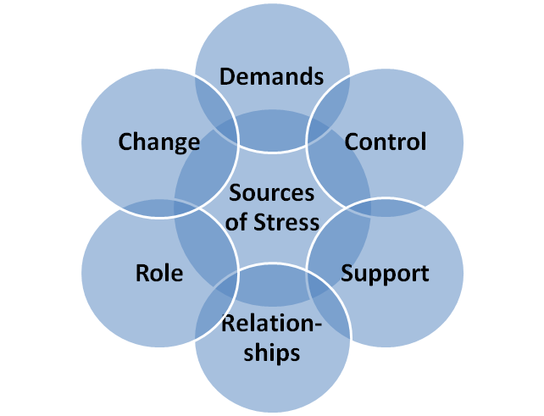

Slide 3
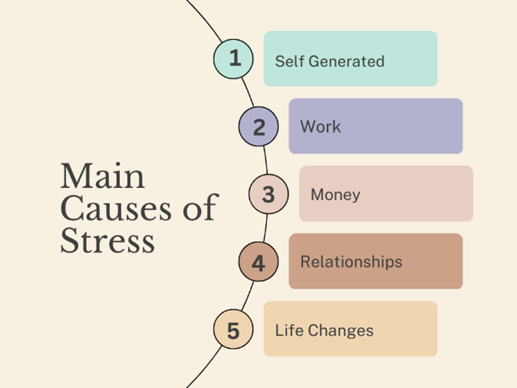

Slide 4
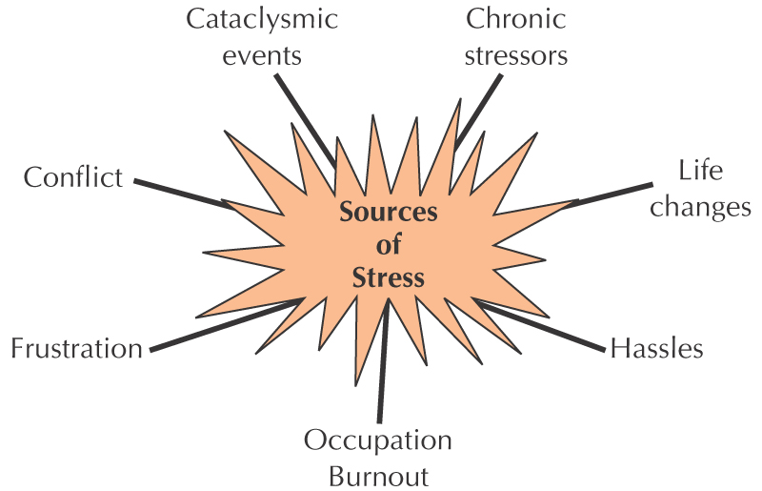

Slide 5
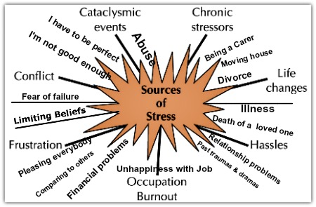

Slide 8
Concentrate on Things that are Calming

Slide 9
Concentrate on Things that are Calming
“Finally, brethren, whatever things are true, whatever things are noble, whatever things are just, whatever things are pure, whatever things are lovely, whatever things are of good report, if there is any virtue and if there is anything praiseworthy—meditate on these things.”
Philippians 4:8

Slide 10
Concentrate on Things that are Calming
“But those who wait on the Lord
Shall renew their strength;
They shall mount up with wings like eagles,
They shall run and not be weary,
They shall walk and not faint.”
Isaiah 40:31

Slide 11
“He calms the storm,
So that its waves are still.”
Psalm 107:29

Slide 12
Cooperate with Inevitable Conditions

Slide 13
Cooperate with Inevitable Conditions
“And we know that all things work together for good to those who love God, to those who are the called according to His purpose.”
Romans 8:28

Slide 14
Cooperate with Inevitable Conditions
“Not that I speak in regard to need, for I have learned in whatever state I am, to be content:”
Philippians 4:11

Slide 15
Cooperate with Inevitable Conditions
“The Lord also will be a refuge for the oppressed,
A refuge in times of trouble. And those who know Your name will put their trust in You;
For You, Lord, have not forsaken those who seek You.”
Psalm 9:9-10

Slide 16
Comfort Others Who Have Complaints

Slide 17
Comfort Others Who Have Complaints
“Blessed be the God and Father of our Lord Jesus Christ, the Father of mercies and God of all comfort, who comforts us in all our tribulation, that we may be able to comfort those who are in any trouble, with the comfort with which we ourselves are comforted by God.”
2 Corinthians 1:3-4

Slide 18
Comfort Others Who Have Complaints
“Not that I speak in regard to need, for I have learned in whatever state I am, to be content:”
Philippians 4:11

Slide 19
Trust God with All Your Concerns

Slide 20
Constantly Trust God with All Your Concerns

Slide 21
Constantly Trust God with All Concerns
“Trust in Him at all times, you people;
Pour out your heart before Him;
God is a refuge for us.”
Psalm 62:8

Slide 22
Constantly Trust God with All Concerns
“And He said to me, “My grace is sufficient for you, for My strength is made perfect in weakness.” Therefore most gladly I will rather boast in my infirmities, that the power of Christ may rest upon me.”
2 Corinthians 12:9

Slide 23
Constantly Trust God with All Concerns
“Trust in the Lord with all your heart,
And lean not on your own understanding;
In all your ways acknowledge Him,
And He shall direct your paths.”
Proverbs 3:5-6

Slide 24
Constantly Trust God with All Concerns
“And do not present your members as instruments of unrighteousness to sin, but present yourselves to God as being alive from the dead, and your members as instruments of righteousness to God.”
Romans 6:13

Slide 25
HOW TO DEAL WITH

