Slide 1
HONEST WITH OURSELVES

Slide 2
HONEST WITH OURSELVES
“But with me it is a very small thing that I should be judged by you or by a human court. In fact, I do not even judge myself.
For I know of nothing against myself, yet I am not justified by this; but He who judges me is the Lord. Therefore judge nothing before the time, until the Lord comes, who will both bring to light the hidden things of darkness and reveal the counsels of the hearts. Then each one’s praise will come from God.”
1 Corinthians 4:3-5

Slide 3
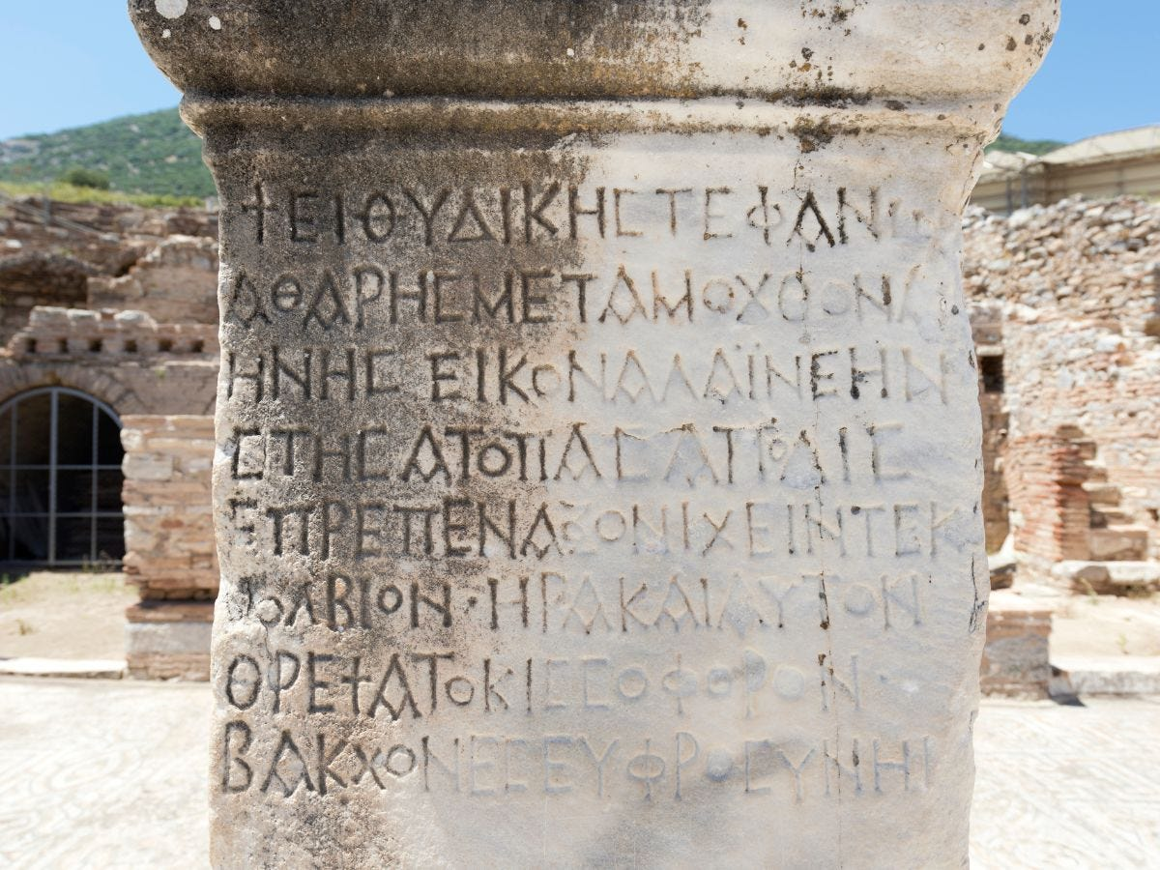
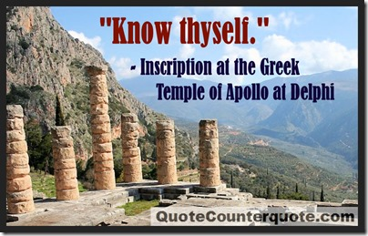

Slide 4
HONEST WITH OURSELVES
The Gospel Requires Repentance
&
Repentance Requires Conscience

Slide 5
HONEST WITH OURSELVES
“I tell you, no; but unless you repent you will all likewise perish.”
Luke 13:3

Slide 6
HONEST WITH OURSELVES
“For godly sorrow produces repentance leading to salvation,
not to be regretted; but the sorrow of the world produces death.”
2 Corinthians 7:10

Slide 7
HONEST WITH OURSELVES
The Advantage of Knowing Ourselves

Slide 8
HONEST WITH OURSELVES
The Advantage of Knowing Ourselves
“For what man knows the things of a man except the spirit of the man which is in him?...
1 Corinthians 2:11

Slide 9
HONEST WITH OURSELVES
The Disadvantage of Knowing Ourselves

Slide 10
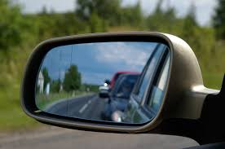
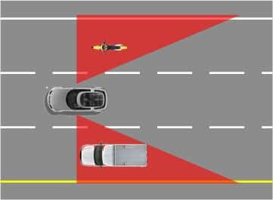
HONEST WITH OURSELVES
The Disadvantage of Knowing Ourselves

Slide 11
HONEST WITH OURSELVES
The Disadvantage of Knowing Ourselves
“Or how can you say to your brother, ‘Brother, let me remove the speck that is in your eye,’ when you yourself do not see the plank that is in your own eye? Hypocrite!
First remove the plank from your own eye, and then you will see clearly to remove the speck that is in your brother’s eye.”
Luke 6:42

Slide 12
HONEST WITH OURSELVES
The Disadvantage of Knowing Ourselves
“Now when Peter had come to Antioch, I withstood him to his face, because he was to be blamed; for before certain men came from James, he would eat with the Gentiles; but when they came, he withdrew and separated himself, fearing those who were of the circumcision. And the rest of the Jews also played the hypocrite with him, so that even Barnabas was carried away with their hypocrisy…
Galatians 2:11-14

Slide 13
HONEST WITH OURSELVES
The Disadvantage of Knowing Ourselves
…But when I saw that they were not straightforward about the truth of the gospel, I said to Peter before them all, “If you, being a Jew, live in the manner of Gentiles and not as the Jews, why do you compel Gentiles to live as Jews?”
Galatians 2:11-14

Slide 14
HONEST WITH OURSELVES
Love of the Truth & Knowing Ourselves

Slide 15
HONEST WITH OURSELVES
Love of the Truth & Knowing Ourselves
“The coming of the lawless one is according to the working of Satan, with all power, signs, and lying wonders, and with all unrighteous deception among those who perish, because they did not receive the love of the truth, that they might be saved.…
2 Thessalonians 2:9-12

Slide 16
HONEST WITH OURSELVES
Love of the Truth & Knowing Ourselves
…And for this reason God will send them strong delusion, that they should believe the lie, that they all may be condemned who did not believe the truth but had pleasure in unrighteousness.”
2 Thessalonians 2:9-12

Slide 17
HONEST WITH OURSELVES
Love of the Truth & Knowing Ourselves
“And you shall know the truth,
and the truth shall make you free.”
John 8:32

Slide 18
HONEST WITH OURSELVES
Love of the Truth & Knowing Ourselves
“If we say that we have no sin, we deceive ourselves, and the truth is not in us. If we confess our sins, He is faithful and just to forgive us our sins and to cleanse us from all unrighteousness. If we say that we have not sinned, we make Him a liar, and His word is not in us.”
1 John 1:8-10

Slide 19
HONEST WITH OURSELVES
A Test of Our Honesty & Love of Truth

Slide 20
HONEST WITH OURSELVES
A Test of Our Honesty & Love of Truth
Do we pray for help in seeing ourselves as God sees us?

Slide 21
HONEST WITH OURSELVES
A Test of Our Honesty & Love of Truth
Do we pray for friends who love
our soul more than they
love our friendship?

Slide 22
HONEST WITH OURSELVES
A Test of Our Honesty & Love of Truth
Do we pray to be set in the midst of circumstances that will make us see our true character?

Slide 23
HONEST WITH OURSELVES
A Test of Our Honesty & Love of Truth
Do we pray for our secrets to be exposed – and be glad for the honesty this forces upon us?

Slide 24
HONEST WITH OURSELVES
A Test of Our Honesty & Love of Truth
Do we pray for every fault which we have hidden from ourselves to be brought out into the open light?

Slide 25
HONEST WITH OURSELVES
A Test of Our Honesty & Love of Truth
Do we pray for help in accepting even the most painful truth,
so we can change our ways?

Slide 26
HONEST WITH OURSELVES
God Knows us Perfectly

Slide 27
HONEST WITH OURSELVES
God Knows us Perfectly
“For the word of God is living and powerful, and sharper than any two-edged sword, piercing even to the division of soul and spirit, and of joints and marrow, and is a discerner of the thoughts and intents of the heart. And there is no creature hidden from His sight, but all things are naked and open to the eyes of Him to whom we must give account.”
Hebrews 4:12-13

Slide 28
HONEST WITH OURSELVES

