Slide 1
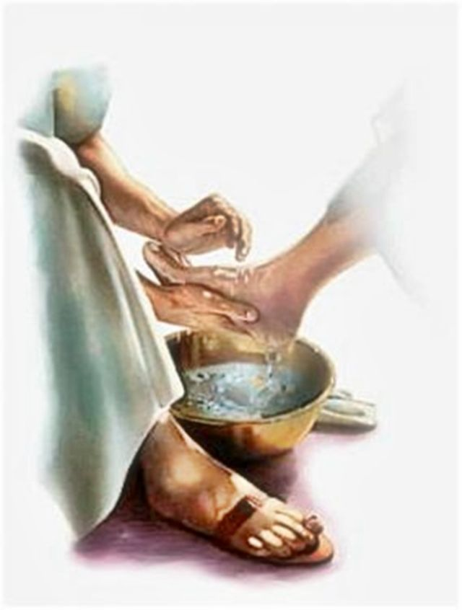
Foot Washing John 13:1-17

Slide 2
“And he said, “Here now, my lords, please turn in to your servant’s house and spend the night, and wash your feet; then you may rise early and go on your way.” And they said, “No, but we will spend the night in the open square.” Genesis 19:2
Foot Washing

Slide 3
“Do not let a widow under sixty years old be taken into the number, and not unless she has been the wife of one man, well reported for good works: if she has brought up children, if she has lodged strangers, if she has washed the saints’ feet, if she has relieved the afflicted, if she has diligently followed every good work.” 1 Timothy 5:9-10
Foot Washing

Slide 4
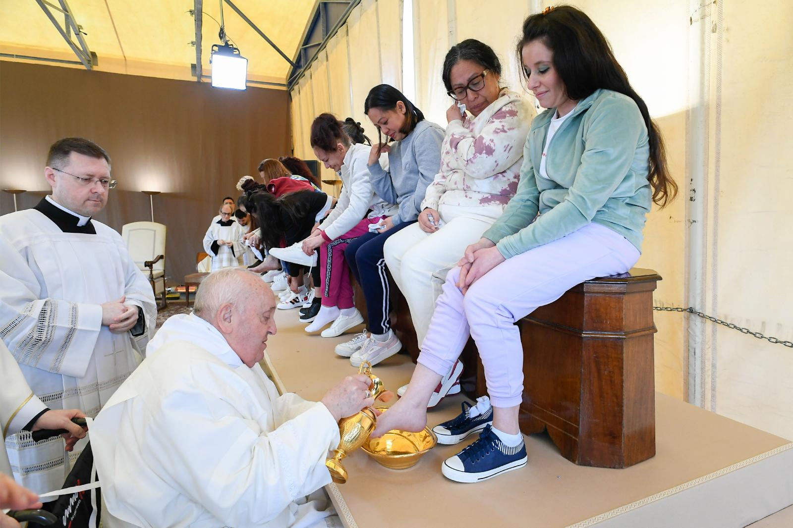
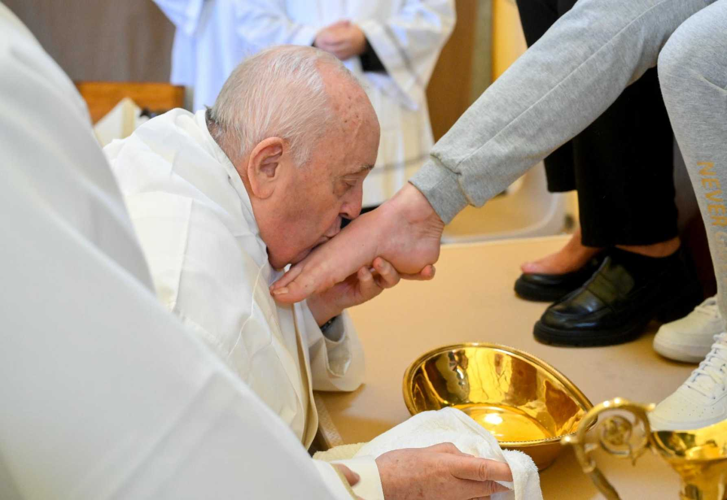
March 28, 2024
Tears flow as pope washes feet of women inmates at Rome prison
As Pope Francis poured water over their feet, dried them with a towel and kissed their feet

Slide 6
Lutheran Deaconess Assoc.
In advance of the service, inform people
that foot washing will take place
Be sure people are clear that they can
simply observe if they choose
Encourage women to refrain from wearing
stockings or pantyhose

Slide 7
Lutheran Deaconess Assoc.
Inform them that a hand washing
alternative will be offered
See that children are encouraged and
supported
Consider separating men and women as
there may be people in your congregation
for whom feet are erotically stimulating

Slide 8
Jesus Taught 2 Lessons
The Disciples Needed to Learn:
HOSPITALITY
HUMILITY

Slide 9
Jesus Taught 2 Lessons
The Disciples Needed to Learn:
HOSPITALITY

Slide 10
Jesus Taught 2 Lessons
The Disciples Needed to Learn: HOSPITALITY
“Peter said to Him, “You shall never wash my feet!” Jesus answered him, “If I do not wash you, you have no part with Me.” Simon Peter said to Him, “Lord, not my feet only, but also my hands and my head!” Jesus said to him, “He who is bathed needs only to wash his feet, but is completely clean; and you are clean, but not all of you.” John 13:8-10

Slide 11
Jesus Taught 2 Lessons
The Disciples Needed to Learn: HOSPITALITY
“and said, “My Lord, if I have now found favor in Your sight, do not pass on by Your servant. Please let a little water be brought, and wash your feet, and rest yourselves under the tree. And I will bring a morsel of bread, that you may refresh your hearts. After that you may pass by, inasmuch as you have come to your servant.” They said,
“Do as you have said.” Genesis 18:3-5

Slide 12
Jesus Taught 2 Lessons
The Disciples Needed to Learn: HOSPITALITY
“And he said, “Here now, my lords, please turn in to your servant’s house and spend the night, and wash your feet; then you may rise early and go on your way.” And they said, “No, but we will spend the night in the open square.” Genesis 19:2

Slide 13
Jesus Taught 2 Lessons
The Disciples Needed to Learn: HOSPITALITY
“Then the man came to the house.
And he unloaded the camels, and provided straw and feed for the camels, and water to wash his
feet and the feet of the men who were with him.” Genesis 24:32

Slide 14
Jesus Taught 2 Lessons
The Disciples Needed to Learn: HOSPITALITY
“So the man brought the men into Joseph’s house and gave them water, and they washed their feet; and he gave their donkeys feed.” Genesis 43:24

Slide 15
Jesus Taught 2 Lessons
The Disciples Needed to Learn: HOSPITALITY
“Then she arose, bowed her face to the earth, and said, “Here is your maidservant, a servant to
wash the feet of the servants of my lord.” 1 Samuel 25:41

Slide 16
Jesus Taught 2 Lessons
The Disciples Needed to Learn: HOSPITALITY
“Do not let a widow under sixty years old be taken into the number, and not unless she has been the wife of one man, well reported for good works: if she has brought up children, if she has lodged strangers, if she has washed the saints’ feet, if she has relieved the afflicted, if she has diligently followed every good work.” 1 Timothy 5:9-10

Slide 17
Jesus Taught 2 Lessons
The Disciples Needed to Learn: HOSPITALITY
“Now on the first day of the week, when the disciples came together to break bread, Paul, ready to depart the next day, spoke to them and continued his message until midnight.” Acts 20:7

Slide 18
Jesus Taught 2 Lessons
The Disciples Needed to Learn: HOSPITALITY
“If I then, your Lord and Teacher, have washed your feet, you also ought to wash one another’s feet.” John 13:14

Slide 19
Jesus Taught 2 Lessons
The Disciples Needed to Learn: HOSPITALITY
“So husbands ought to love their own wives as their own bodies; he who loves his wife loves himself.” Ephesians 5:28

Slide 20
Jesus Taught 2 Lessons
The Disciples Needed to Learn: HOSPITALITY
“By this we know love, because He laid down His life for us. And we also ought to lay down
our lives for the brethren.” 1 John 3:16

Slide 21
Jesus Taught 2 Lessons
The Disciples Needed to Learn: HOSPITALITY
“Beloved, if God so loved us,
we also ought to love one another.” 1 John 4:11

Slide 22
Jesus Taught 2 Lessons
The Disciples Needed to Learn:
HUMILITY

Slide 23
Jesus Taught 2 Lessons
The Disciples Needed to Learn: Humility
“Now there was also a dispute among them, as to which of them should be considered the greatest. And He said to them, “The kings of the Gentiles exercise lordship over them, and those who exercise authority over them are called ‘benefactors.’ But not so among you; on the contrary... Luke 22:24-27

Slide 24
Jesus Taught 2 Lessons
The Disciples Needed to Learn: Humility
…he who is greatest among you, let him be as the younger, and he who governs as he who serves. For who is greater, he who sits at the table, or he who serves? Is it not he who sits at the table?
Yet I am among you as the One who serves.” Luke 22:24-27

Slide 25
Jesus Taught 2 Lessons
The Disciples Needed to Learn: Humility
“You call Me Teacher and Lord, and you say well, for so I am. If I then, your Lord and Teacher, have washed your feet, you also ought to wash one another’s feet. For I have given you an example, that you should do as I have done to you. Most assuredly, I say to you, a servant is not greater than his master; nor is he who is sent greater than he who sent him.” John 13:13-16

Slide 26
Jesus Taught 2 Lessons
The Disciples Needed to Learn: Humility
“At that time the disciples came to Jesus, saying, “Who then is greatest in the kingdom of heaven?” Then Jesus called a little child to Him, set him in the midst of them, and said, “Assuredly, I say to you, unless you are converted and become
as little children,… Matthew 18:1-4

Slide 27
Jesus Taught 2 Lessons
The Disciples Needed to Learn: Humility
…you will by no means enter the kingdom of heaven. Therefore whoever humbles himself
as this little child is the greatest in the
kingdom of heaven.” Matthew 18:1-4

Slide 28
Jesus Taught 2 Lessons
The Disciples Needed to Learn: Humility
“Pride goes before destruction,
And a haughty spirit before a fall.
Better to be of a humble spirit with the lowly,
Than to divide the spoil with the proud.”
Proverbs 16:18-19

Slide 29
Jesus Taught 2 Lessons
The Disciples Needed to Learn: Humility
“not a novice, lest being puffed up with pride he fall into the same condemnation as the devil.”
1 Timothy 3:6

Slide 30
Jesus Taught 2 Lessons
The Disciples Needed to Learn: Humility
“And you are puffed up, and have not rather mourned, that he who has done this deed might
be taken away from among you.”
1 Corinthians 5:2

Slide 31
Jesus Taught 2 Lessons
The Disciples Needed to Learn: Humility
“If anyone teaches otherwise and does not consent to wholesome words, even the words of our Lord Jesus Christ, and to the doctrine which accords with godliness, he is proud, knowing nothing,
but is obsessed with disputes and arguments over words, from which come envy, strife,
reviling, evil suspicions,”
1 Timothy 6:3-4

Slide 32
Jesus Taught 2 Lessons
Foot Washing – Hospitality & Humility
Let us be HUMBLE enough to serve in the
“little things” in life.
Let us be HUMBLE enough to perform any
needful act of HOSPITALITY daily.
Let us be HUMBLE enough to obey God in
all things.

