Slide 1
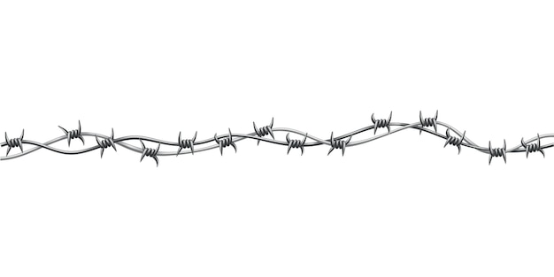
Remorse

Slide 2
Remorse:
Regret, Sorrow, Repentance, Penitence, Shame

Slide 3
Remorse
All of us Encounter Temptation…

Slide 4
Remorse
All of us Encounter Temptation…
“all ate the same spiritual food, and all drank the same spiritual drink. For they drank of that spiritual Rock that followed them, and that Rock was Christ. But with most of them God was not well pleased, for their bodies were scattered in the wilderness…
1 Corinthians 10:3-7

Slide 5
Remorse
All of us Encounter Temptation…
…Now these things became our examples, to the intent that we should not lust after evil things as they also lusted. And do not become idolaters as were some of them. As it is written,
“The people sat down to eat and drink, and rose up to play.”
1 Corinthians 10:3-7

Slide 6
Remorse
Do You Recognize
When This Happens?

Slide 7
Remorse
The keen or hopeless anguish caused by a sense of guilt
Distressing self-reproach

Slide 8
Remorse
How Do You Deal
With Guilt?

Slide 9
Remorse
Do You Willfully Accept Guilt?

Slide 10
Remorse
Do You Willfully Accept Guilt?
“When morning came, all the chief priests and elders of the people plotted against Jesus to put Him to death. And when they had bound Him, they led Him away and delivered Him to
Pontius Pilate the governor.…
Matthew 27:1-4

Slide 11
Remorse
Do You Willfully Accept Guilt?
…Then Judas, His betrayer, seeing that He had been condemned, was remorseful and brought back the thirty pieces of silver to the chief priests and elders, saying, “I have sinned by betraying innocent blood.” And they said, “What is that to us? You see to it!”
Matthew 27:1-4

Slide 12
Remorse
Do You Willfully Accept Guilt?
“For even if I made you sorry with my letter, I do not regret it; though I did regret it. For I perceive that the same epistle made you sorry, though only for a while. Now I rejoice, not that you were made sorry, but that your sorrow led to repentance. …
2 Corinthians 7:8-10

Slide 13
Remorse
Do You Willfully Accept Guilt?
…For you were made sorry in a godly manner, that you might suffer loss from us in nothing. For godly sorrow produces repentance leading to salvation, not to be regretted;
but the sorrow of the world produces death.”
2 Corinthians 7:8-10

Slide 14
Remorse
Do You Willfully Accept Guilt?
…For you were made sorry in a godly manner, that you might suffer loss from us in nothing. For godly sorrow produces repentance leading to salvation, not to be regretted;
but the sorrow of the world produces death.”
2 Corinthians 7:8-10

Slide 15
Remorse
Do You Fight It (Guilt)?

Slide 16
Remorse
Do You Fight It (Guilt)?
“Then Saul said to Samuel, “I have sinned, for I have transgressed the commandment of the Lord and your words, because I feared the people and obeyed their voice.”
1 Samuel 15:24

Slide 17
Remorse
Do You Fight It (Guilt)?
“So David said to Nathan, “I have sinned against the Lord.”
And Nathan said to David, “The Lord also has put
away your sin; you shall not die.”
2 Samuel 12:13

Slide 18
Remorse
Do Not Accept Guilt At All

Slide 19
Remorse
Do Not Accept Guilt At All
“LOST ETERNALLY”

Slide 20
Remorse
Have You Identified How You Respond to Guilt?

Slide 21
Remorse
Have You Identified How You Respond to Guilt?
Willfully accept it = godly sorrow & remorse
To fight it = forced remorse
Do not accept it = lost eternally

